Slide 1
MareMathics
Functions – basics

Slide 2
What is a function?

Slide 3
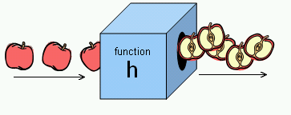
What is a function?

Slide 4
What is a function?
Function $f$ is a relation in which __________from the set of inputs $X$ is associated to _________object from the set of outputs $Y$. Each function must have three elements defined:

Slide 5
What is a function?
Function $f$ is a relation in which each object from the set of inputs $X$ is associated to exactly one object from the set of outputs $Y$. Each function must have three elements defined:
1. Domain $X$ – a set of inputs, i.e. a set of all arguments of the function
2. Mapping rule $f$ – the way this data is transformed - functional equation
3. Codomain $Y$ – a set of possible outputs

Slide 6
What is a function?
Video: What is a function?
Video: What is a function? Explanations

Slide 7
Example 1a
More than 31 000 students graduated from high school in Croatia in 2021. Some of them enroled in college. Is the mapping in which each student is asociated with a college a function?

Slide 8
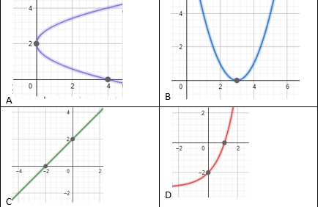
Example 2: Which of the following is NOT a graph of a function?

Slide 9
Example 3
Functions where domain and codomain are subsets of real number sets are commonly used in real life problems.
Are functions $f:ℝ→ℝ$ defined by $f(x)=x^{2}−1$ and $g:〈0,∞〉→〈−1,∞〉$ defined by $g(x)=x^{2}−1$ the same functions?

Slide 10
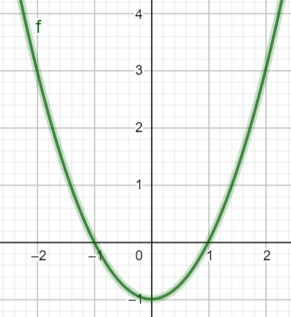
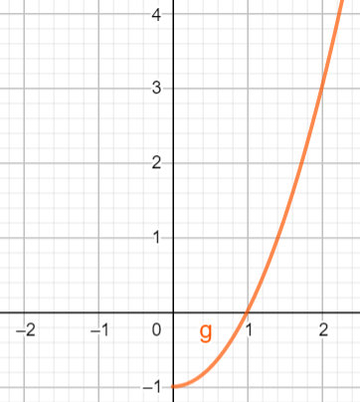
$f:ℝ→ℝ$ $f(x)=x^{2}−1$
$g:〈0,∞〉→〈−1,∞〉$ $g(x)=x^{2}−1$

Slide 11
Video: Vertical line test

Slide 12
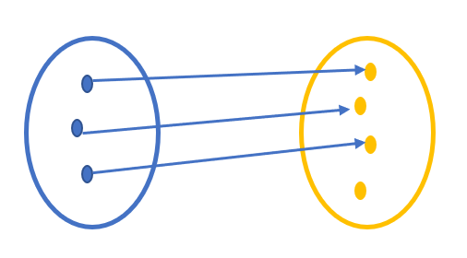
Injective function
Injection is a one-to-one function. It is a function that maps distinct elements of the domain to distinct elements of the codomain.

Slide 13
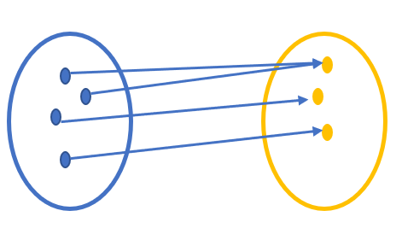
Surjective function
A function is called surjection if every element of the codomain is mapped by at least one element of the domain.

Slide 14
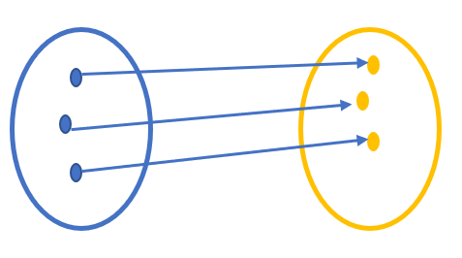
Bijective function
A function is called bijection if a function is both injection and surjection.

Slide 15
Example 1b
More than 20 000 students enroled in college in Croatia in 2021. Is the mapping in which each student who enroled in exactly one college is asociated with a college:
function
injection
surjection
bijection

Slide 16
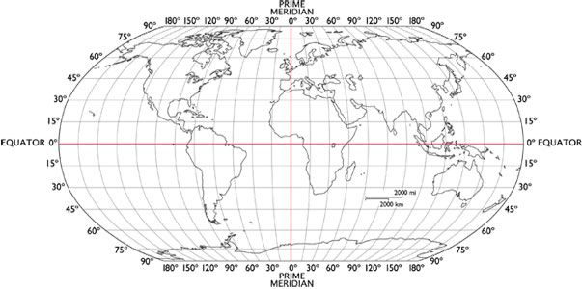
Example 4
Each point on the Earth's surface is associated with a unique combination of two coordinates.

Slide 17
Example 4
On Google maps choose the place you want to travel to next summer and read its longitude and latitude.
Convert the values in degrees to degrees, minutes and seconds.
Split (Croatia)
Latitude 43.508695° N
Longitude 16.440303° E

Slide 18
Example 4
Tongariro National Park (New Zealand)
Latitude 43.508695° N
$$0.508695∙60=30.5217$$
$$0.5217∙60=31$$
Latitude 43.508695° N = 43° 30’ 31’’
Longitude 16.440303° E= 16° 26’ 25’’

Slide 19
Example 4
Is the mapping that accompanies each point on the Earth's surface an ordered pair of number coordinates:
function
injection
surjection
bijection

Slide 20
Example 5
In a port 300 passengers can board one of the 3 ships (A, B or C) that depart at the same time. Each ship has at least 2 passengers.
Is the mapping in which each passenger is associated to a ship:
function
injection
surjection
bijection
Passenger 1
Passenger 2
Passenger 3
…
Passenger 300
Boat A Boat B Boat C
⁝

Slide 21
Example 6
The GPS system receives messages about the coordinates of the Nautilus ship every hour during the four-hour voyage.
The last voyage of a ship is given by the table:
Time | X coordinate (Northern latitude) | Y coordinate (Eastern longitude)
12:00 | 44.52 | 14.51
13:00 | 44.52 | 14.62
14:00 | 44.52 | 14.69
15:00 | 44.52 | 14.81
16:00 | 44.52 | 14.89

Slide 22
Example 6
https://www.geogebra.org/m/shtqu5kq

Slide 23
Example 6
In which direction did the ship move? What was its course?
From Rovenska Nova to Novalja
If we know that the total length of the voyage was 24 km, what was the average speed of the ship?
6 km/h
Did the ship have a steady speed during the voyage?
No.

Slide 24
Example 6
When did the ship go the fastest and when the slowest?
The fastest interval 14:00 – 15:00; the slowest 13:00 – 14:00
Determine the speed of the ship in each of the intervals.

Slide 25
Example 6
Time | ∆Y coordinate (longitude) | ∆Y coordinate (km) | v (km/h)
12:00 – 13:00 | 0.11 | 6.95 | 6.95
13:00 – 14:00 | 0.07 | 4.42 | 4.42
14:00 – 15:00 | 0.12 | 7.58 | 7.58
15:00 – 16:00 | 0.08 | 5.05 | 5.05

Slide 26

Example 6
Try to determine the $Y$ coordinate of the ship in each time interval if the ship moved at a constant velocity of 6 km/h.

Slide 27
Example 6
Time | Y coordinate (Eastern longitude) (real values) | Y coordinate (Eastern longitude) (with constant velocity 6/km/h)
12:00 | 14.51 | 14.51
13:00 | 14.62 | 14.605
14:00 | 14.69 | 14.70
15:00 | 14.81 | 14.795
16:00 | 14.89 | 14.89

Slide 28

Example 6
If 1 knot = 1.85 km/h, what was the average velocity of the ship in knots
$$v=\frac{6}{1.85}=3.24 knots$$

Slide 29
Example 7 – hydrostatic pressure
https://phet.colorado.edu/sims/html/under-pressure/latest/under-pressure_en.html
1) Pick the first model (one fosset and one pool). 2) In the upper right corner tick the grid option (as to measure the water depth) 3) Pour water into the pool to the brim 4) Drag and drop the barometer to measure the pressure above the pool and in the pool

Slide 30
Example 7 – hydrostatic pressure
When the depth increases, the pressure
increases
b) What is the atmospheric pressure (the pressure at 0 m, in pool level)?
101 325 Pa

Slide 31
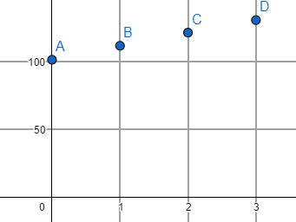
Example 7 – hydrostatic pressure
Fill out the table and sketch a graph
Water depth (m) | Water pressure (kPa)
0 | 101.325
1 | 111.125
2 | 120.925
3 | 130.725

Slide 32
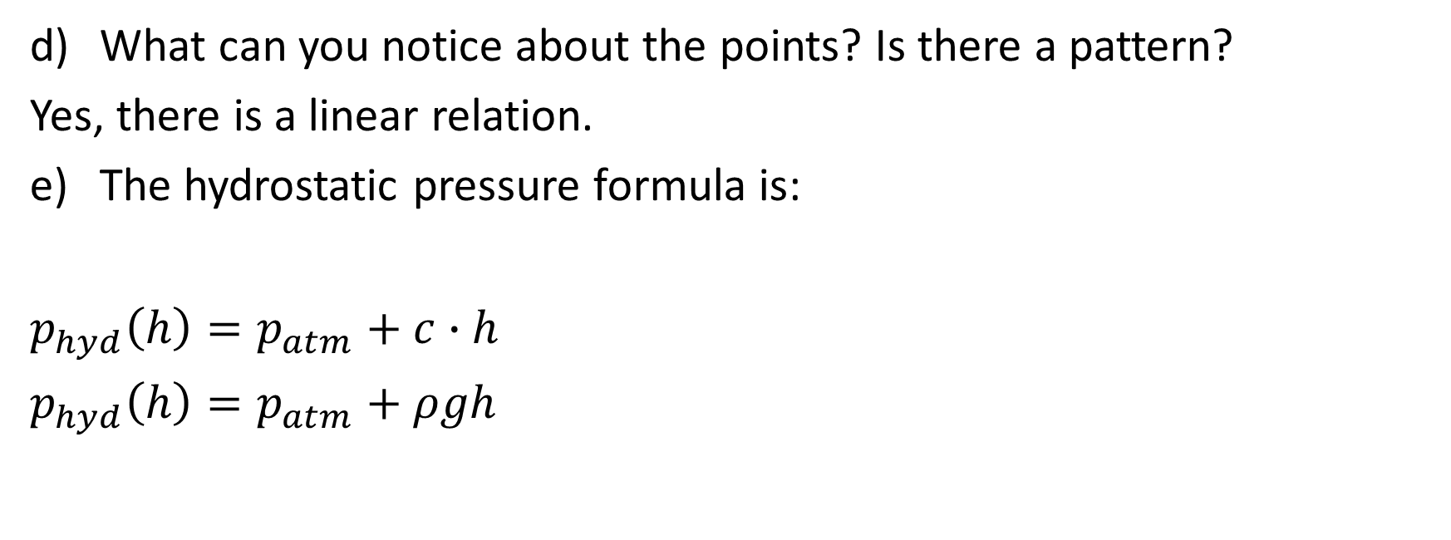
Example 7 – hydrostatic pressure
What can you notice about the points? Is there a pattern?
Yes, there is a linear relation.
The hydrostatic pressure formula is:
$$p_{hyd}\left(h\right)=p_{atm}+c∙h$$
$$p_{hyd}\left(h\right)=p_{atm}+ρgh$$

Slide 33
Example 7 – hydrostatic pressure
Given the saltwater density is $ρ=1025 kg/m^{3},$ the atmospheric pressure is $p_{atm}=101 325 Pa$ and $g=9.81 m/s^{2}$, determine the hydrostatic pressure at a depth of 40 m?
$$p_{hyd}\left(40\right)=101 325+1025⋅9.81⋅40=503 535 Pa$$

Slide 34
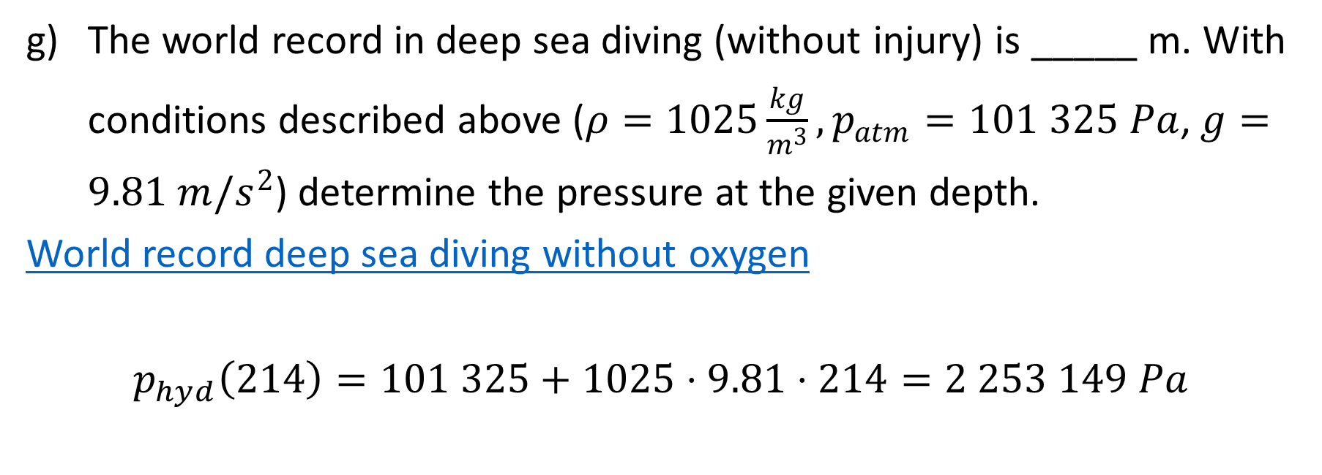
Example 7 – hydrostatic pressure
The world record in deep sea diving (without injury) is _____ m. With conditions described above ($ρ=1025\frac{kg}{m^{3}}, p_{atm}=101 325 Pa$,$g=9.81 m/s^{2}$) determine the pressure at the given depth.
World record deep sea diving without oxygen
$$p_{hyd}\left(214\right)=101 325+1025⋅9.81⋅214=2 253 149 Pa$$

Slide 35
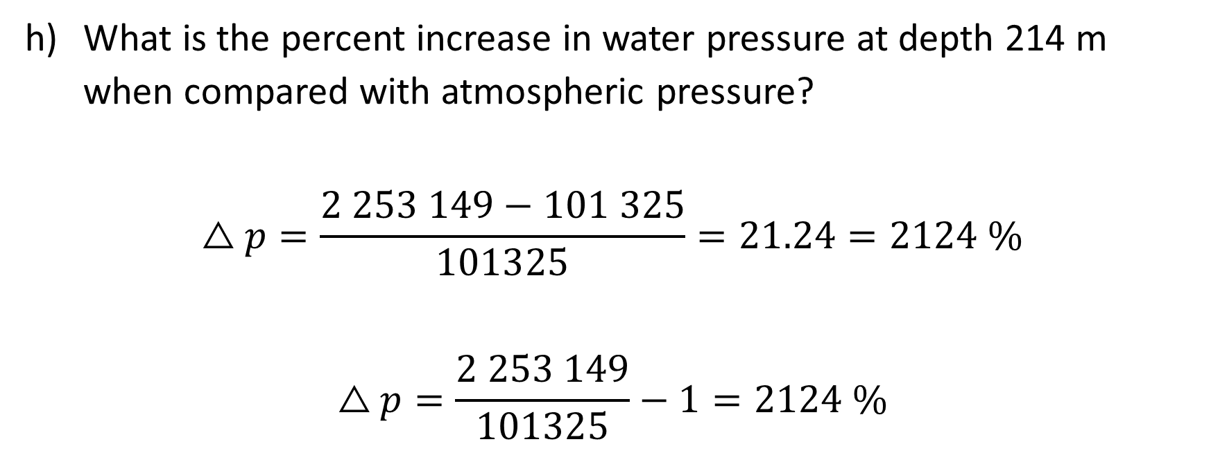
Example 7 – hydrostatic pressure
What is the percent increase in water pressure at depth 214 m when compared with atmospheric pressure?
$$△p=\frac{2 253 149−101 325}{101325}=21.24=2124 \%$$
$$△p=\frac{2 253 149}{101325}−1=2124 \%$$

Slide 36
Thank you for your attention!
"This project has been funded with support from the European Commission. This publication [communication] reflects the views only of the author, and the Commission cannot be held responsible for any use which may be made of the information contained therein".

