Slide 1
MareMathics

Slide 2
Trigonometry

Slide 3
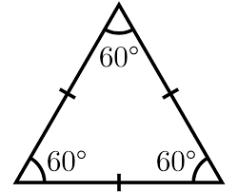
What is a radian angle?
If we bend one side what will happen to the measure of the opposite angle?
a) decrease
b) stay the same
c) increase

Slide 4
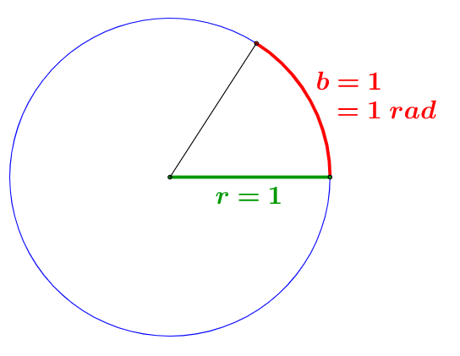
What is a radian angle?

Slide 5
What is a radian angle?
Radian represents the measure of an angle made at centre of a circle by an arc that is equal in length to the radius of a circle.

Slide 6
What is a radian angle?
Geogebra radian
$$1 rad≈57.3\text{°}$$

Slide 7
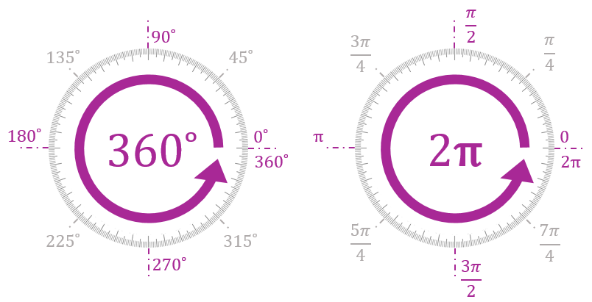
$$π=180\text{°}$$

Slide 8
Exercise 1
Let’s convert:
$$\frac{5π}{6}=$$
$$=\frac{5∙180\text{°}}{6}=1\text{50}\text{°}$$

Slide 9
Exercise 1
Let’s convert:
$$20\text{°}\text{=}$$
$$=20∙\frac{π}{180}$$
$$=\frac{π}{9}$$

Slide 10
Exercise 1
Let’s convert:
$$2 rad ≈$$
$$≈2∙57.3°$$
$$≈114.6°$$

Slide 11
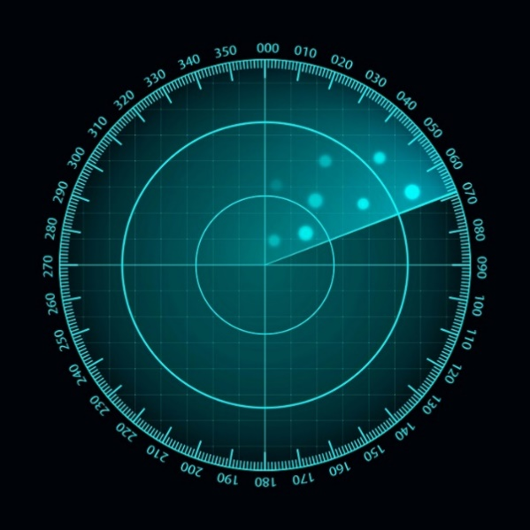
Why trigonometry matters?
How to read a radar?

Slide 12
Why trigonometry matters?
direction | azimuth
N | 000
E
W
S

Slide 13
Why trigonometry matters?
direction | azimuth
N | 000
E | 090
W
S

Slide 14
Why trigonometry matters?
direction | azimuth
N | 000
E | 090
W | 270
S

Slide 15
Why trigonometry matters?
direction | azimuth
N | 000
E | 090
W | 270
S | 180

Slide 16
Exercise 2
A submarine accompanies a ship on its voyage.
At each point in time, the ships distance is 200 meters in the direction 060.
Geogebra submarine

Slide 17
Exercise 2a
The submarine captain spots a dangerous reef located directly north from the submarines’ location, 200 m away. 1) Plot the point locating the reef in Geogebra. 2) What is the distance from the ship to the reef? 3) What would be the reefs azimut when observed from the ship?

Slide 18
Exercise 2a
The submarine captain spots a dangerous reef located directly north from the submarines’ location, 200 m away. 1) Plot the point locating the reef in Geogebra. 2) What is the distance from the ship to the reef?
200 meters 3) What would be the reefs azimut when observed from the ship?
300

Slide 19
Exercise 2b
The ships safe harbour is located 400 m away, in the direction 300 from the current submarine location.
Plot the harbour location
Determine the distance from the ship to the harbour
Determine the course (azimuth) of the ship if it wants to reach the harbour

Slide 20
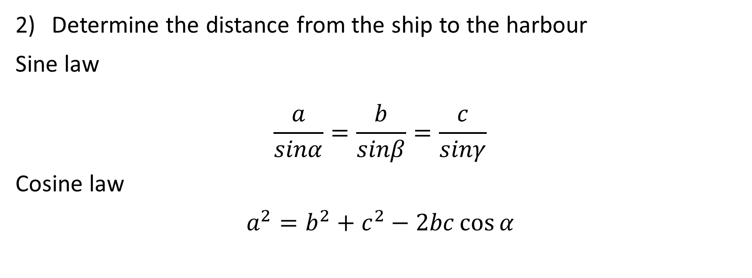
Exercise 2
Determine the distance from the ship to the harbour
Sine law
$$\frac{a}{sinα}=\frac{b}{sinβ}=\frac{c}{sinγ}$$
Cosine law
$$a^{2}=b^{2}+c^{2}−2bc\cos{α}$$

Slide 21
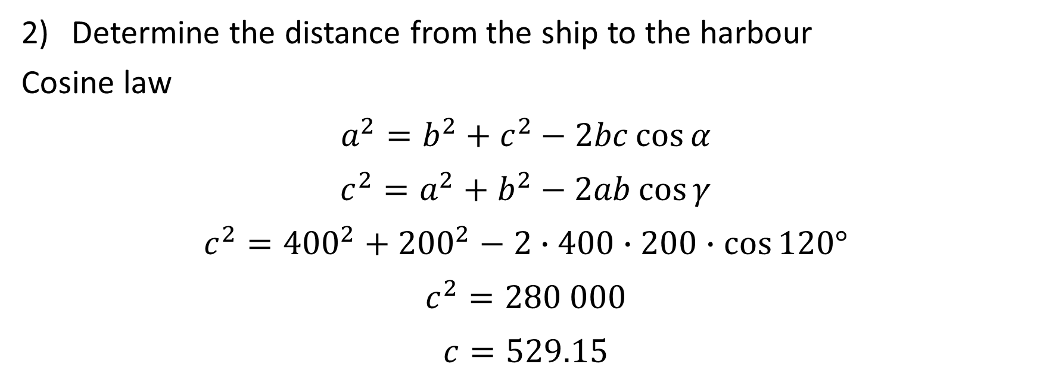
Exercise 2
Determine the distance from the ship to the harbour
Cosine law
$$a^{2}=b^{2}+c^{2}−2bc\cos{α}$$
$$c^{2}=a^{2}+b^{2}−2ab\cos{γ}$$
$$c^{2}={400}^{2}+{200}^{2}−2∙400∙200∙\cos{120°}$$
$$c^{2}=280 000$$
$$c=529.15$$

Slide 22
Exercise 2
Determine the distance from the ship to the harbour
Geogebra
529.15

Slide 23
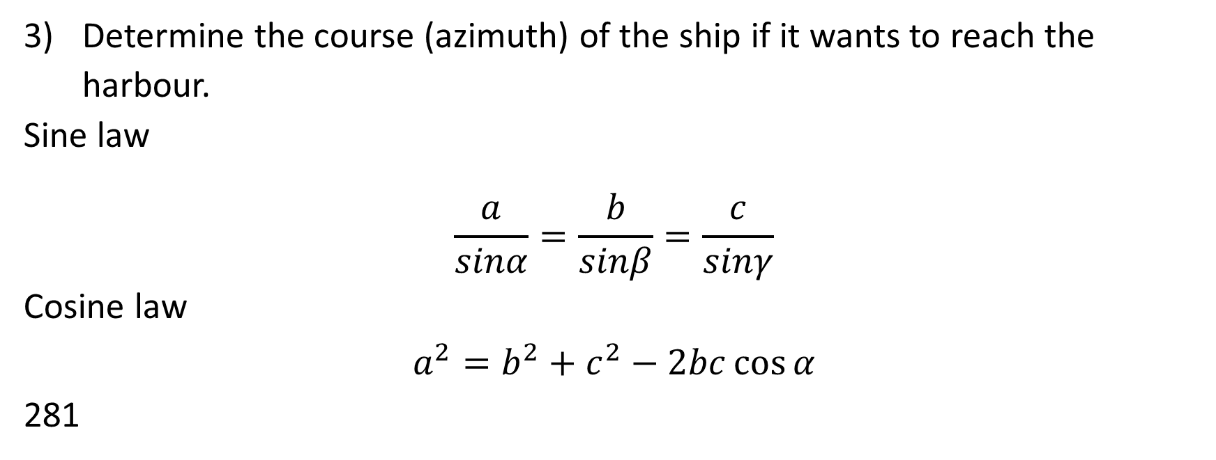
Exercise 2b
Determine the course (azimuth) of the ship if it wants to reach the harbour.
Sine law
$$\frac{a}{sinα}=\frac{b}{sinβ}=\frac{c}{sinγ}$$
Cosine law
$$a^{2}=b^{2}+c^{2}−2bc\cos{α}$$
281

Slide 24
Exercise 3
The following link shows part of the Split sea area, with islands which are close by. Geogebra Rogac
Your ship is located in the Rogac port on the island of Solta.
Which of the three harbours: Split, Rogac or Supetar (on the island Brac, on the right side of a figure) is the nearest to the location of Signal?
Find the distance between the Signal and the nearest harbour.

Slide 25
Exercise 3
Find the missing value and correct a mistake:
Direction Rogac – Split 043
Direction Rogac – Signal ___
Distance Rogac – Split 15.1 km
Direction Signal – Split 345
Direction Signal – Rogac 240

Slide 26
Exercise 3
Find the missing value and correct a mistake:
Direction Rogac – Split 043
Direction Rogac – Signal 060
Distance Rogac – Split 15.1 km
Direction Signal – Split 015
Direction Signal – Rogac 240
Find the distance between the Signal and the nearest harbour.

Slide 27

Exercise 3
Sine law
$$\frac{a}{sinα}=\frac{b}{sinβ}=\frac{c}{sinγ}$$
Cosine law
$$a^{2}=b^{2}+c^{2}−2bc\cos{α}$$
Distance (Split, Signal) = 6.2 km

Slide 28
Thank you for your attention!
"This project has been funded with support from the European Commission. This publication [communication] reflects the views only of the author, and the Commission cannot be held responsible for any use which may be made of the information contained therein".

