Slide 1




21.04.2020
APPLICATIONS OF COMPLEX NUMBERS, INVERSE TRIGONOMETRICAL FUNCTIONS AND SECOND-ORDER CURVES
Viktor Bolgov, D.Sc., Phone: +372 53887671, e-mail: victor_bolgov@yahoo.com
Estonian Maritime Academy / Centre for General and Basic Studies
Tallinn University of Technology

Slide 2
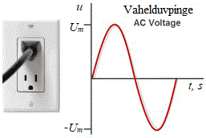
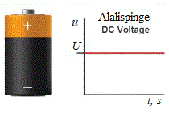
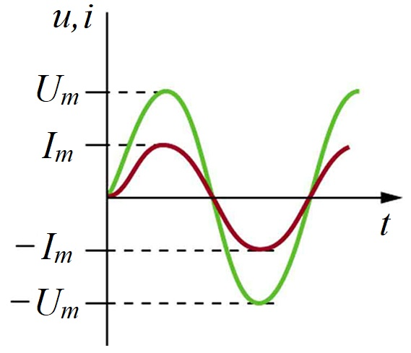
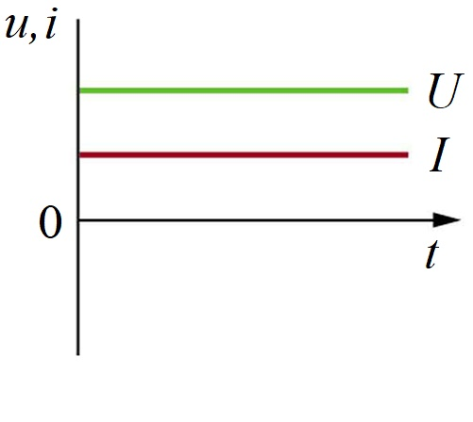

Complex numbers in electrical circuits
Introduction into DC and DC
There are two types of electrical power supplies used both on board of ships and on the mainland: direct current (DC) and alternating current (AC). Let us assume that we apply either DC or AC voltage to a resistor R. Resistive element R models transformation of electrical energy into any other form of energy: mechanical, thermal, lighting, chemical, etc.
DC is used in electronics, electrical vehicles, local networks with renewable energy sources, submarine cables etc.
AC is used in the vast majority of power transmissions and distribution networks, electrical machines and electrotechnological installations.
DC current and voltage are unipolar. AC current and voltage varies in the value and polarity over the time.
If a direct voltage U is applied to a resistor with resistance R it will cause a direct current I flowing in the circuit. Both voltage and current are unipolar and related to each other by means of Ohm’s law
The power dissipating in the resistor R can be found by using Joule-Lenz law

Slide 3
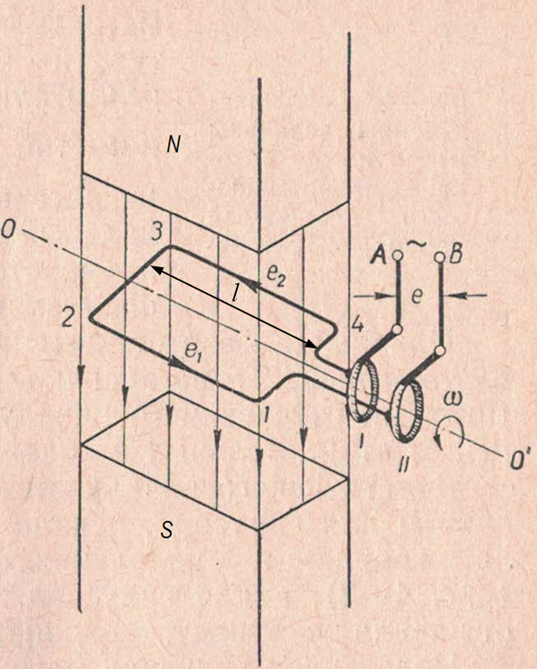
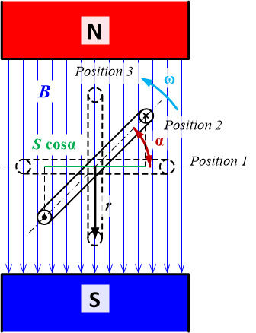
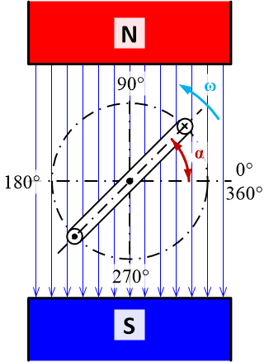
Faraday’s law of induction is used to find the emf induced:
where dΦ is change of magnetic flux through the coil 1234 over the time dt.
Int he Position1 the magnetix fux is of maximum value
Φ_{m}=2rlB,
where r is the radius of the coil (m), l – the active coil lengths 12 and 34 pikkus (m), B – magnetix flux density (T).
Complex numbers in electrical circuits
Generation of sinusoidal EMF
Electric generators induce an electromotive force (EMF) by rotating a loop in a magnetic field. When this generator loop is rotated from the Postion 1 to the Postiton 3 around the axis OO’, the magnetic flux Φ passing the loop internal ares changes from its maximum value to zero, inducing an EMF.
When the coil side conductors 12 and 34 cut magnet flux lines, EMFs e₁ and e₂ are generated producing resultant EMF e = e₁ + e₂ at the coil terminals A and B.
To find the time dependence of EMF, we assume the loop rotates at a constant angular velocity ω. The angle α is related to angular velocity by α = ωt.
The magnetic flux at any position can be found as
The total EMF around the loop is then

Slide 4
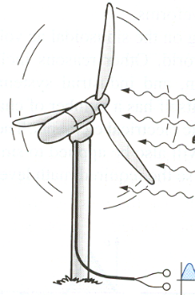
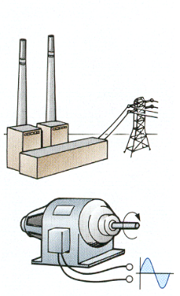
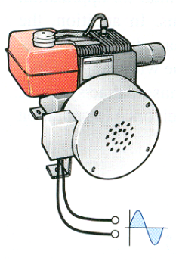
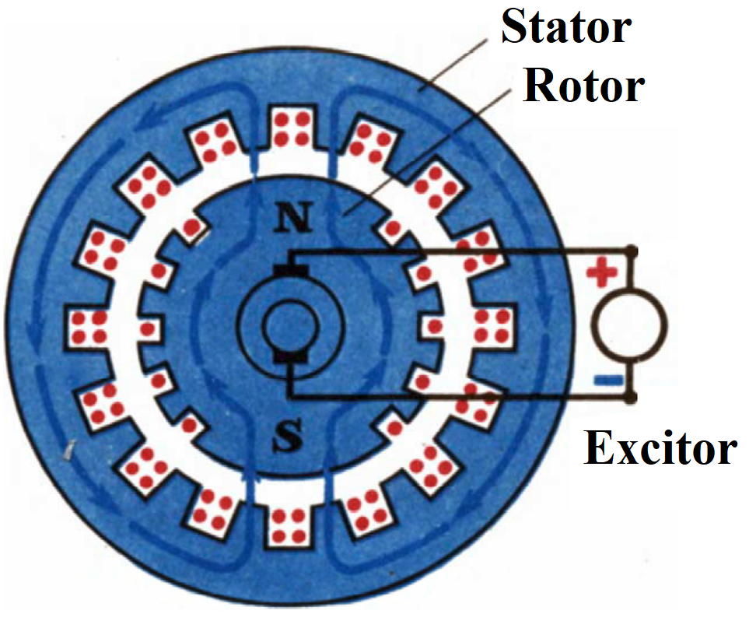
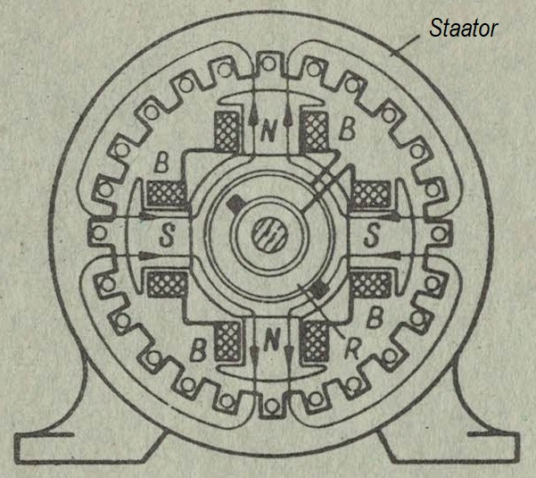
Complex numbers in electrical circuits
Generation of sinusoidal EMF

Slide 5
Complex numbers in electrical circuits
Introduction into aC
The alternating voltage is usually a sine wave with the maximum value or amplitude U_{m} that can mathematically be described as follows
u = U_{m} sin ωt = U_{m} sin 2πft
where u is the instantaneous value of the voltage (V) at the time instant t (s), f is the frequency of sine wave (Hz), ω = 2πf is the angular frequency (rad/s). The frequency f can be found via the period T (s) of the sine wave in the next way
That means
Such a sine voltage being applied to a resistor R causes an alternating current i
i = I_{m} sin ωt = I_{m} sin 2πft
where i is the instantaneous current value (A) at the time instant t (s), I_{m} is the amplitude of the current.
At each instant of time, there is relationship between instantaneous values of the voltage and current according to Ohm’s law
Since maximum values are also instant ones, there is valid
Let us find the amplitudes of the alternating current and voltage that produce the same power P dissipation as happens in the resistance R under the direct voltage U and current I. In electrical engineering theory, it is found that the sinusoidal voltage u and current i with amplitudes
and
produce the power P in the AC circuit equal to the DC power caused by U and I in the DC circuit
The values of alternating voltage and current that are equivalents to DC values and found as follows
and
and they are named rms or effective values.

Slide 6
Complex numbers in electrical circuits
Phasor of sine wave
There is a set of mathematical tools developed for DC circuits that could be applied to AC cses. The application of Ohm’s and Kirchhoff’s laws to each instant of an alternating sine wave is a vast and complicated task. One way to facilitate the use of DC circuit laws in AC circuits is the application of effective values instead of amplitudes. However, it is not enough. The alternating nature of sine waves creates complex electromagnetic field around AC circuits that creates time (angle) shifts between voltages and currents. To represent and calculate those shifts, there was proposed the substitution of sine values with their rotating vectors also known as phasors. Let us consider how to substitute a sinusoidal current i = I_{m} sinωt with its phasor.
If a vector with the magnitude I_{m} is placed on a Cartesian plane and rotates counter clockwise around the point O with the angular velocity ω then it can be described in polar and trigonometrical form as
I_{m} = I_{m} e^{jωt} = I_{m} cosωt + jI_{m} sinωt,
where I_{m} is the complex amplitude, j is the electrical notation for the imaginary quantity denoted in mathematics as i, ω is the angular velocity that is equal to the angular frequency of the alternating current.
Thus, a complex number I_{m} is obtained. Using the complex plane, we can envision the behaviour of this complex parameter. The magnitude of the complex amplitude is OA, and the initial angle is equal to zero at t = 0 s. As time increases, the locus of points traced by the complex amplitude creates a circle with the constant magnitude of OA. The number of times per second I_{m} goes around the circle equals to the frequency f. The time taken to go around the circle once is period T.
The projections of I_{m} onto the real x and imaginary y-axes give us the real and imaginary parts of the complex amplitude. There is an interest towards the imaginary part of the complex amplitude in electrical engineering.
Im[I_{m} e^{jωt}] = Im[I_{m} cosωt + jI_{m} sinωt] = I_{m} sinωt = i.

Slide 7
Complex numbers in electrical circuits
Phasor of sine wave
In electrical engineering, there is a traditional way to present a complex vector with its amplitude and initial phase keeping in mind that it rotates with the angular frequency ω
If the vector OA is under the angle Ψ at the time instant t₀ = 0 s then its initial value is not equal to zero i₀ = I_{m} sin(ωt₀ + Ψ) = I_{m} sinΨ (since ωt₀ = 0°).
The common expression for the sine waveform is as follows
i = I_{m} sin(ωt + Ψ),
where Ψ is the initial phase.
The corresponding phasor in a complex form in this case looks like
I_{m} = I_{m} e^{j(ωt + Ψ)}= I_{m} cos(ωt + Ψ) + jI_{m} sin(ωt + Ψ).
.
For example the notation
A means the current with the amplitude of 5 A is shifted by the 30° in relation to the y-axis.
Therefore, any alternating current of a sinusoidal waveform may be described with a phasor rotating with the angular speed that equals to the angular frequency of the sine wave. Those phasor notations differ in different textbooks and could be, for example

Slide 8
Complex numbers in electrical circuits
Addition of phasors
Let us explore how one can use phasors in electrical calculations. There is a node between three branches with currents i₁, i₂ and i₃ (Fig. 1.7, a). For example, the currents i₁ and i₂ flow through two separate cables to some loads and i₁ is the current of a ship’s main busbar. The currents i₁ and i₂ are known and the current i₃ is unknown. According to Kirchhoff’s, law those node currents are interrelated at any time instant
Phasors on a complex plane are called vector or phasor diagram. There are two sinusoidal currents i₁ and i₂ on the right side in Figure. Their phasors are presented on the left side. The y-axis of a complex plane is called imaginary axis and has notation “+j” while x-axis is called real one and denoted as “+1”.
Instead of calculating the sum i₁+i₂ at each time instant the phasors I_{m1} and I_{m2} can be added to each other to get the resultant phasor I_{m3}
I_{m3} = I_{m1} + I_{m2}.
The projections of the complex amplitude I_{m3} onto axes x (real axis +1) and y (imaginary axis +j) can be found by using trigonometrical functions
I_{m3} = I_{m1} + I_{m2} = I_{m1} cos(ωt + Ψ₁) + I_{m2} cos(ωt + Ψ₂) + j{cos(ωt + Ψ₁) + I_{m2} cos(ωt + Ψ₂)} = I_{m3} ∠Ψ₃,
where the amplitude of the current i₃ is found by means of Pythagoras theorem
The sine waves i₁ and i₂ has different initial angles, i.e. their complex amplitudes may be expressed as
I_{m1} = I_{m1}∠Ψ₁ and I_{m2} = I_{m2}∠Ψ₂.
The current i₁ leads the current i₂ and there is a phase shift between them φ = Ψ₁ – Ψ₂. This phase shift is also seen from their vector diagram, i.e. it is the angle between phasors I_{m1} and I_{m2}.
and the phase angle – by means of some inverse trigonometrical function, e.g.

Slide 9
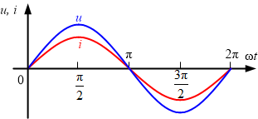
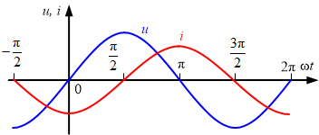
Complex numbers in electrical circuits
Resistance and Inductive reactance
It must be noted, that in practical electrical calculations phasors are usually mot expressed by using amplitudes of electrical state parameters, but with their effective (rms) values.
If to apply a sinusoidal voltage u to a resistance R then a sine wave of a current i immediately appears without any time delay, which value may be found by means of Ohm’i law
Therefore, there is no phase shift between their vectors and Ohm’s law can be rewritten either via amplitudes
or, being divided by , via effective values like in DC circuits
The ability of an AC current to store magnetic field energy around a conductor is characterised by its inductance L and inductive reactance X_{L} = ωL = 2πfL. As a result, the current lags voltage by angle π/2 or 90°. This lag can be briefly and clearly presented by means of complex values. If a voltage u is supposed to be with a phase of 0° then Ohm’s law for effective complex values can be written like this
where –j = e^{-j90°} is the operator shifting the complex current I back in relation to U by 90° or π/2 .

Slide 10
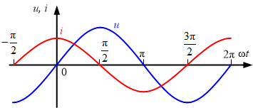
Complex numbers in electrical circuits
Capacitive reactance amd impedance
Practical loads on board of ships and in ports (electrical motors, lighting installations, etc.) may usually be modelled by a series combination of resistance R and inductive reactance X_{L}.
The ability of an AC current to store electric field energy around a conductor is characterised by its capacitance C and capacitive reactance
As a result, the current i leads the voltage u by angle π/2 or 90°. This phase shift can be clearly presented by means of complex values. If voltage u is supposed to be with a phase of 0° then Ohm’s law for effective complex values can be written in the next way
where j = e^{j90°} is the operator shifting complex current I in relation to U ahead by 90° or π/2 .
There is no phase shift between the current and the voltage drop across the resistance R. Thus, the voltage drop U_{a} is in phase with the current I. The voltage drop over the inductive reactance U_{L} leads the current I.
According to Kirchhoff’s second law, the input voltage U may be found as
U = U_{a}+U_{L}.

Slide 11
Complex numbers in electrical circuits
impedance AND
If the phase of the current phasor I is equal to 0° then the voltages can be presented as follows:
a) Resistive voltage drop U_{a} = I·R = I R e^{j0°} = U_{a}e^{j0°},
b) Inductive voltage drop U_{L} = I·jX_{L} = I X_{L}e^{j90°} = U_{L}e^{j90°},
c) Input voltage U = I(R+jX_{L}) = I·R + I·jX_{L}= U_{a}e^{j0°}+U_{L}e^{j90°} = Ue^{jφ}.
Let us have a closer look at the last expression. The sum R + jX_{L} is named impedance Z = Z e^{jφ}, which is a complex number with the magnitude
and the argument or phase
It is better seen from so-called impedance triangle constituted by resistance, reactance and impedance
Therefore, Ohm’s law in the most common form is as follows
U = I·Z = IZe^{jφ} = Ue^{jφ}.
That means it is the impedance phase φ defines phase shift between the terminal voltage u and the current i.
Example
As shown in Fig. 1.11, a, there are a resistor with resistance R = 4 Ω, an inductor with inductive reactance X_{L} = 3 Ω and the current I = 1 A.
Find impedance Z, voltages across resistance U_{a}, reactance U_{L}, and a terminal voltage U.
Solution:
Impedance may be found as follows Z = R + jX_{L} = 4 + j3 Ω.
According to the Pythagorean Theorem impedance magnitude
Its argument
Hence, the complex value of impedance Z = Z e^{jφ}= 5 e^{j36.9°} Ω.
Voltages may be found by means of Ohm’s law in a complex form.
The voltage across the resistor U_{a} = I·R = IR e^{j0°} = 1·4 e^{j0°}= 4e^{j0°} = 4 V.
The voltage across the reactance U_{L} = I·jX_{L} = IX_{L} e^{j90°} = 1·3e^{j90°}= 3e^{j90°} V.
The terminal or input voltage U_{L} = I·Z = IZe^{jφ} = 1·5e^{j36.9°}= 5e^{j36.9°} V.

Slide 12
Inverse trigonometrical functions in electrical circuits
Inverse trigonometrical functions are a vital part of electrical engineering and any other science using complex numbers. For example in the RL circuit, there is phase shift φ = Ψ_{U} – Ψ_{I} between an input voltage U and a current I as well as in the impedance triangle between resistance R and impedance Z. It means one needs to calculate the angle φ in order to present terminal voltage or impedance in a complex form, i.e. correspondingly U = U e^{jφ} and Z = Z e^{jφ}.
As a result, there are several opportunities to find the phase shift angle φ:

Slide 13
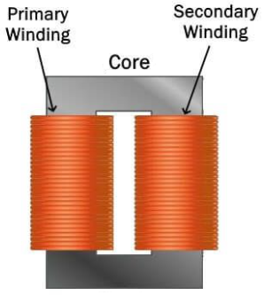
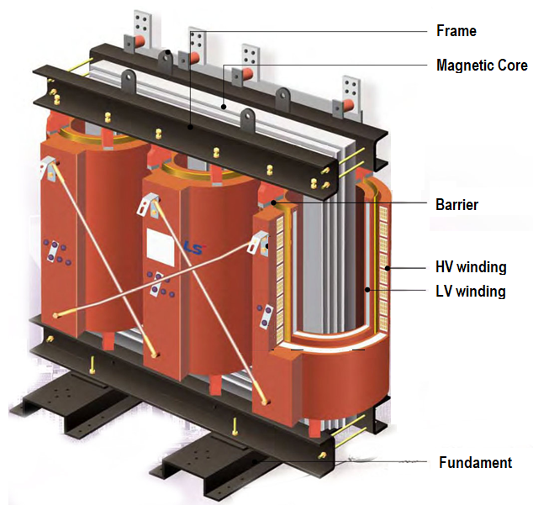
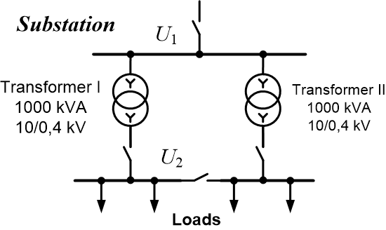
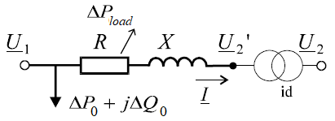
Second order curves and optimal operation of electrical substation
There is always concern about decreasing active power losses in electrical networks. It reduces bills for electricity for mainland customers and the consumption of the fuel on board of ships. One of tasks related to active power saving is the choosing of the proper configuration of the electrical substation.
A distributing substation usually contains two transformers that steps down middle voltage U₁ of 6…35 kV to low voltage U₂ = 0.4 kV. That is the case for port network and for many ships with the on-board gird containing a high-voltage part.
Each transformer has at least two windings: middle voltage (ML) and low voltage (LV) ones. Those are wound around a magnetic core that facilitates energy transfer from MV side to LV side. The active power losses have place in each of the transformer component.
The active power loss in magnetic core ∆P₀ is called core loss or no-load loss and it is supposed to be almost constant. It is because this loss depends on voltage U₁ that is kept as stiff as possible. That is why the iron loss is often modelled as a constant power load.
The active power losses in MV and LV windings called copper losses are often considered together and they happens in aggregated resistance R of both the windings called short-circuit resistance. This variable loss depends on loading of a transformer, i.e. on the load current I flowing through the windings to consumers. That is why it is also called load loss and may be calculated as follows:
a) Single-phase transformer ∆P_{load} = I²R;
b) Three-phase transformer ∆P_{load} = 3I²R.
The total active power loss in transformer can be found in this way:
a) Single-phase case ∆P_{I} = ∆P₀ + I²R;
b) Three-phase case ∆P_{I} = ∆P₀ + 3I²R.

Slide 14
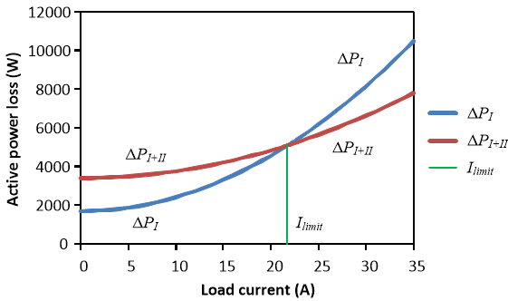
Second order curves and optimal operation of electrical substation
Example
There are two three-phase transformers at the substation with the following parameters:
Nominal power: 1000 kVA
Nominal voltages: 10.5/0.4 kV
No-load loss: ∆P₀ = 1700 W
Short-circuit resistance: R = 2.4 Ω.
Find at which boundary load current I_{limit} the substation should be switched from the operation with a single transformer to the operation with two transformers in parallel.
Solution: The active power loss under operation with a single transformer can be expressed as
∆P_{I} = ∆P₀ + 3RI² = 1700 + 7.2I² (curve P_{I}).
In the case of two transformers in parallel connection, the active power loss depends on current as follows
(curve P_{I+II})
The intersection point of two parabolas gives us the value of I_{limit}. It can be found by equating the expressions for ∆P_{I} and ∆P_{I+II}
It is clear that total active power loss in transformer depends on the squared load current forming a parabolic curve shifted upwards by amount of no-load active loss (curve P_{I}). If two similar transformers operates in parallel then the total loss in substation transformers (curve P_{I+II}) may be calculated in the next way:
Single-phase case
Three-phase case
The optimal choice of the substation configuration, i.e. whether to keep in operation one or two transformers in parallel connection in order to get minimum active power loss, depends on some boundary load current I_{limit}. If the load current is less than I_{limit} then the operation with a single transformer is preferable. If the load current is greater than I_{limit} then the substation configuration with two operating transformers gives less loss of active power.

Slide 15
Nagu on näha, erinevalt arkuskoosinusist arkustangens annab nurga märki. Kuna φ₁ > 0, siis vool I₁ jääb maha pingest U ehk omab aktiivinduktiivset iseloomu. Negatiivne nurk φ₂ < 0 näitab, et vool teises harus I₂ edestab pinget U, ehk haru omab aktiivmahtuvuslikku iseloomu. Need vektorid on kujutatud joonisel.
Esimese Kirchhoff’i seaduse alusel on sisendvool võrdne haruvoolude geomeetrilise summaga
I = I₁ + I₂.
Näide 2. HARGNEV RLC-ahel
Vaatleme kahest rööpaharust koosnevat ahelat, kusjuures kumbki haru omab aktiivtakistust ja reaktiivtakistust (üks on induktiivse ja teine on mahtuvusliku iseloomuga). Tuleb arvutada skeemi talitluse.
Antud: R₁ = 60 Ω, R₂ = 80 Ω, X_{L1} = 80 Ω, X_{C2} = –60 Ω, Q_{C2} = – 60 var.
Leida: Voolud, võimsustegur, nurk φ, võimsused S, P, Q, ahela näivtakistus Z, näivjuhtivus Y.
Lahendused:
Kuna harud 1 ja 2 on ühendatud rööbiti, siis nende peal on sama pinge U. Kui me leiame pinge ühe haru peal, siis on leitud ka pinge teisel harul. Harupinge määramiseks Ohm’i seaduse abil on vaja teada haru takistust ja voolu. On antud mahtuvusvõimsus (miinusmärgiga) teise haru mahtuvelemendis. Seega on võimalik kirjutada
Selleks, et leida summaarset ehk sisendvoolu I saab kasutada erinevaid meetodeid. Vaatleme, kuidas saab liita vektoreid nende koordinaatide või projektsioonide abil.
Voolu I₁ aktiivkomponent I_{a1}, mis ühtib pingega U, on leitav järgmiselt
I_{a1} = I₁ cos φ₁ = 1·cos 53,13° = 0,6 A.
Voolu I₁ induktiivkomponent I_{a1}, mis jääb maha pingest U täisnurga võrra, leitakse niimoodi
I_{L1} = I₁ sin φ₁ = 1· sin 53,13° = 0,8 A.
Voolu I₂ aktiivkomponent I_{a2}, mis ühtib pingega U, on leitav järgmiselt
I_{a2} = I₂ cos φ₂ = 1· cos (–36,87°) = 0,8 A.
Voolu I₂ reaktiivkomponent I_{a2}, mis edestab pinget U täisnurga võrra, on leitav niiviisi
I_{a2} = I₂ sin φ₂ = 1·sin (–36,87°) = –0,6 A.
Otsitava voolu I aktiivkomponent I_{a} = I_{a1} + I_{a2} = 0,6 + 0,8 = 1,4 A.
Otsitava voolu I reaktiivkomponent I_{r} = I_{L1} + I_{C2} = 0,8 – 0,6 = 0,2 A.
Leiame teise haru näivtakistuse
Siit leiame Ohm’i seaduse alusel U = Z₂I₂ = 100·1 = 100 V.
Vool esimese harus on samuti leitav Ohm’i seaduse alusel. Selle rakendamiseks on vajalik haru takistus
Siis esimese haru vool
Kuigi voolude I₁ ja I₂ efektiivväärtused on samasugused, nende nurgad pingega on erinevad

Slide 16
k
o
T
thank you for your attention!
Viktor Bolgov, D.Sc., e-mail: victor_bolgov@yahoo.com
Estonian Maritime Academy / Centre for General and Basic Studies
Tallinn University of Technology

