Slide 1
MareMathics
Teachers’ Training - Tallinn
prof. Merica Slišković, PhD
Filip Bojić, mag. ing.
University of Split
Faculty of Maritime Studies

Slide 2
Application of Statistics in Solving Maritime Problem
Prof. Merica Slišković
Filip Bojić
University of Split
Faculty of Maritime Studies

Slide 3
Statistics in maritime studies
Statistics
Branch of applied mathematics that deals with the collection, editing, analysis, and interpretation of data and drawing conclusions about the phenomena and processes that these data represent.
In a broader sense, data on various natural, social, and other phenomena and processes can be examined.

Slide 4
Statistics in maritime studies
Statistics in maritime studies
Feature scaling
Descriptive statistics
Data Sets / Big Data
Machine learning

Slide 5
Data Sets & Big Data
Conventional and IoT based data sources
The Automatic Identification System (AIS) is a maritime transponder/receiver system defined by the IMO (international maritime organization).
Static Information
Dynamic Information

Slide 6
Data Sets & Big Data
AIS as a surveillance tool
The application of AIS data in research has developed from simply navigation-oriented to multiple research areas like trade flow estimation, environmental analysis, vessel performance monitoring, hydrometeorology, marine infrastructure planning…

Slide 7
Data Sets & Big Data

Slide 8
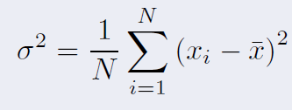
Descriptive statistics
Mathematical background
Population
Sample
Average
Variance
Standard deviation
Resources

Slide 9
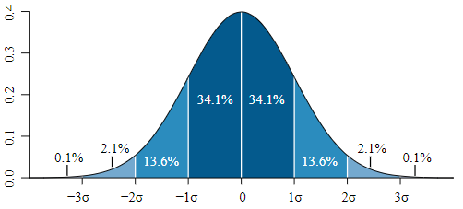
Descriptive statistics
Example from Environmental analysis
mareMathics R”esource

Slide 10
Feature scaling
Mathematical background
Rescaling (min-max normalization)
Mean normalization
Standardization (Z-score Normalization)

Slide 11
Feature scaling
Example from Environmental analysis
Ship type | Gas Pollution Index per one vessel Arrival & Deparure |  |  |  |  |  | 0-20 20-40 40-60 60-80 80-100
 |  |  |  |  |  |  | Very Low Low Moderate High Very High
 | NOx 2005 | CO | VOC | SOx | PM 10 & 2.5 | CO2 | NOx 2005 | CO | VOC | SOx | PM 10 & 2.5 | CO2
Cruise ships large | 100 | 100 | 100 | 100 | 100 | 100 | Very High | Very High | Very High | Very High | Very High | Very High
Cruise ships medium | 47,4 | 45,2 | 48,6 | 49,5 | 43,7 | 46,5 | Moderate | Moderate | Moderate | Moderate | Moderate | Moderate
Cruise ships small | 29,6 | 27,1 | 22,5 | 25,0 | 24,1 | 29,1 | Moderate | Moderate | Moderate | Moderate | Moderate | Moderate
International Ro-Ro ferry's | 19,2 | 19,3 | 25,5 | 23,1 | 19,7 | 18,8 | Low | Low | Moderate | Moderate | Low | Low
Ro-Ro ferry's large | 7,1 | 7,2 | 10,0 | 8,7 | 7,5 | 6,9 | Very Low | Very Low | Very Low | Very Low | Very Low | Very Low
Ro-Ro ferries small | 4,3 | 4,4 | 5,8 | 4,9 | 4,4 | 4,2 | Very Low | Very Low | Very Low | Very Low | Very Low | Very Low
High speed crafts | 1,5 | 1,8 | 2,5 | 1,4 | 2,3 | 1,7 | Very Low | Very Low | Very Low | Very Low | Very Low | Very Low
Excursion & Tourist boats | 0,5 | 0,6 | 0,7 | 0,5 | 0,7 | 0,5 | Very Low | Very Low | Very Low | Very Low | Very Low | Very Low
Yachts large | 0,8 | 1,1 | 1,3 | 1,0 | 1,2 | 0,9 | Very Low | Very Low | Very Low | Very Low | Very Low | Very Low
Yachts small | 0,28 | 0,36 | 0,43 | 0,23 | 0,38 | 0,30 | Very Low | Very Low | Very Low | Very Low | Very Low | Very Low

Slide 12
Feature scaling
Data collecting:
Conventional & AIS
Data processing through descriptive statistics methods
Machine learning: modeling, predicting, decision support tools, risk assessment
Feature scaling of output
For future work
Appling feature scaling methods can make basis for creating standardised scale of pollutants that could also serve as a foundation for generating marine pollution estimation models.

Slide 13
Thank you for your attention!
"This project has been funded with support from the European Commission. This publication [communication] reflects the views only of the author, and the Commission cannot be held responsible for any use which may be made of the information contained therein".

