Slide 1
MareMathics
Teachers’ Training - Tallinn
prof. Rino Bošnjak, PhD
prof. Zaloa Sanchez Varela, PhD
University of Split
Faculty of Maritime Studies

Slide 2
Cargo Handling
Nautical Engineering program
Rino Bošnjak, PhD
Zaloa Sanchez Varela, PhD

Slide 3
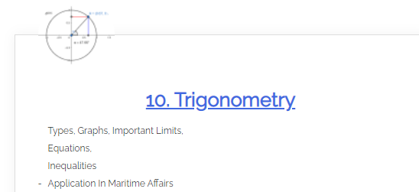
Angle of List
Calculation of the angle of list after a weight ’’w’’ is shifted over a distance ’’d’’.
Force as Vector
Use of trigonometry.
MareMathics

Slide 4
Angle of List
If a unit is in upright condition the centre of gravity is assumed to be in the centre line of the vessel.
The unit will be in equilibrium as long as the centres of gravity and buoyancy are in the same vertical below the metacentre.
M
G
WATERLINE
B
K

Slide 5
Angle of List
If a weight w is shifted over a distance d, the centre of gravity will move from G to G₁.
M
d
w
G
G1
WATERLINE
B
K

Slide 6
Angle of List
Because of the moment w x d, the vessel will list and stabilize under an angle with a new position of G₁.
The stabilizing angle is the position when the moment $w ∙ d=D ∙ GG1$
KM can be obtained from the hydrostatic properties and KG can be found by calculation.
$$GG_{1}= \frac{w ∙d}{D}$$
M
θ
$$GM=KM −KG$$
G
G1
WATERLINE
B
B1
D = Displacement of the vessel
K

Slide 7
Angle of List
Knowing two cateti of the right-angled triangle, the tangent of the angle can be calculated as:
$$tanθ=\frac{opposite}{adjacent}= \frac{GG_{1}}{GM}$$
M
θ
$$θ=arctan \left(\frac{{GG}_{1}}{GM}\right)$$
G
G1

Slide 8
Example:
A unit of 5000 tonnes displacement is initially upright. If a 25-tonnes weight onboard the vessel is shifted 9m across the deck from starboard to port, calculate the angle of list. The unit has a KM of 6m and a KG of 5m.
M
$$GG_{1}= \frac{w ∙d}{D}= \frac{25 t ∙9m}{5000 t}=0.045m$$
$$tanθ= \frac{GG_{1}}{GM}= \frac{0.045m}{1m}=0.045$$
θ
$$GM=KM −KG=6m−5m=1m$$
$$θ=arctan \left(0.045\right)=2.58°$$
G1
G

Slide 9
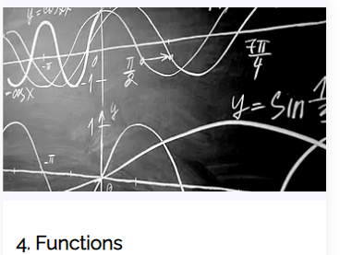
Calculation of Residual Area
Calculation of the residual area given a statical stability curve and an upsetting arms straight line.
Use of Simpson’s approximation (1st rule)
Use of geometry
Resources:
MareMathics

Slide 10
Simpson
ANGLE | 0 | 5 | 10 | 12 | 15 | 20 | 30 | 40 | 50
GZ | 0 | 0.34 | 0.68 | 0.82 | 1.05 | 1.40 | 1.72 | 1.95 | 1.90
ANGLE | 0 | 40
λ | 0.61 | 0.488
Righting and upsetting arms (metres)
9°
Angle of heel (degrees)
Notes:
For the application of Simpson, we have the following example of a vessel carrying grain cargo, and the Residual Dynamic Stability has to be calculated.
The blue line indicates the Righting arms curve, and has been built with the data provided in the blue table.
The orange line indicates the Upsetting arms line, and has been built with the data provided in the orange table.
They interesect in a point, and by calculation, the angle of intersection is deteremined to be 9° in this case.

Slide 11
Residual Dynamic Stability
RDS
Notes:
We want to calculate the area below the GZ curve and above the upsetting arms line, up to 40°. For doing so, we need to first calculate the area below the GZ curve.

Slide 12
Area below Righting arms curve
Applying Simpson’s 1st rule
First, divide the required area into a pair number of strips with equal width (’’d’’)
d = 10 degrees
Notes:
We call the area below the GZ curve „F”. For calculating this are, we apply the Simpson approximation. Simpson's first rule is used when the number of intervals is divisible by 2..
First, divide the required area into a pair number of strips with equal width (’’d’’). In our case, d is equal to 10 degrees.

Slide 13
Area below Righting arms curve
d = 10 degrees
There are 5 ordinals, as indicated in the table.
ANGLE | 0 | 10 | 20 | 30 | 40
GZ | 0 | 0.68 | 1.40 | 1.72 | 1.95
Notes:
Having four sections, there are 5 ordinals, as indicated in the table.
Next, knowing the area is calculated by applying the factors 1, 4, 2, 4, 1 to the consecutive ordinals.

Slide 14
Area below Righting arms curve
angle | Ordinate -GZ (m) | Simpson | Ordinates (m)
0 | 0 | 1 | 0
10 | 0.68 | 4 | 2.72
20 | 1.05 | 2 | 2.10
30 | 1.40 | 4 | 5.60
40 | 1.72 | 1 | 1.72
 |  | SUM= | 12.14
Notes:
A table is constructed, where the ordinates or GZ values are multiplied by the Simpson’s factors, and the corrected ordinates are obtained. These ordinates are summed up.

Slide 15
Area below Righting arms curve
d = 10 degrees
SUM= | 12.14 m
$$F = \frac{d}{3} Sum of ordinates= \frac{10°}{3}∙12.14 m=40.47 m∙deg$$
Notes:
In the end, knowing the area F will be equal to the sum of corrected ordinates multiplied by one third of the common interval, the area is calculated.

Slide 16
Area A
Area A is calculated as a triangle
φ = 9°
Base = φ ;
Height = GZ za φ = λ za φ
A
φ
Notes:
To continue the exercise, the following Area A is calculated. Area A in a triangle below the GZ curve, from 0 degrees up to the angle of intersection, which was determined to be 9° in our example.
The base equals the angle 9°.
The height will be determined to be the Righting arm corresponding to the angle phi, or the point in the straight line (lambda), corresponding to the angle phi.

Slide 17
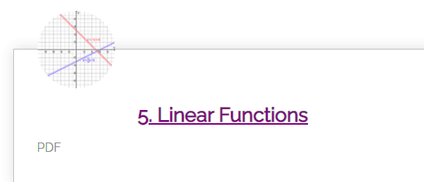
Equation of a straight line
ANGLE | 0 | 40
λ | 0.61 | 0.488
x = 0 –> y = 0.61
0.61 = b
y = ax +b
x = 40 –> y = 0.488
0.488 = 40a + 0.61
0.488 – 0.61 = 40a
a = -0.00305
y = -0.00305x +0.61
$$y = −0.00305∙9+0.61=0.58255 m$$
MareMathics
Notes:
The straight line for upsetting moments was defined by using two points, as indicated in the table. The equation of a straight line is given by y = ax+b.
When x (angle ) equals zero, y (lambda) equals 0,61, so from here we can obtain that b = 0,61.
With the second point, when x is 40 degrees, then y = 0.488 metres, and from here we can obtain the value a.
With this equation, we can now obtain the ordinate value for whatever the angle. In this case, for an angle of 9°, the ordinate is 0.58255 metres, which corresponds to the height of the triangle.

Slide 18
Area A
Area A is calculated as a triangle
$$Area of a triangle= \frac{Base ∙Height}{2}= \frac{9° ∙0.58255m}{2}=2.62 m∙deg$$
Base = φ = 9° ;
Height = λ za φ = 0.58255m
A
φ
Notes:
Now we have all the necessary items, and the area can be calculated.

Slide 19
Area B
Area B is calculated as a trapezium
$$Area B =\frac{(H1+H2)}{2}∙Base=\frac{(0.58255+0.488)}{2} ∙31°=16.59 m∙deg$$
H1 = λ za φ = 0.58255m
H2 = λ za 40° = 0.488m
B
φ = 9°
Base = (40 – φ) = 31°
Notes:
Next, we need to calculate the area B. Area B has the shape of a trapezium. Here, we have a base, that equals 40 minus the angle phi; and two heights: H1 is the value of lambda at the angle phi (calculated in the previous section), and H2 is the value of lambda for 40°, which is given in the table.

Slide 20
Residual Dynamic Stability
RDS = F - A - B
$$RDS = F − A − B=40.47 −2.62 −16.59=21.26 m∙deg$$
RDS
B
A

Slide 21
Thank you for your attention!
"This project has been funded with support from the European Commission. This publication [communication] reflects the views only of the author, and the Commission cannot be held responsible for any use which may be made of the information contained therein".

