Slide 1
MareMathics
Teachers’ Training - Tallinn
Goran Kovačević, prof.
University of Split
Faculty of Maritime Studies

Slide 2
Excel VBA tools for matrices and determinants
Tools list:
Determinant
Generating the determinant of the desired value
Inverse matrix (using Gauss-Jordan method)
Solving a linear system with a unique solution in which m=n=r (Gauss-Jordan)

Slide 3
Excel VBA tools for matrices and determinants
Why are they useful?

Slide 4
Excel VBA tools for matrices and determinants
Why are they useful?
Checking the solution
Composing new tasks
Quick solving

Slide 5
Excel VBA tools for matrices and determinants
Before use:

Slide 6
Excel VBA tools for matrices and determinants
Before use:
Enable macros in Excel

Slide 7
Excel VBA tools for matrices and determinants
Before use:
Enable macros in Excel
Step 1: In the File tab, click “options.”
Step 2: In the “Excel options” dialog box, click “trust center settings” in the “trust center” option.
Step 3: In the “macro settings” option, select “enable all macros.” Click “Ok” to apply the selected macro settings.

Slide 8
Excel VBA tools for matrices and determinants
Before use:

Slide 9
Excel VBA tools for matrices and determinants
Before use:
Add Developer tab to Excel ribbon

Slide 10
Excel VBA tools for matrices and determinants
Before use:
Add Developer tab to Excel ribbon
On the File tab, go to Options > Customize Ribbon.
Under Customize the Ribbon and under Main Tabs, select the Developer check box.

Slide 11
Excel VBA tools for matrices and determinants
Use of tool – Determinant.xlsm

Slide 12
Excel VBA tools for matrices and determinants
Use of tool – Determinant.xlsm
Open the file and delete all data from the table

Slide 13
Excel VBA tools for matrices and determinants
Use of tool – Determinant.xlsm
Open the file and delete all data from the table
Enter the matrix of order $n$ in the table starting from the upper left corner, so that the first row (column) of the matrix is ​​in the first row (column) of the table

Slide 14
Excel VBA tools for matrices and determinants
the determinant of the given matrix is ​​displayed in the cell with coordinates (1, n + 2)
Use of tool – Determinant.xlsm
Open the file and delete all data from the table
Enter the matrix of order $n$ in the table starting from the upper left corner, so that the first row (column) of the matrix is ​​in the first row (column) of the table
Click the Button

Slide 15
Excel VBA tools for matrices and determinants
Use of tool – Determinant.xlsm
Open the file and delete all data from the table
Enter the matrix of order $n$ in the table starting from the upper left corner, so that the first row (column) of the matrix is ​​in the first row (column) of the table
Click the Button
The determinant of the given matrix is ​​displayed in the cell at the intersection of the first row and the (n + 2)nd column

Slide 16
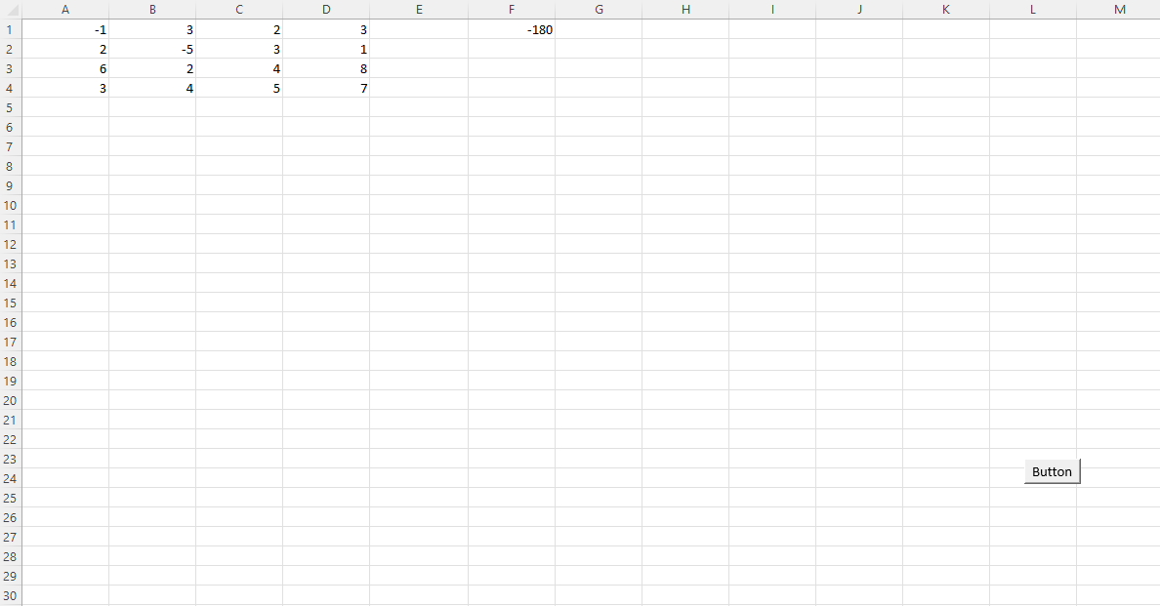

Slide 17
Excel VBA tools for matrices and determinants
Use of tool – Generating the determinant of the desired value.xlsm

Slide 18
Excel VBA tools for matrices and determinants
Use of tool – Generating the determinant of the desired value.xlsm
Open the file and delete all data from the table

Slide 19
Excel VBA tools for matrices and determinants
Use of tool – Generating the determinant of the desired value.xlsm
Open the file and delete all data from the table
To change the parameters (order of the matrix $n$, interval of integers and value of the determinant) under Developer tab select Visual Basic, then go to VBAProject>Modules and double click on Module1

Slide 20
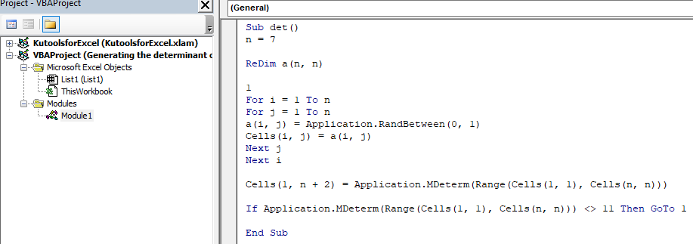

Slide 21
Excel VBA tools for matrices and determinants
Use of tool – Generating the determinant of the desired value
Open the file and delete all data from the table
To change the parameters (order of the matrix $n$, interval of integers and value of the determinant) under Developer tab select Visual Basic, then go to VBAProject>Modules and double click on Module1
When you're done, return to the main window and click the Button

Slide 23
Excel VBA tools for matrices and determinants
After executing the program, in the first n rows and the first n columns of the table there is a matrix of order n whose determinant is equal to the set value.
The determinant of that matrix is ​​displayed in the cell at the intersection of the first row and the (n + 2)nd column.

Slide 24
Excel VBA tools for matrices and determinants
Use of tool – Inverse matrix (using Gauss-Jordan method).xlsm

Slide 25
Excel VBA tools for matrices and determinants
Use of tool – Inverse matrix (using Gauss-Jordan method).xlsm
Open the file and delete all data from the table
Enter the regular matrix $A$ of order 𝑛 in the table starting from the upper left corner, so that the first row (column) of the matrix is ​​in the first row (column) of the table
Click the Button

Slide 26
Excel VBA tools for matrices and determinants
Use of tool – Inverse matrix (using Gauss-Jordan method).xlsm
After executing the program, exactly below the entered matrix, the matrices $A^{−1}$ and $A⋅A^{−1}$ are obtained
Between the matrices $A$ and $A^{−1}$ are three blank table lines.
Also, between the matrices $A^{−1}$ and $A⋅A^{−1}$ are three blank lines.

Slide 28
Excel VBA tools for matrices and determinants
Use of tool – Solving a linear system with a unique solution in which m=n=r (Gauss-Jordan).xlsm

Slide 29
Excel VBA tools for matrices and determinants
Use of tool – Solving a linear system with a unique solution in which m=n=r (Gauss-Jordan).xlsm
Enter the augmented matrix $\tilde{A}=\left[A\left|B\right.\right]$ of the system, that is $n×\left(n+1\right)$ matrix, in the table starting from the upper left corner, so that the first row (column) of the matrix is ​​in the first row (column) of the table

Slide 30
Excel VBA tools for matrices and determinants
Use of tool – Solving a linear system with a unique solution in which m=n=r (Gauss-Jordan).xlsm
Enter the augmented matrix $\tilde{A}=\left[A\left|B\right.\right]$ of the system, that is $n×\left(n+1\right)$ matrix, in the table starting from the upper left corner, so that the first row (column) of the matrix is ​​in the first row (column) of the table
Click the Button

Slide 31
Excel VBA tools for matrices and determinants
Use of tool – Solving a linear system with a unique solution in which m=n=r (Gauss-Jordan).xlsm
After executing the program, exactly below the entered matrix, the matrix $M=\left[I\left|X\right.\right]$ is obtained, where $I$ is a unit matrix of order $n$ and vector $X$ is a solution to the given system
The solution is checked by multiplying the system matrix $A$ and the vector $X$. If the solution is correct, $A⋅X$ must be equal or approximately equal to $B$, where $B$ is a vector of free terms of the system.

Slide 33
MATLAB tools for matrices and determinants
My MATLAB tools list:
Generating_a_matrix_of_the_desired_rank
Generating_a_matrix_polynomial
Generating_a_system_with_a_unique_solution
Generating_a_system_with_an_infinite_number_of_solutions
Generating_an_impossible_system
Solving_a_linear_system

Slide 34
MATLAB tools for matrices and determinants
If anyone is interested, I could make a little guide for any of these tools.
Contact mail: goran.kovacevic@pfst.hr

Slide 35
Thank you for your attention!
"This project has been funded with support from the European Commission. This publication [communication] reflects the views only of the author, and the Commission cannot be held responsible for any use which may be made of the information contained therein".

