Slide 1
Innovative Approach in Mathematical Education for Maritime Students
2019-1-HR01-KA203-061000
8th project meeting
Latvian Maritime Academy
02-02 March 2022
RIGA, LATVIA
Agata Załęska-Fornal, PhD
Polish Naval Academy, Gdynia

Slide 2
will use to denote the function in Laplace space
Innovative Approach in Mathematical Education for Maritime Students
2019-1-HR01-KA203-061000
How to solve differential equations using Laplace Transform
The Laplace transform is an integral transform that is widely used to solve linear differential equations with constant coefficients. When such a differential equation is transformed into the space of functions of complex variable${ {}_{}^{′}s}^{′} by using the Laplace integral$, the result is an algebraic equation, which is much easier to solve. Furthermore, the Laplace transform can be used to directly solve for functions given initial conditions. It is why the Laplace transform is often used to solve such equations.
We will use Y(s) to denote the function y(t) in Laplace space
A few properties of the Laplace transform will be listed below:
Agata Załęska-Fornal, PhD
Polish Naval Academy, Gdynia
Latvian Maritime Academy
02-02 March 2022 RIGA, LATVIA

Slide 3
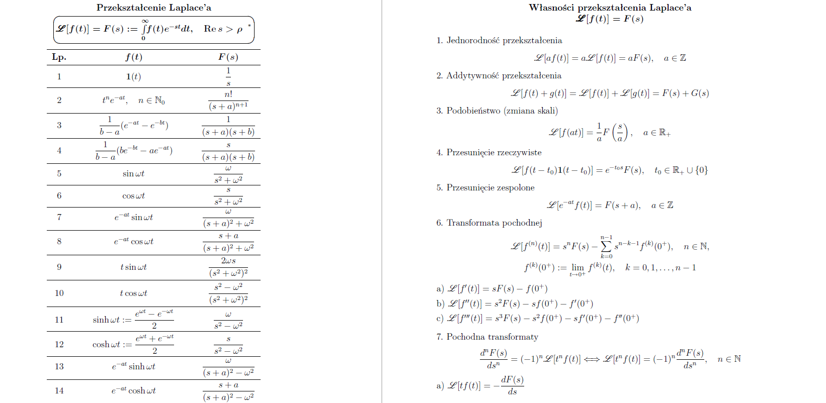
Innovative Approach in Mathematical Education for Maritime Students
2019-1-HR01-KA203-061000
Agata Załęska-Fornal, PhD
Polish Naval Academy, Gdynia
Latvian Maritime Academy
02-02 March 2022 RIGA, LATVIA

Slide 4
Innovative Approach in Mathematical Education for Maritime Students
2019-1-HR01-KA203-061000
$ℒ\left\{y′(t)\right\}=sY\left(s\right)−y\left(0\right)$
$ℒ\left\{y^{′′}\left(t\right)\right\}=s^{2}Y\left(s\right)−sy\left(0\right)−y^{′}\left(0\right)$
$ℒ\left\{y^{′′′}\left(t\right)\right\}=s^{3}Y\left(s\right)−s^{2}y\left(0\right)−{sy}^{′}\left(0\right)$- $y^{′′}\left(0\right)$
⁞
$ℒ\left\{y^{(n)}\left(t\right)\right\}=s^{n}Y\left(s\right)−\sum_{k=0}^{n−1}{s^{n−k−1}}y^{\left(k\right)}\left(0\right), n∈ℕ$
Notice that these derivatives encode the information about the initial conditions into the algebraic equation.
Agata Załęska-Fornal, PhD
Polish Naval Academy, Gdynia
Latvian Maritime Academy
02-02 March 2022 RIGA, LATVIA

Slide 5
Innovative Approach in Mathematical Education for Maritime Students
2019-1-HR01-KA203-061000
Example 1.
Solve the equation $y"−10y′+9y=5t, y(0)=−1, y′(0)=2$
Solution
The first step in using Laplace transforms to solve it is to take the transform of every term in the differential equation:
$ℒ\left\{y^{′′}\right\}−10ℒ\left\{y^{′}\right\}+ℒ\left\{y\right\}=$ $ℒ${5t}
Using the appropriate formulas from the table of Laplace transforms ($3^{rd}$ slide) gives the following:
$$s^{2}Y\left(s\right)−sy\left(0\right)−y^{′}\left(0\right)−10\left(sY\left(s\right)−y\left(0\right)\right)+9Y\left(s\right)=\frac{5}{s^{2}}$$
Now take in the initial conditions and collect all the terms that have a $Y(s)$ in them:
$${(s}^{2}−10s+9)Y\left(s\right)+s−12=\frac{5}{s^{2}}$$
Agata Załęska-Fornal, PhD
Polish Naval Academy, Gdynia
Latvian Maritime Academy
02-02 March 2022 RIGA, LATVIA

Slide 6
Innovative Approach in Mathematical Education for Maritime Students
2019-1-HR01-KA203-061000
Solving the equation for Y(s) :
$$Y(s)=\frac{5}{(s−9)(s−1)s^{2}}+\frac{12−s}{(s−9)(s−1)}$$
and
$Y(s)=\frac{5+12s^{2}−s^{3}}{s^{2}(s−9)(s−1)}$.
The partial fraction decomposition for this transform is:
$Y(s)=\frac{A}{s}+\frac{B}{s^{2}}+\frac{C}{s−9}+\frac{D}{s−1}$;
setting numerators equal gives,
$$5+12s^{2}−s^{3}=As(s−9)(s−1)+B(s−9)(s−1)+Cs^{2}(s−1)+Ds^{2}(s−9)$$
picking appropriate values of s and solving for the constants gives:
$A=\frac{50}{81},B=\frac{5}{9} ,C=\frac{31}{81}$ , $D=−2$.
plugging in the constants gives:
$$Y(s)=\frac{\frac{50}{81}}{s}+\frac{\frac{5}{9}}{s^{2}}+\frac{\frac{31}{81}}{s−9}+\frac{−2}{s−1}$$
Agata Załęska-Fornal, PhD
Polish Naval Academy, Gdynia
Latvian Maritime Academy
02-02 March 2022 RIGA, LATVIA

Slide 7
Innovative Approach in Mathematical Education for Maritime Students
2019-1-HR01-KA203-061000
Finally taking the inverse Laplace transform gives the solution :
$y(t)=\frac{50}{81}+\frac{5}{9}t+\frac{31}{81}e^{9t}−2e^{t}$.
Note:
The point of this problem, was to show how we would use Laplace transforms to solve a differential equation.
Using Laplace transforms reduces a differential equation down to an algebra problem. In the case of the last example the algebra was probably more complicated than usual solution of such diferentail equation. However, in engineering analysis that method is applied.
https://www.scribd.com/document/546673142/hsu-Chapter-6-Laplace-transform
Using Laplace transform we did not need to first find a general solution, differentiate it, plug in the initial conditions and then solve for the constants to get the solution. With Laplace transforms, the initial conditions are applied during the first step and at the end we get the actual solution instead of a general solution.
Agata Załęska-Fornal, PhD
Polish Naval Academy, Gdynia
Latvian Maritime Academy
02-02 March 2022 RIGA, LATVIA

Slide 8
Innovative Approach in Mathematical Education for Maritime Students
2019-1-HR01-KA203-061000
Students of Mechatronics and Automation and Robotics apply the above mentioned method of solving differential equations by means of Laplace transform on subjects:
Fundamentals of automation ( ${\text{2}}^{\text{nd}}$- $3^{\text{r}\text{d}}$ semester) in problems of electronics circuts
Dynamic systems (${\text{5}}^{\text{th}}$ semester) in problems of stability, controllability and observability
Agata Załęska-Fornal, PhD
Polish Naval Academy, Gdynia
Latvian Maritime Academy
02-02 March 2022 RIGA, LATVIA

Slide 9
https://www.ius.edu.ba/sites/default/files/u772/ee202laplacetransform.pdf
Innovative Approach in Mathematical Education for Maritime Students
2019-1-HR01-KA203-061000
Agata Załęska-Fornal, PhD
Polish Naval Academy, Gdynia
Latvian Maritime Academy
02-02 March 2022 RIGA, LATVIA

Slide 10
Innovative Approach in Mathematical Education for Maritime Students
2019-1-HR01-KA203-061000
An example presentation prepared by former student of automation and robotics - currently Joanna Sznajder is employed as an assistant at the Department of Naval Automation:
https://prezi.com/view/kw9aSkKmE6VWfZfCYTpD/
An example tutorial concerning application of Laplace Transform in Electrical Circuits:
https://youtu.be/HeVZx0yVVso
An example homework of Erasmus students:
Agata Załęska-Fornal, PhD
Polish Naval Academy, Gdynia
Latvian Maritime Academy
02-02 March 2022 RIGA, LATVIA

Slide 11
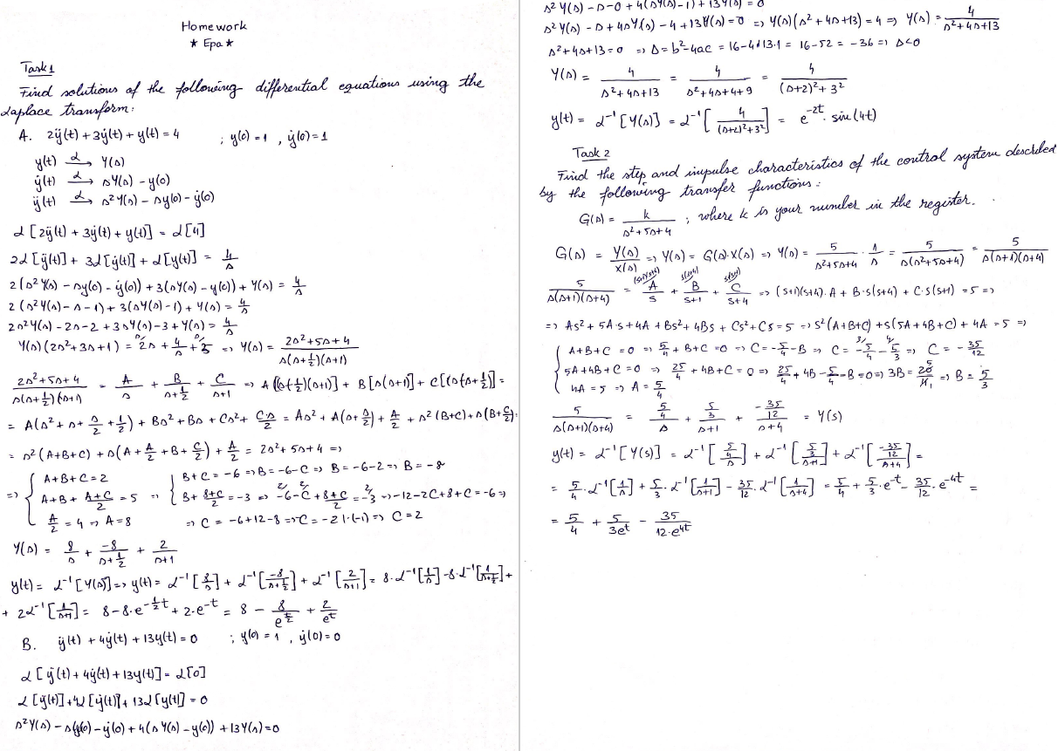
Innovative Approach in Mathematical Education for Maritime Students
2019-1-HR01-KA203-061000
Agata Załęska-Fornal, PhD
Polish Naval Academy, Gdynia
Latvian Maritime Academy
02-02 March 2022 RIGA, LATVIA

Slide 12
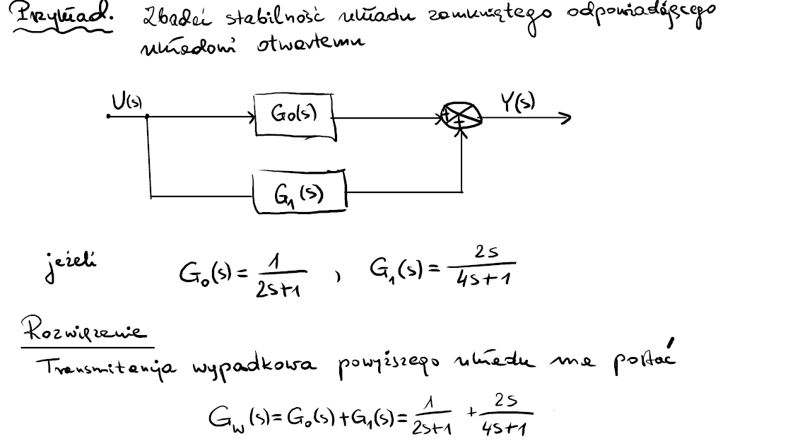
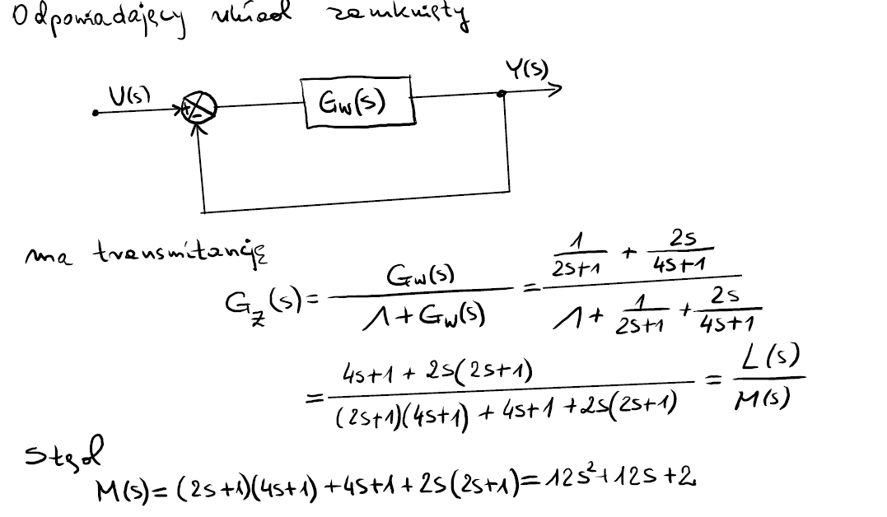
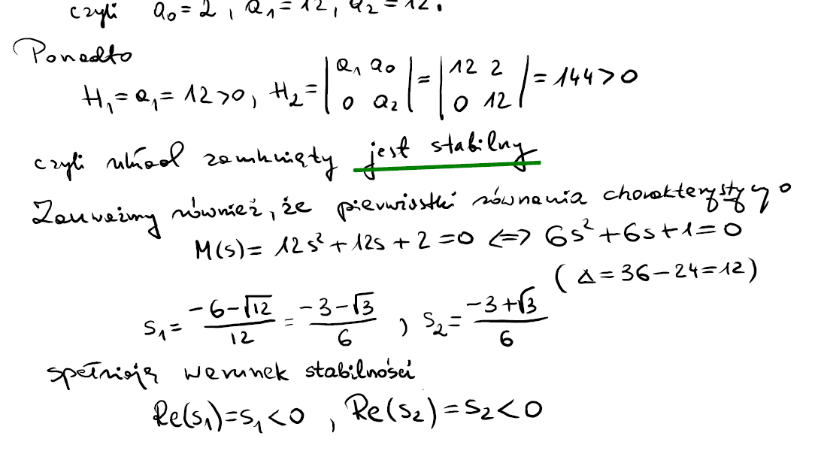
Innovative Approach in Mathematical Education for Maritime Students
2019-1-HR01-KA203-061000
An example taken from a lecture given by professor Hubert Wysocki – head of Mathematics and Physics Department of PNA-
Subject: Dynamic systems
Lecture: Stability of the dynamic system
On-line lectures given during pandemic situation using Wacom One Display 13 (DTC133) pen tablet and Open-Board - open source cross-platform teaching software for
interactive whiteboard designed primarily for use in schools and universities.
Agata Załęska-Fornal, PhD
Polish Naval Academy, Gdynia
Latvian Maritime Academy
02-02 March 2022 RIGA, LATVIA

Slide 13
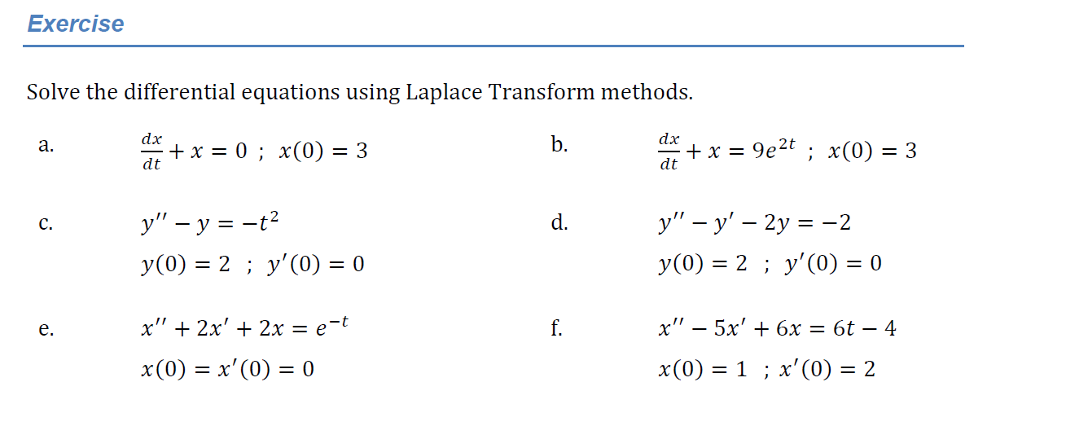
Innovative Approach in Mathematical Education for Maritime Students
2019-1-HR01-KA203-061000
https://emedia.rmit.edu.au/
Agata Załęska-Fornal, PhD
Polish Naval Academy, Gdynia
Latvian Maritime Academy
02-02 March 2022 RIGA, LATVIA

Slide 14
Innovative Approach in Mathematical Education for Maritime Students
2019-1-HR01-KA203-061000
Thank you for attention !
8th project meeting
Latvian Maritime Academy
02-02 March 2022
RIGA, LATVIA
Agata Załęska-Fornal, PhD
Polish Naval Academy, Gdynia

