Slide 1
MareMathics
Introduction to Vectors
In this lesson we will cover:
The difference between a scalar and a vector quantity,
How to represent a vector,
The different types of notation used to identify a vector,
How to multiply a vector by a scalar.

Slide 2
Lesson objective
To be able to identify and use vector notation
To understand the difference between a vector and a scalar quantity
To multiply a vector by a scalar
Notes:
The lesson begins by……..

Slide 3
What is a Scalar?
Scalars are quantities that are simply defined by a magnitude.
For example the mass of an object just has a magnitude, so it is a scalar quantity.
Without Scalars We Wouldn’t Be Able To Model a
Temperature
Another example of a scalar is a speed!

Slide 4
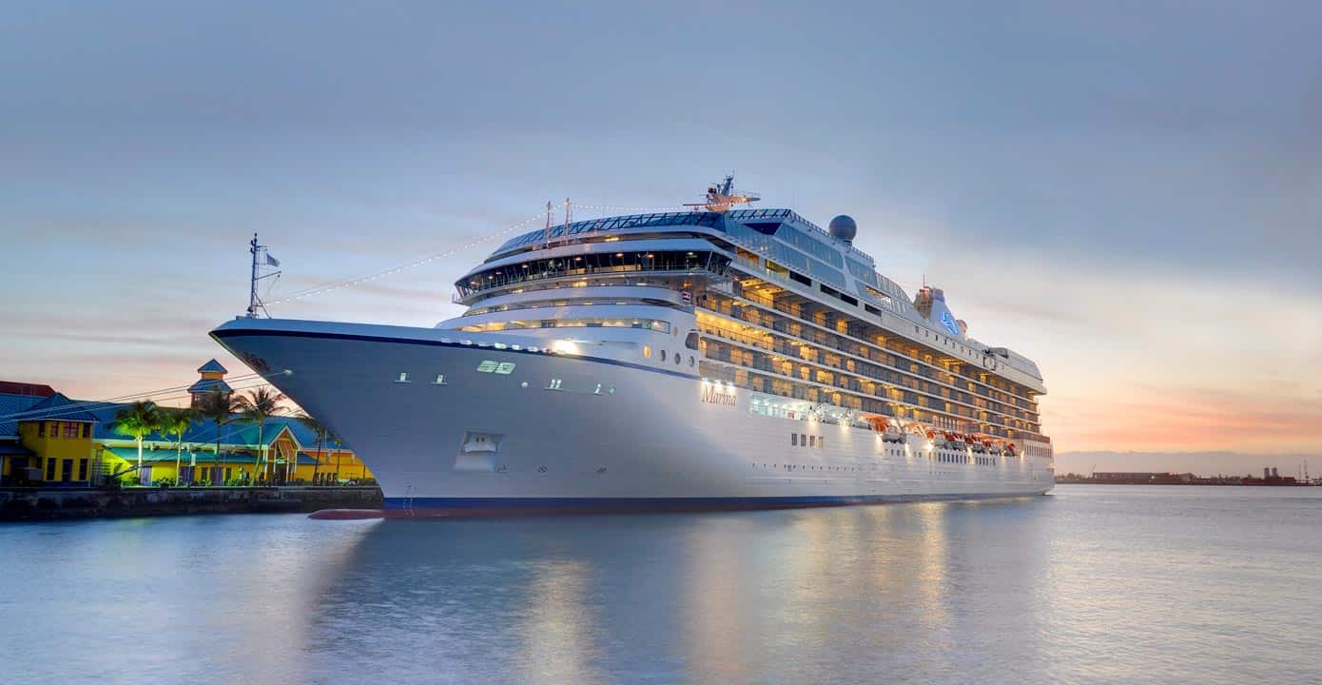
The length of an average cruise ship is 1,187 feet.
quantity
magnitude

Slide 5
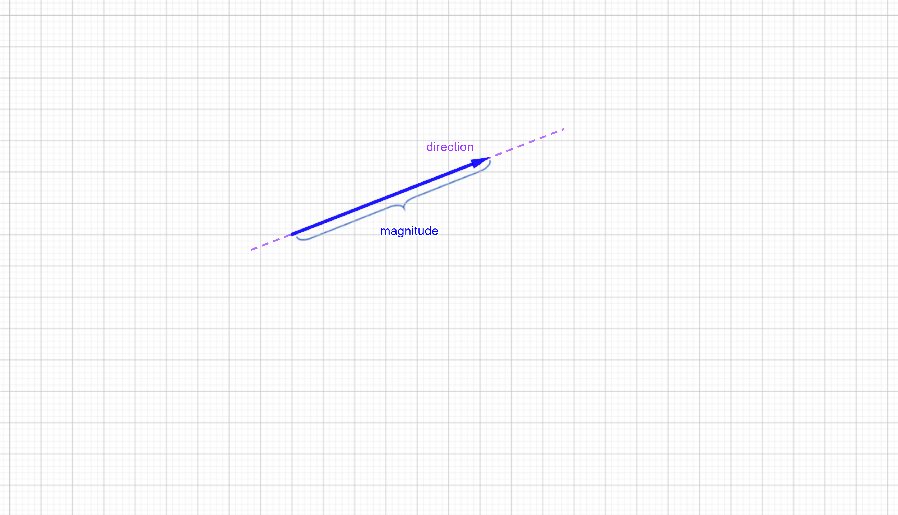
What is a Vector?
A vector quantity has both a direction, orientation and a magnitude .
  For example velocity is a speed in some given direction, for example wind.
    The wind is blowing 8 mph in
    a westerly direction
Without Vectors We Wouldn’t Be Able To Model Forces.

Slide 6
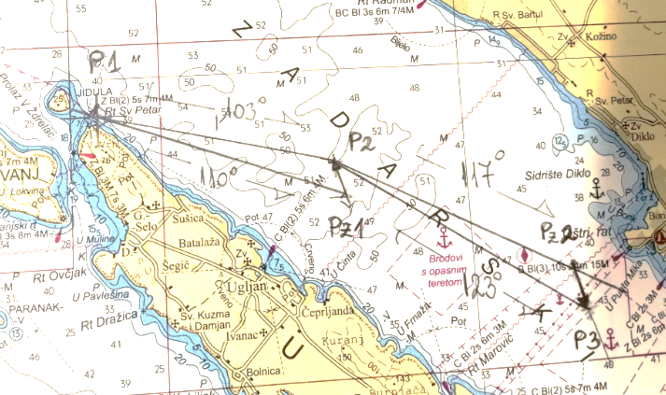
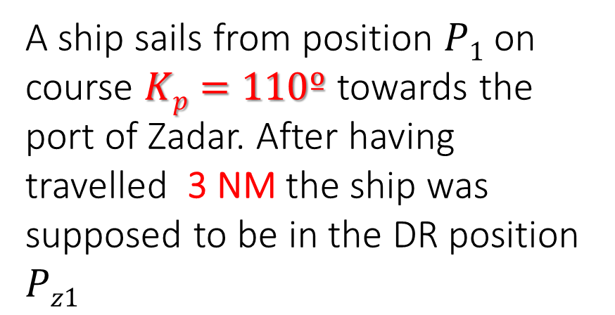
A ship sails from position $P1$on course $Kp=110º$ towards the port of Zadar. After having travelled 3 NM the ship was supposed to be in the DR position $Pz1$
magnitude
direction

Slide 7
Scalar or Vector?
Which of the following are vector quantities?

Slide 8
Properties of Vectors

Slide 9
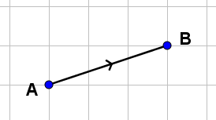
Properties of vectors
A vector can be represented by a straight line, with an arrow to show its direction. The length of the line may represent the magnitude of the vector.
a
This vector a represents the translation or movement from A to B.

Slide 10
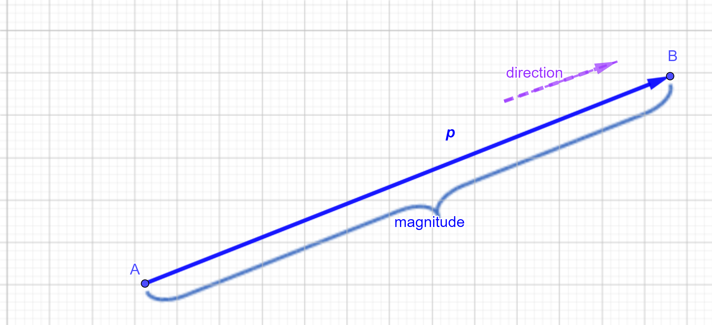
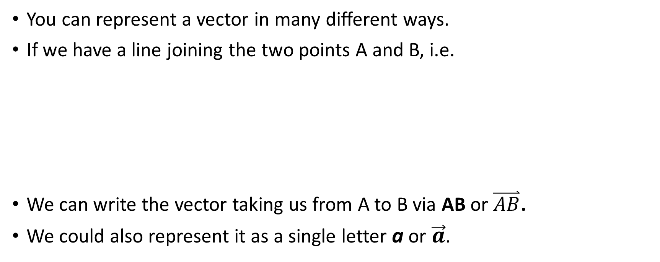
Representation of Vectors
You can represent a vector in many different ways.
If we have a line joining the two points A and B, i.e.
We can write the vector taking us from A to B via AB or $\overset{⃑}{AB}$.
We could also represent it as a single letter a or $\vec{a}$.
The arrow above the letter shows the direction of movement which in this case is from A to B.

Slide 11
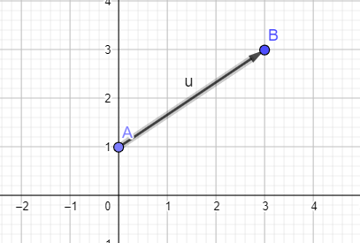
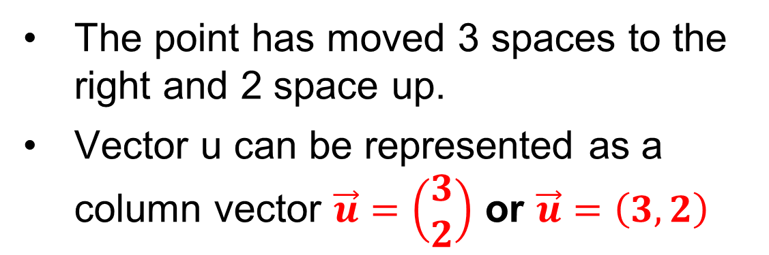
Translations
You can use vectors to describe a translation of point A to point B.
The point has moved 3 spaces to the right and 2 space up.
Vector u can be represented as a column vector $\vec{u}=\left(\begin{matrix}3 \\ 2\end{matrix}\right)$ or $\vec{u}=\left(3,2\right)$

Slide 12
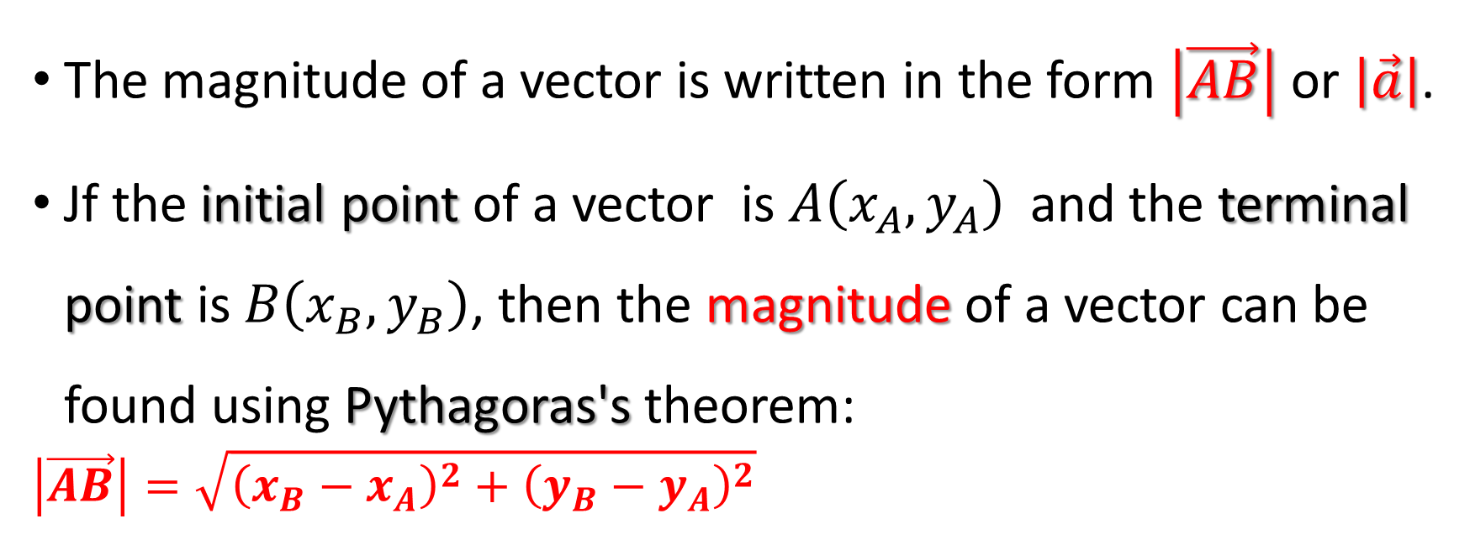
Magnitude or Norm of a Vector
The magnitude of a vector is written in the form $\left|\vec{AB}\right|$ or $\left|\vec{a}\right|$.
Jf the initial point of a vector is $A\left(x_{A},y_{A}\right)$ and the terminal point is $B\left(x_{B},y_{B}\right)$, then the magnitude of a vector can be found using Pythagoras's theorem:
$$\left|\vec{AB}\right|=\sqrt{{\left({x_{B}−x}_{A}\right)}^{2}+{\left({y_{B}−y}_{A}\right)}^{2}}$$
IMPORTANT NOTE
A magnitude is always a positive number. It is a scalar.

Slide 13
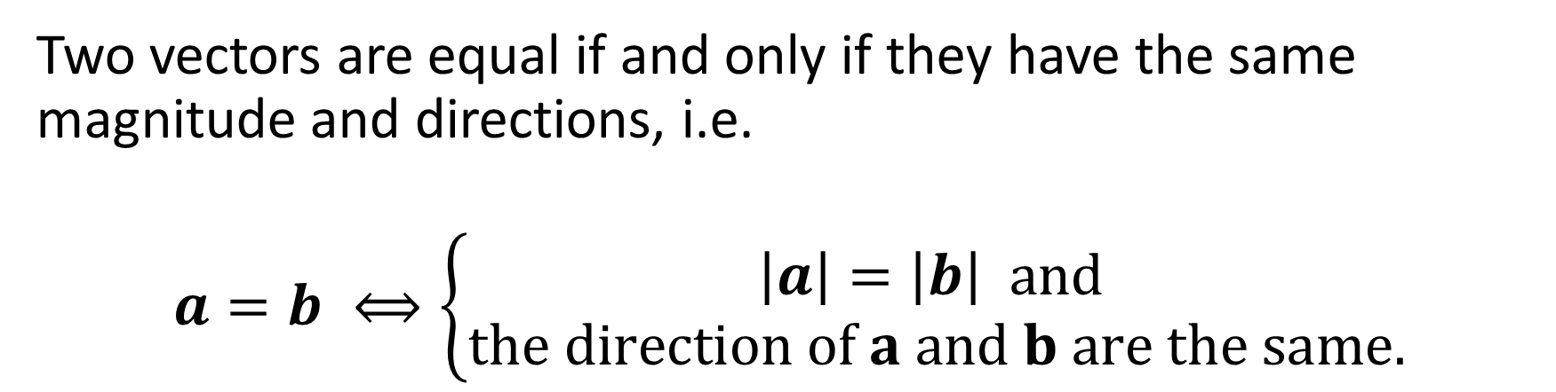
Equality of Vectors
Two vectors are equal if and only if they have the same magnitude and directions, i.e.
$$a=b ⟺\left\{\begin{matrix}\left|a\right|=\left|b\right| and \\ the direction of a and b are the same.\end{matrix}\right.$$
The following vectors are equal

Slide 14
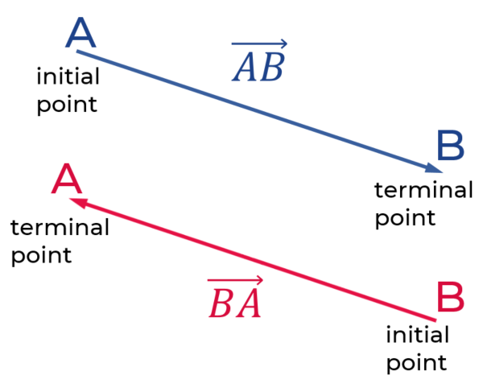
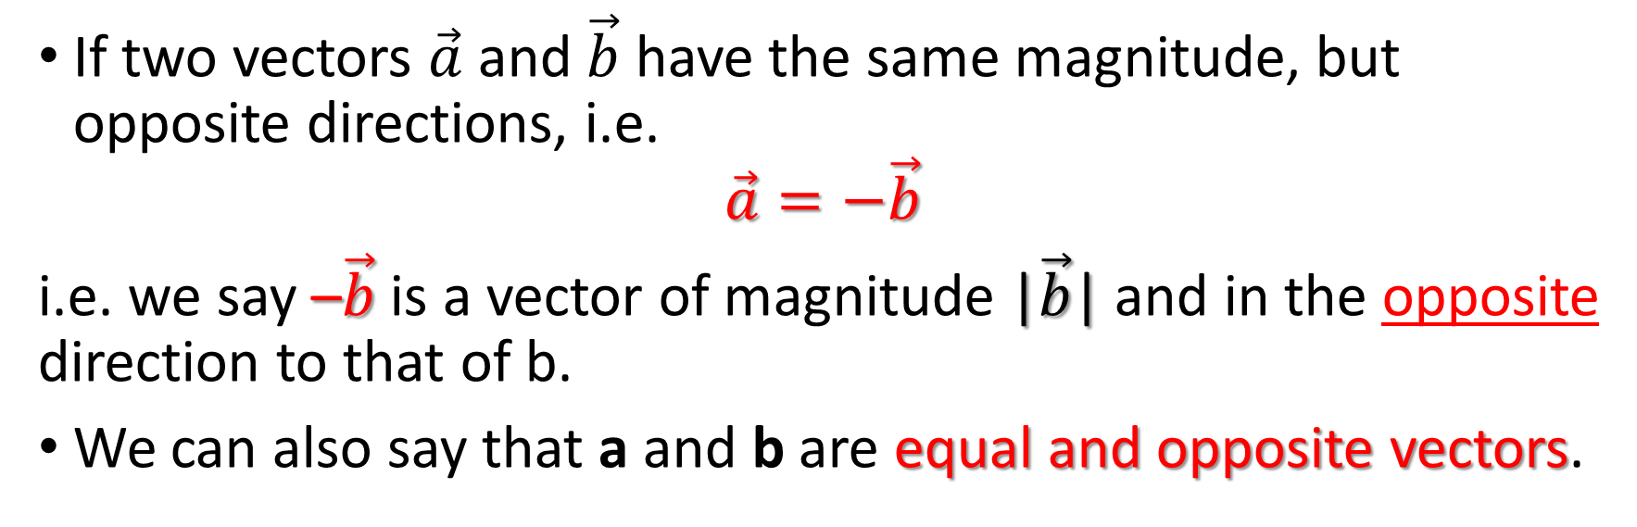

Negative Vectors
If two vectors $\vec{a}$ and $\vec{b}$ have the same magnitude, but opposite directions, i.e.
$$\vec{a}=−\vec{b}$$
i.e. we say –$\vec{b}$ is a vector of magnitude |$\vec{b}$| and in the opposite direction to that of b.
We can also say that a and b are equal and opposite vectors.
$$\overset{→}{BA}=−\overset{→}{AB}$$

Slide 15
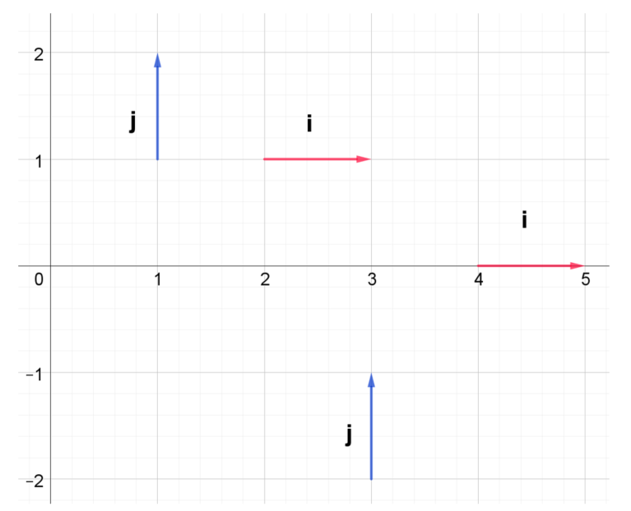

Unit Vector
Unit vector of the vector $\vec{a}$ is the vector
Examples of unit vectors

Slide 16
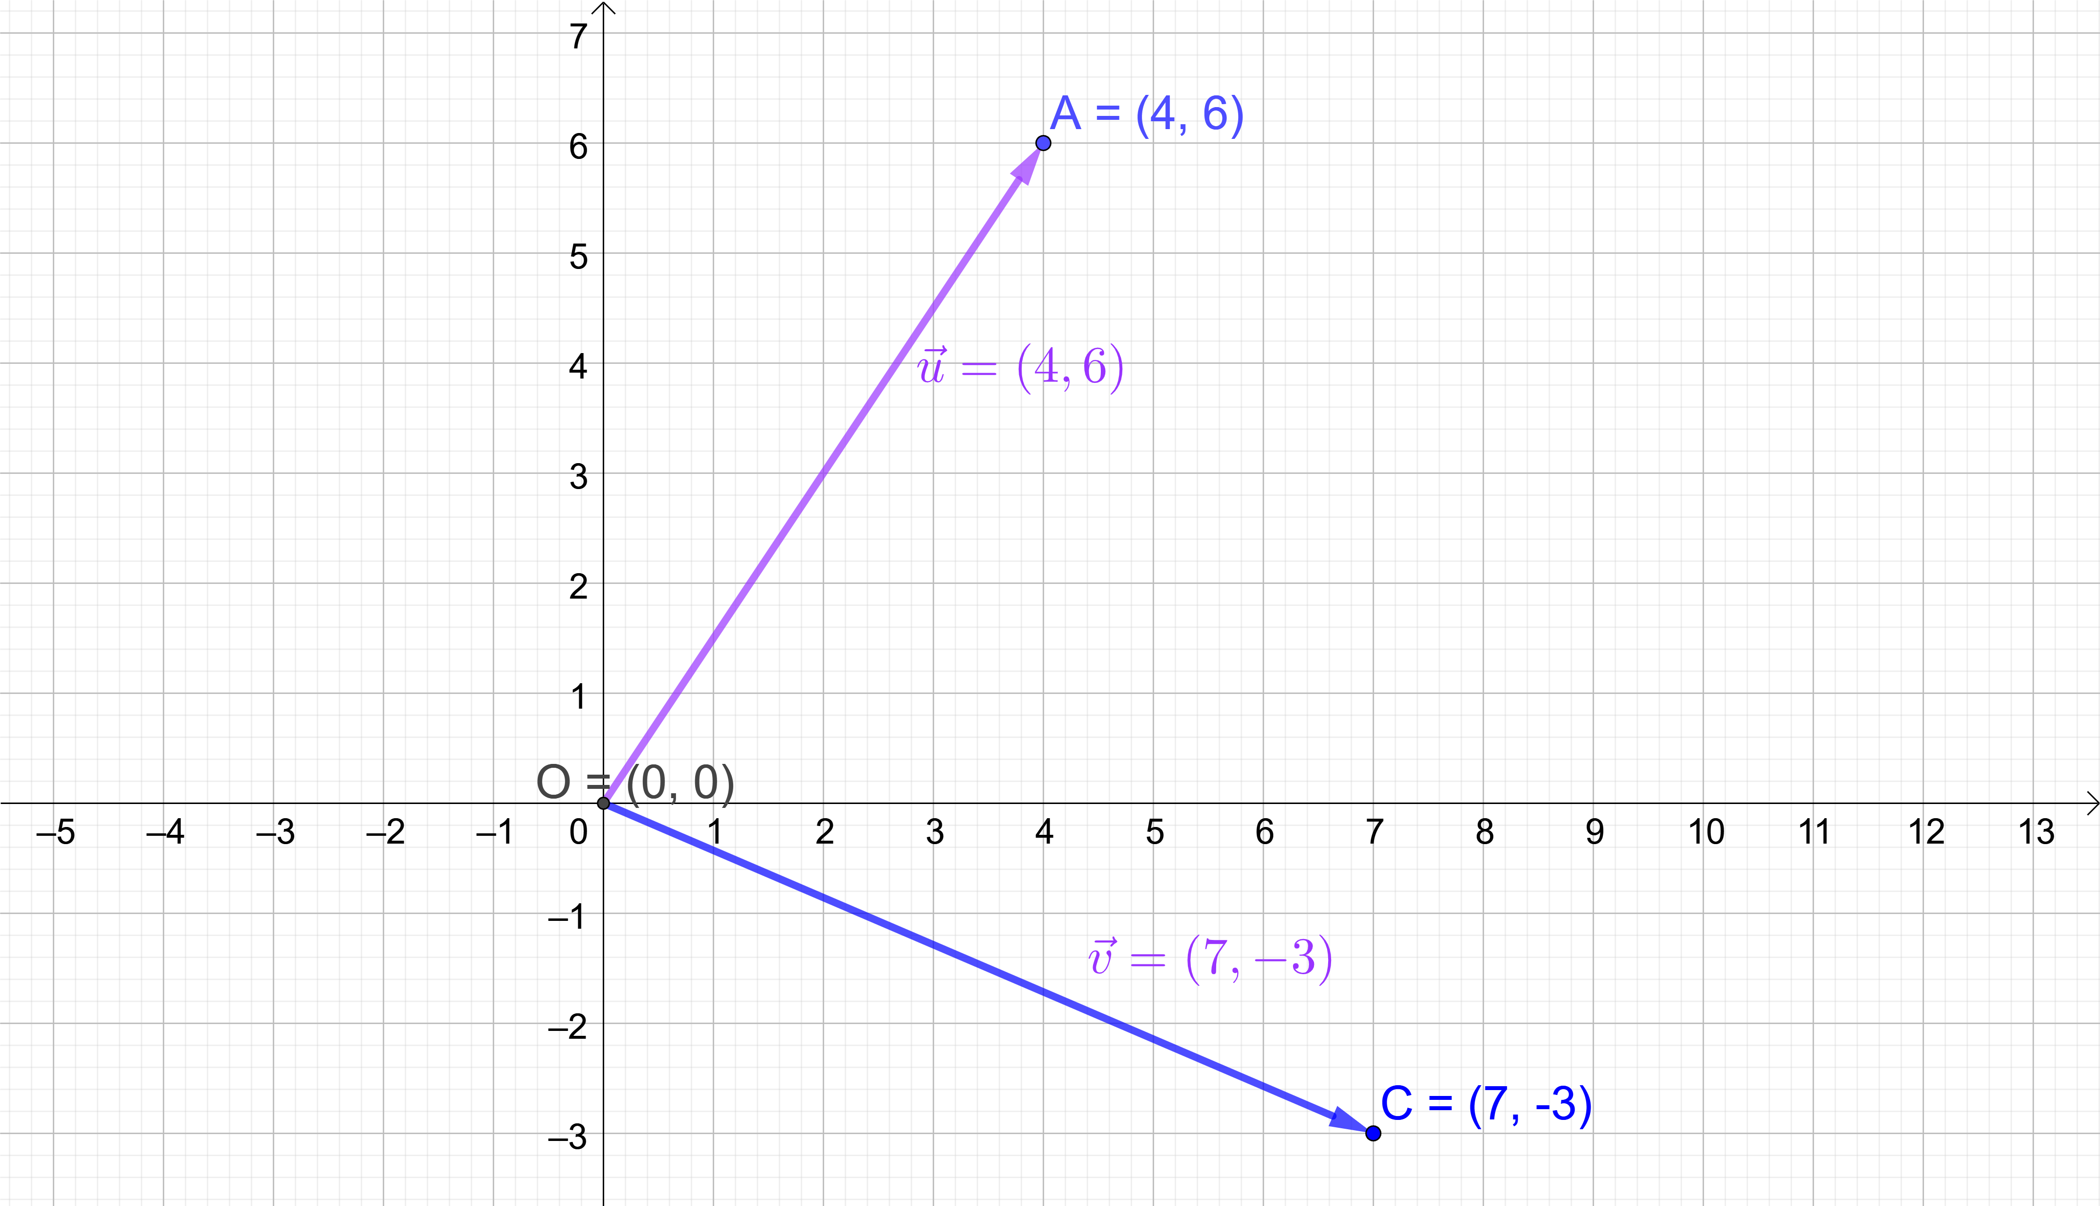
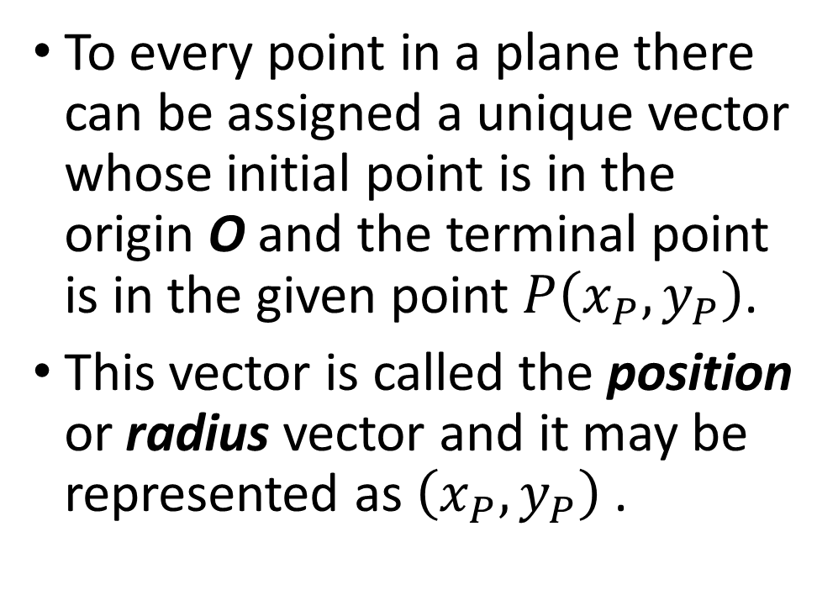
Position Vector
To every point in a plane there can be assigned a unique vector whose initial point is in the origin O and the terminal point is in the given point $P\left(x_{P},y_{P}\right)$.
This vector is called the position or radius vector and it may be represented as $\left(x_{P},y_{P}\right)$ .

Slide 17

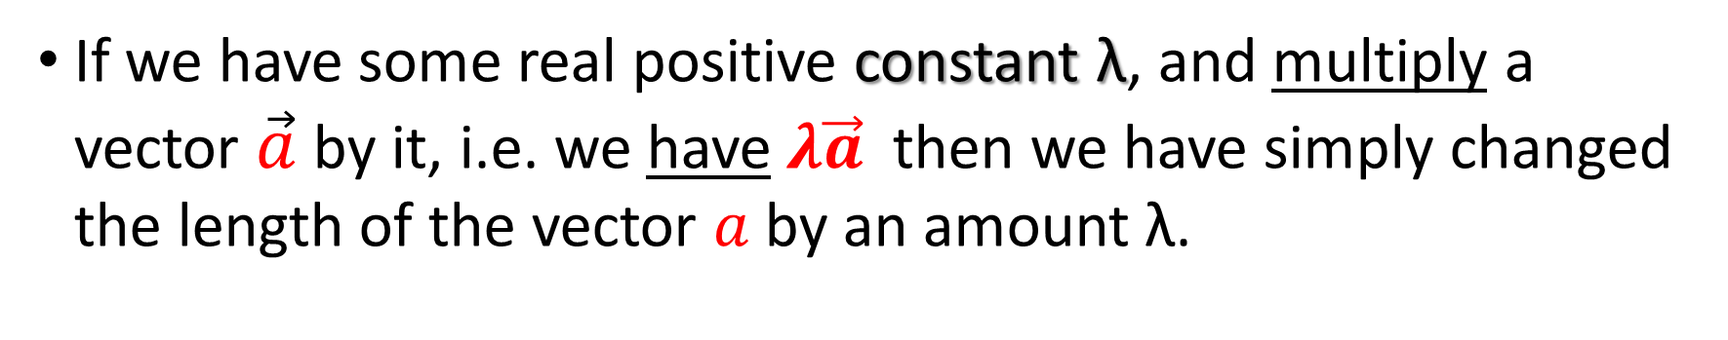

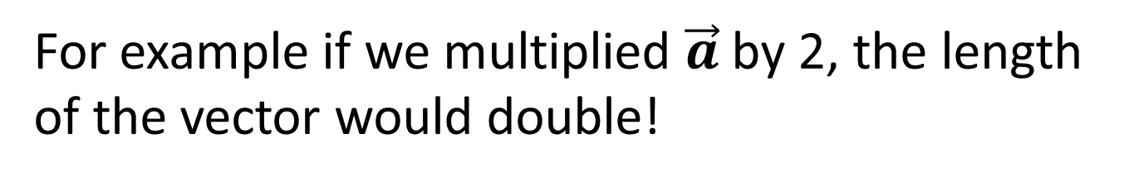
Multiplication by a Scalar
If we have some real positive constant λ, and multiply a vector $\vec{a}$ by it, i.e. we have$λ\vec{a}$ then we have simply changed the length of the vector $a$by an amount λ.
For example if we multiplied $\vec{a}$ by 2, the length of the vector would double!
$$\vec{a}$$
$$2\vec{a}$$

Slide 18
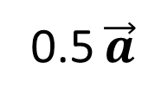

Multiplication by a Scalar
If we multiply by a number less than one, we shorten the length of our vector.
For example if we multiplied a by 0.5, the length of the vector would be halved!
If we were to multiply by a negative number, we would reverse the direction of the vector.
$$\vec{a}$$
0.5 $\vec{a}$

Slide 19
Angle Between Two Vectors
If we consider two vectors, there are two possible angles between them, φ and 180 – φ.
The angle two vectors is uniquely defined.
It is the angle between their directions when the lines representing them diverge.
180- φ
φ
φ
φ

