Slide 1
Matemathics in Electrical Engineering
Prof. Maja Krčum
University of Split
Faculty of Maritime Studies

Slide 2
POWER ELECTRICAL SYSTEM - POWER FACTOR
In an AC power system
the power factor is a very important parameter that defines how efficiently electrical power is being utilized by the load.
It is a rational number between -1 and 1 but has no unit.
The power factor of a system depends on the type of load present, whether
resistive,
inductive, or
capacitive.
The inductive and capacitive load has a negative impact on the power factor of the system.
Poor power factor results in an increase in current drained by the load.

Slide 3
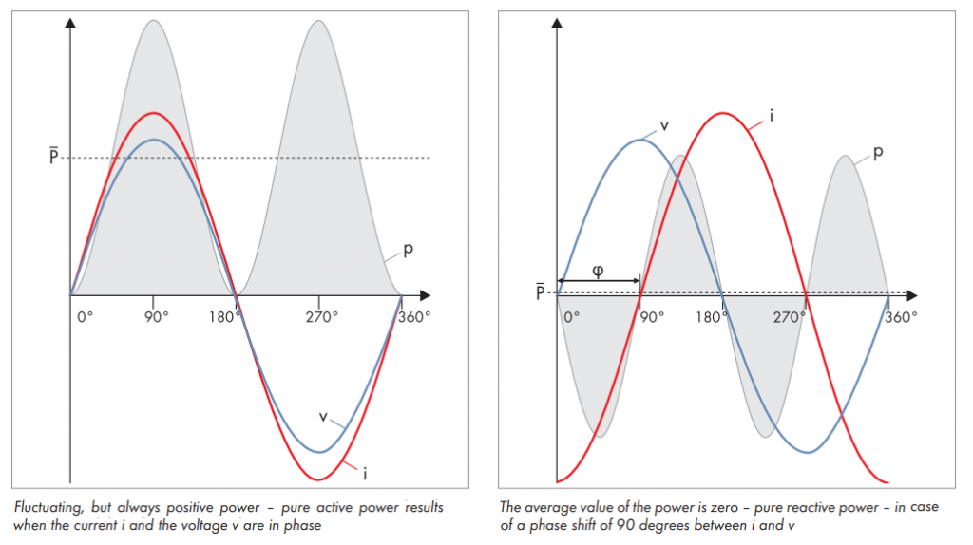
POWER ELECTRICAL SYSTEM - POWER FACTOR
Power Factor - Defined as the cosine of the angle between the voltage and current.
In AC circuit, the voltage and current are ideally in phase.
Practically, there exists a phase difference between them.
The cosine of this phase difference is termed as power factor.
(It can be defined and mathematically represented as follows):
Pure reactive power with current and voltage perfectly out-of-phase
Pure active power with current and voltage perfectly in-phase

Slide 4
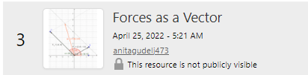


MareMathics Resources
Force as Vector
Use of trigonometry.
MareMathics

Slide 5
POWER ELECTRICAL SYSTEM - POWER FACTOR
PHASOR
A phasor is vector is a vector that is used to represent a sinusoidal signal.
When we have more than one sinusoidal signal with the same frequency, different phase and
different amplitude then we can use this phasor diagram to represent the phase difference between
these sinusoidal signals.
The magnitude of the phasor represents the peak value of the voltage and the current.
The term “phasor” can also be applied to impedance and related complex quantities that are not time dependent.
The international standard is that phasors always rotate in the counterclockwise direction.

Slide 6
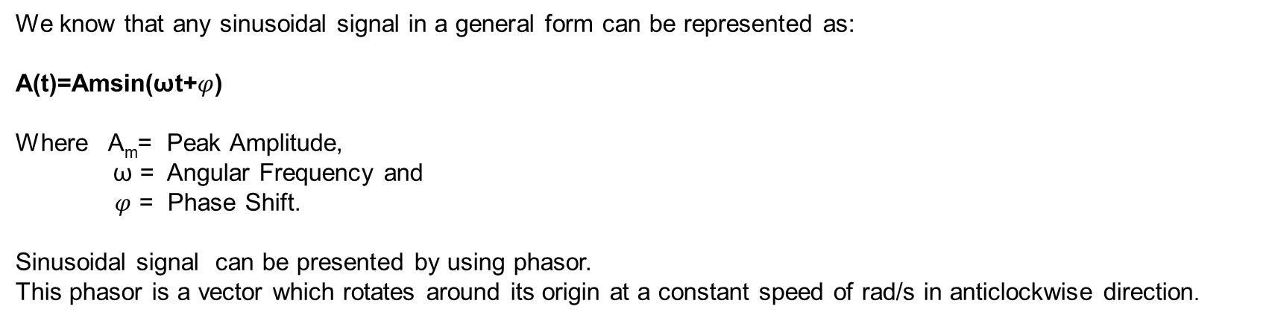
POWER ELECTRICAL SYSTEM - POWER FACTOR
We know that any sinusoidal signal in a general form can be represented as:
A(t)=Amsin(ωt+$φ$)
Where A_{m}= Peak Amplitude,
ω = Angular Frequency and
$φ$ = Phase Shift.
Sinusoidal signal can be presented by using phasor.
This phasor is a vector which rotates around its origin at a constant speed of rad/s in anticlockwise direction.

Slide 7
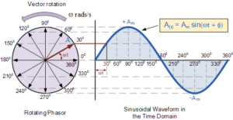
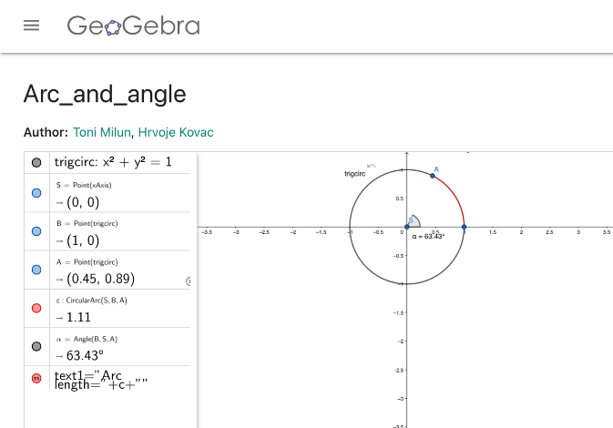

POWER ELECTRICAL SYSTEM - POWER FACTOR
At diagram as the vector rotates in an anticlockwise direction at a speed of rad/s and if we take the projection of this vector in Y-axis then we get the instantaneous value of this sinusoidal signal.
If we dot all the values which are possible for this phasor then we can reproduce the sinusoidal signal.

Slide 8
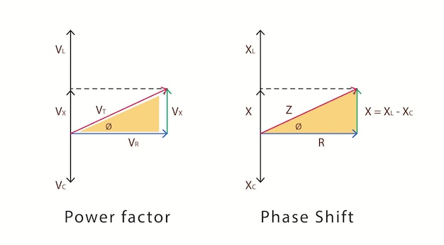
POWER ELECTRICAL SYSTEM - POWER FACTOR
Rules for Drawing a Phasor Diagram
Rule 1: The length of the phasor is directly proportional to the amplitude of the wave depicted.
Rule 2: In circuits which have combinations of L, C and R in series it is customary to draw the phasor representing current horizontally and call this the reference phasor. This is because the current in a series circuit is common to all the components.
Rule 3: In parallel circuits, where L, C and R are connected in parallel the phasor representing the supply Voltage is always drawn in the reference direction. This is because in a parallel circuit it is the supply voltage that is common to all components.
Rule 4: The direction of rotation of all phasors is considered to be anticlockwise.
Rule 5: In any one diagram, the same type of value(RMS, peak etc)is used for all phasors, not a mixture of values.

Slide 9

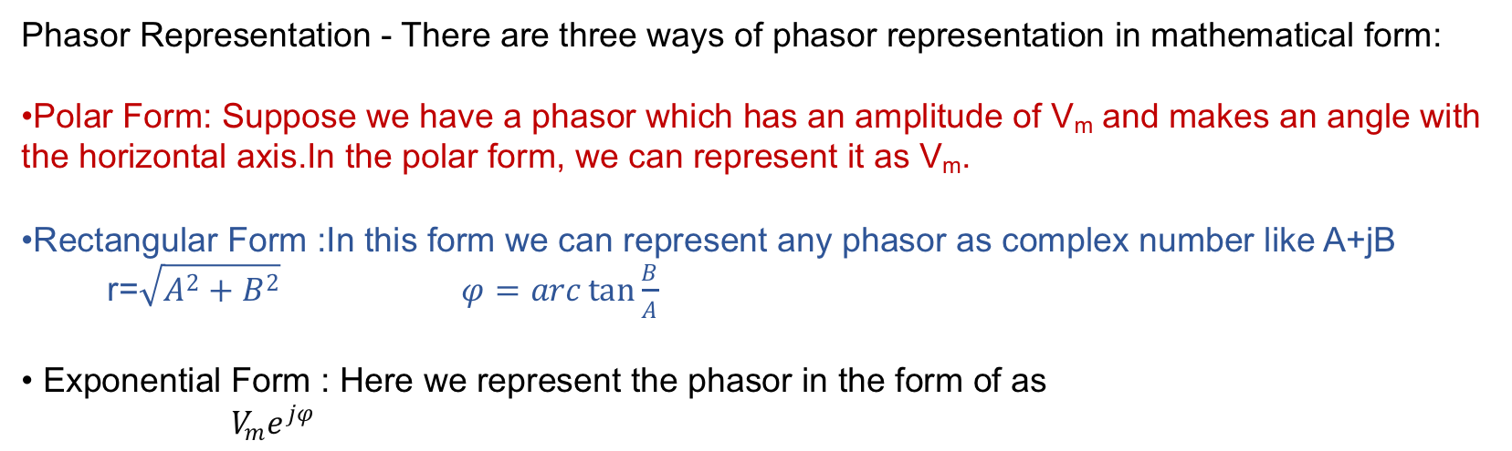
POWER ELECTRICAL SYSTEM - POWER FACTOR
Phasor Representation - There are three ways of phasor representation in mathematical form:
Polar Form: Suppose we have a phasor which has an amplitude of V_{m} and makes an angle with the horizontal axis.In the polar form, we can represent it as V_{m}.
Rectangular Form :In this form we can represent any phasor as complex number like A+jB
r=$\sqrt{A^{2}+B^{2}}$ $φ=arc\tan{\frac{B}{A}}$
Exponential Form : Here we represent the phasor in the form of as
$V_{m}e^{jφ}$
https://maremathics.pfst.hr/wp-content/uploads/2021/09/IO2-2-Complex-Numbers-2.pdf

Slide 10
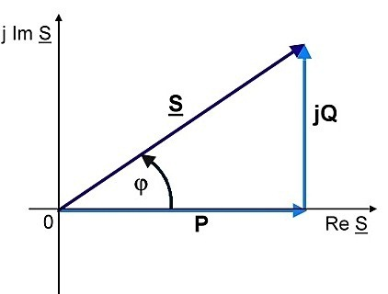
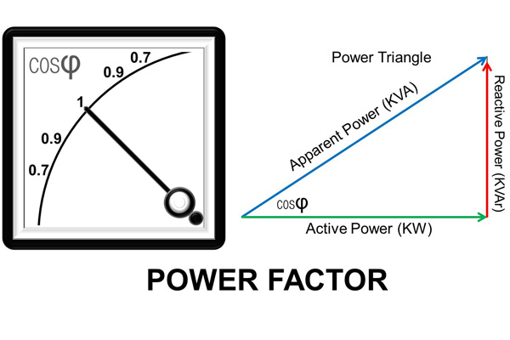
POWER ELECTRICAL SYSTEM - POWER FACTOR
https://maremathics.pfst.hr/wp-content/uploads/2021/09/IO2-2-Complex-Numbers-2.pdf
If the power factor cos φ=1 it means that there is no reactive power flow and the phase angle between the voltage and current is zero.

Slide 11
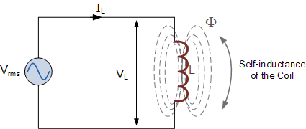
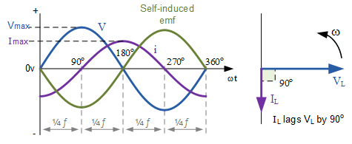
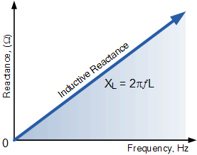


POWER ELECTRICAL SYSTEM - POWER FACTOR
We can also write this statement as, V_{L} = 0º and I_{L} = -90º with respect to the voltage, V_{L}.
If the voltage waveform is classed as a sine wave then the current, I_{L} can be classed as a negative cosine and we can define the value of the current at any point in time as being:

Slide 12
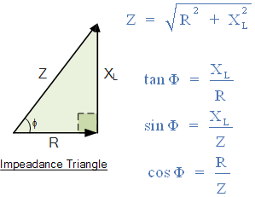
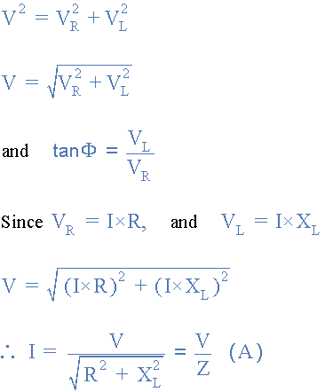
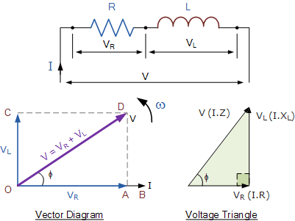
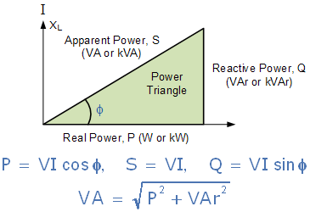
POWER ELECTRICAL SYSTEM - POWER FACTOR

Slide 13
POWER ELECTRICAL SYSTEM - POWER FACTOR
Active power (kW)
It is the true power transmitted to the load for energy conversion. For example, a motor consumes the true power from the circuit and converts it into mechanical power, whereas lamps, on the other hand, convert the same into light. It is represented by the letter P (Re S).
Reactive power (kW)
Reactive power is the power required to produce the magnetic field in motors and transformers and has a direct impact on the p.f. It is represented by the letter Q (Im S).
Apparent power (kVA)
Apparent power is the product of voltage and current consumed by a load irrespective of its phase angle. It is the combination of real and reactive powers. It is represented by the letter S

Slide 14
POWER ELECTRICAL SYSTEM - POWER FACTOR
The major cause of the low power factor is the highly inductive industrial load connected to the system. When we say inductive industrial load, induction motors are the major contributors. Most of these motors operate at low lagging p.f. When operated at light loads, it operates at a p.f of 0.1-0.4 and rises to 0.8-0.9 at full load. Apart from induction motors, induction heating furnaces, and arc lamps also have a very poor p.f.
Disadvantages of poor power factor
Since kVA is inversely proportional to the p.f., hence smaller the p.f of the load, higher will be the kVA rating of the transformers, generators and switchgear used.
At a fixed kW, the cables will carry more current if the p.f. is low. Hence, this increases the size of cables to be used.
Higher the current flow, higher will be the copper losses.
Large currents at the time of low p.f. operations results in poor voltage regulation in transformers, alternators and transmission line (because of internal copper losses).

Slide 15
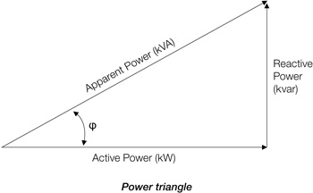
POWER ELECTRICAL SYSTEM - POWER FACTOR
(PF = kW / kVA)
It is the measure of the systems electrical efficiency in an alternating current circuit and is represented as a % or a decimal (i.e. PF = 0.9 or 90%).
The relationship between kVA, kW and kVAR is non-linear and is expressed:
kVA² = kW² + kVAR²

Slide 16
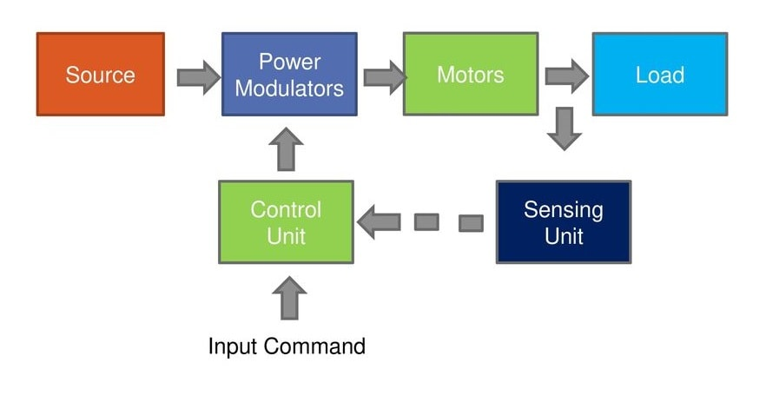
ELECTRICAL SYSTEM - ELECTROMOTOR
The general equation of motion of rotating masses of an electric motor drive is:
M - motor torque ,
Mt - load moment,
J - moment of inertia (inertia) of all moving parts reduced to the axis of the electric motor,
ω - angular velocity,

Slide 17
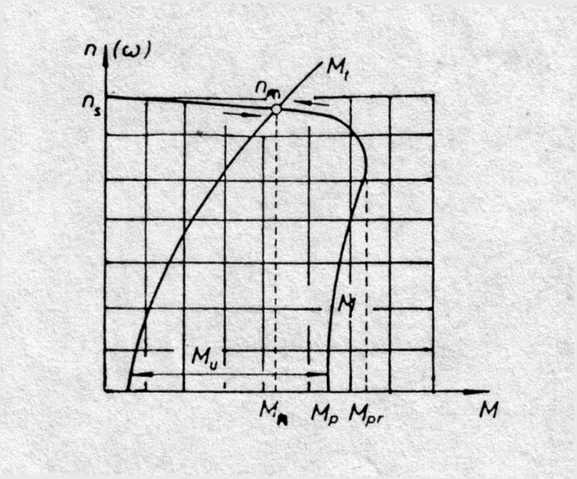


POWER ELECTRICAL SYSTEM - ELECTROMOTOR
In the stationary operating state of the electric motor drive in the mechanical sense, the torque of the electric motor and the torque of the load of the working machine are equal to each other, ie.
M = Mt.
The steady state is characterized by equations
ω = const. n= const.
$$\frac{ⅆω}{ⅆt}=0 \frac{ⅆn}{ⅆt}=0$$
$ε=0$, M_{u}= 0

Slide 18
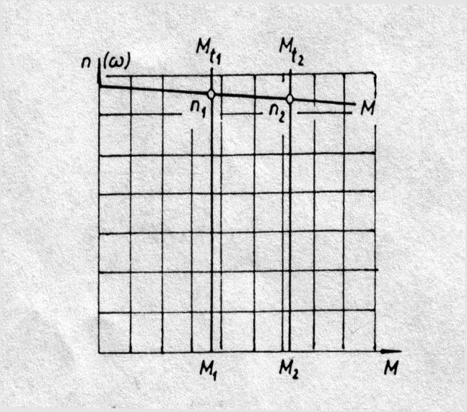
POWER ELECTRICAL SYSTEM - ELECTROMOTOR
It is impossible to bring the electric motor drive into any stationary state, or to take it out of it, without going through a dynamic state.

Slide 19
Thank you for your attention!
"This project has been funded with support from the European Commission. This publication [communication] reflects the views only of the author, and the Commission cannot be held responsible for any use which may be made of the information contained therein".

