Slide 1
MareMathics
Teachers’ Training - Tallinn
prof. Zdeslav Jurić, PhD
University of Split
Faculty of Maritime Studies

Slide 2
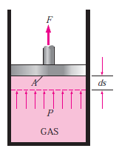
Math in Thermodynamics
Partial derivative of ideal gas state equation (or law) (1st example):
$$p∙V=n∙ℜ∙T=k∙T$$
$$p=\frac{k∙T}{V} ; \frac{∂p}{∂V}=−k∙T∙V^{−2}$$ $$\frac{∂p}{∂V}=−\frac{k∙T}{V^{2}}=−\frac{k∙T}{V}∙\frac{1}{V}=−\frac{p}{V}$$ $$\frac{∂p}{∂V}=−\frac{p}{V}$$ | $$p=\frac{k∙T}{V}$$ $$\frac{∂p}{∂T}=\frac{k}{V}$$

Slide 3
Math in Thermodynamics
Derivation of product of ideal gas state equation (2nd example):
$$p∙V=n∙ℜ∙T$$
$$p∙dV+V∙dp=dn∙ℜ∙T+n∙dℜ∙T+n∙ℜ∙dT$$
$$p∙dV+V∙dp=n∙ℜ∙dT$$
$if T=const. \frac{∂p}{∂V}=−\frac{p}{V}$ ; $if V=const.\frac{∂p}{∂T}=\frac{k}{V}$

Slide 4
Math in Thermodynamics
Using of integral:
Equation of obtained work (by mechanical means):
$$W=F∙s \left(N∙m=J\right)$$
Equation of obtained work (thermodynamic adjusted):
$$p=\frac{F}{A}→F=p∙A$$
$$W=p∙A∙s\left(\frac{N}{m^{2}}∙m^{2}∙m=J\right)$$
Notes:
The work done can be found by integrating Eq

Slide 5
Math in Thermodynamics
Equation of obtained work (thermodynamic adjusted):
$$δW=p∙A∙ds$$
$$\int_{1}^{2}{δW}=\int_{1}^{1}{p∙A∙ds }$$
$$W=\int_{1}^{2}{p∙dV}$$
Notes:
However, this integration can be performed only if we know the relationship between P and V during this process. This relationship may be expressed as an equation or it may be shown as a graph.

Slide 6
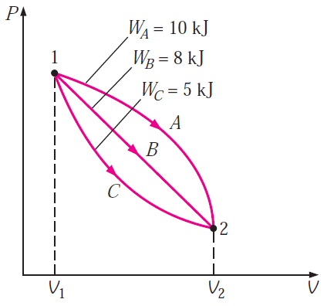
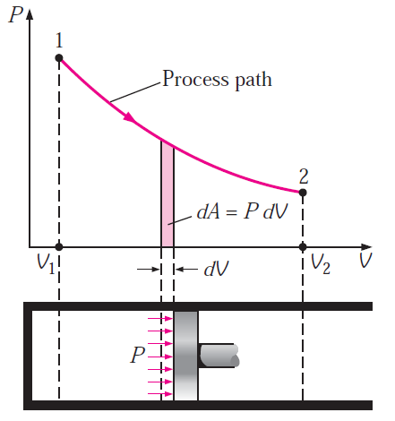
Math in Thermodynamics
Integral:
$$p∙V=n∙ℜ∙T$$
$$W=\int_{1}^{2}{p∙dV}$$
Notes:
Further consideration of a P–V diagram, such as Fig. 3.9, leads to another important conclusion. It is possible to go from state 1 to state 2 along many different quasi-equilibrium paths, such as A, B, or C. Since the area under each curve represents the work for each process, the amount of work done during each process not only is a function of the end states of the process but also depends on the path followed in going from one state to another.
For this reason, work is called a path function or, in mathematical parlance, δW is an inexact differential.
This concept leads to a brief consideration of point and path functions or, to use other terms, exact and inexact differentials.

Slide 7
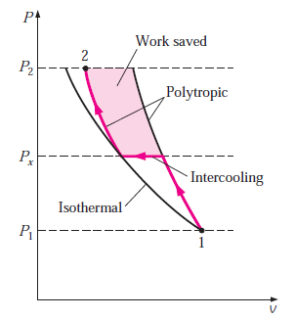
Math in Thermodynamics
Multistage compression (optimisation by means of mid-pressure - p_{x})
$$w_{LPC}=\frac{n∙R∙T_{1}}{n−1}∙\left[{\left(\frac{p_{x}}{p_{1}}\right)}^{\frac{n−1}{n}}−1\right]$$
$$w_{HPC}=\frac{n∙R∙T_{1}}{n−1}∙\left[{\left(\frac{p_{2}}{p_{x}}\right)}^{\frac{n−1}{n}}−1\right]$$
$${w=w}_{LPC}+w_{HPC}=\frac{n∙R∙T_{1}}{n−1}∙\left[{\left(\frac{p_{x}}{p_{1}}\right)}^{\frac{n−1}{n}}+{\left(\frac{p_{2}}{p_{x}}\right)}^{\frac{n−1}{n}}−2\right]$$

Slide 8
Math in Thermodynamics
Multistage compression (optimisation by means of mid-pressure - p_{x})
$${w=w}_{LPC}+w_{HPC}=\frac{n∙R∙T_{1}}{n−1}∙\left[{\left(\frac{p_{x}}{p_{1}}\right)}^{\frac{n−1}{n}}+{\left(\frac{p_{2}}{p_{x}}\right)}^{\frac{n−1}{n}}−2\right]$$
$$\frac{dw}{dp_{x}}=0$$
$$\frac{n∙R∙T_{1}}{n−1}\left\{\left[\frac{{\left(\frac{p_{x}}{p_{1}}\right)}^{\frac{n−1}{n}−1}∙\left(n−1\right)}{n∙p_{1}}\right]−\left[\frac{{p_{2}∙\left(\frac{p_{2}}{p_{x}}\right)}^{\frac{n−1}{n}−1}∙\left(n−1\right)}{n∙p_{x}^{2}}\right]\right\}=0$$

Slide 9
Math in Thermodynamics
Multistage compression (optimisation by means of mid-pressure - p_{x})
$$\left[\frac{{\left(\frac{p_{x}}{p_{1}}\right)}^{\frac{n−1}{n}−1}∙\left(n−1\right)}{n∙p_{1}}\right]=\left[\frac{{p_{2}∙\left(\frac{p_{2}}{p_{x}}\right)}^{\frac{n−1}{n}−1}∙\left(n−1\right)}{n∙p_{x}^{2}}\right]$$
$$p_{x}^{\frac{2∙n−2}{n}}={\left(p_{1}∙p_{2}\right)}_{}^{\frac{n−1}{n}}$$
$$p_{x}^{}={\sqrt{p_{1}∙p_{2}}}_{}^{}$$

Slide 10
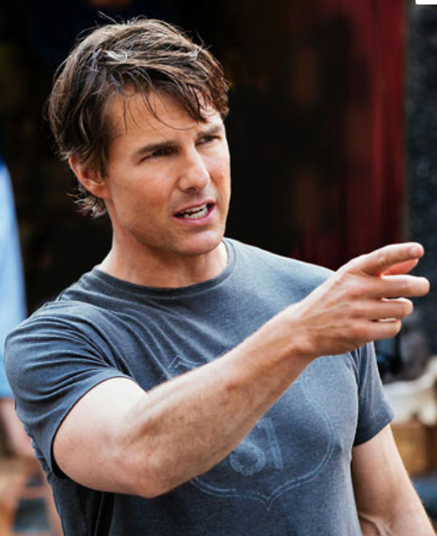
Math in Thermodynamics
Studying fundamentals of thermodynamics without basic knowledge of mathematics (especilly differentials and integals) is…
Don't even think about it

Slide 11
Thank you for your attention!
"This project has been funded with support from the European Commission. This publication [communication] reflects the views only of the author, and the Commission cannot be held responsible for any use which may be made of the information contained therein".

