Slide 1

Mathematics hidden in the finite element method
LT PhD Radosław KICIŃSKI, PNA, Gdynia, Poland
Transnational Project Meeting & Teaching Stars
26 – 27 April 2022 TalTech Estonian Maritime Academy, Tallinn, Estonia.

Slide 2
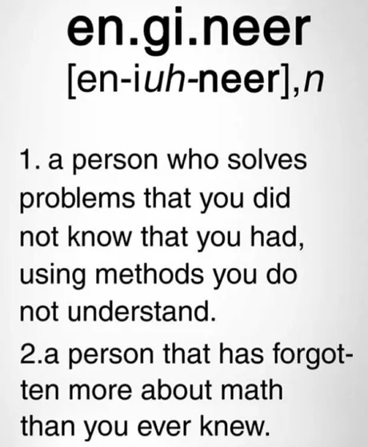
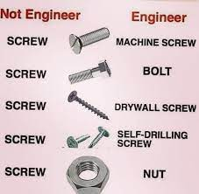
Definitions
Transnational Project Meeting & Teaching Stars
26 – 27 April 2022 TalTech Estonian Maritime Academy, Tallinn, Estonia.

Slide 3
An extremely important question for humanity:
Is it possible to stand on an empty beer can?
Transnational Project Meeting & Teaching Stars
26 – 27 April 2022 TalTech Estonian Maritime Academy, Tallinn, Estonia.

Slide 4
We can answer this question in two ways:
Experimental – preferred at home
Theoretically – presented
Transnational Project Meeting & Teaching Stars
26 – 27 April 2022 TalTech Estonian Maritime Academy, Tallinn, Estonia.

Slide 5
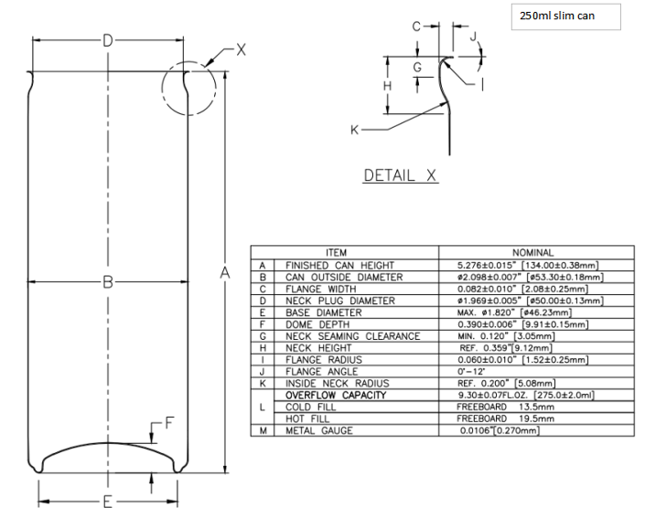
The drawing
Vector graphics
Unit systems
Unit conversions
Volume
Density
more…
Transnational Project Meeting & Teaching Stars
26 – 27 April 2022 TalTech Estonian Maritime Academy, Tallinn, Estonia.

Slide 6
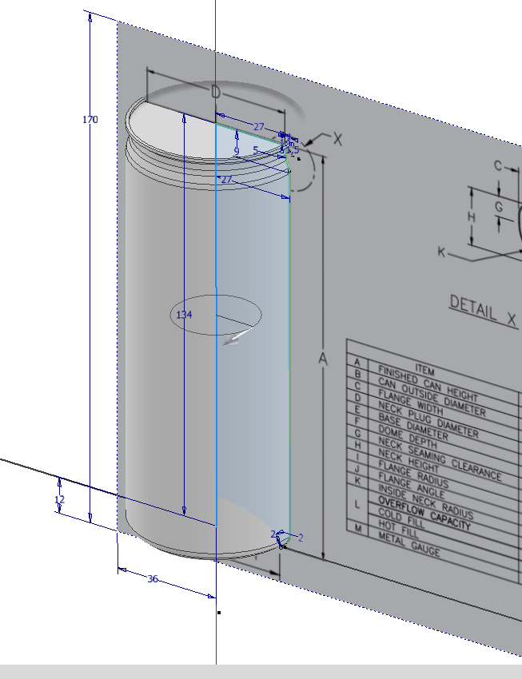
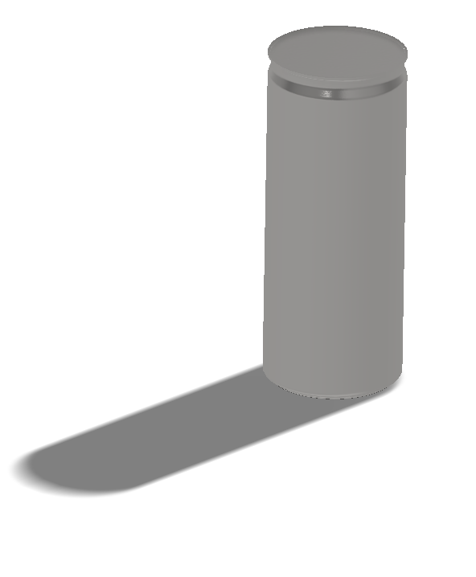
CAD model
Boolean algebra
Non-uniform rational basis spline (NURBS)
Matrix
Transnational Project Meeting & Teaching Stars
26 – 27 April 2022 TalTech Estonian Maritime Academy, Tallinn, Estonia.

Slide 7
Finite Element Method
Physical model - Real object, (continuum)
Mathematical model
Differential or algebraic equations describing the state of equilibrium in the studied area, description of the boundary conditions on the surface of the studied area, the conditions of continuity for heterogeneous bodies, also the description of the load on the body and other features called constitutive equations.
Numerical model
Mathematical devices used to describe given physical phenomena often constitute sets of differential and integral equations that should be converted into sets of algebraic equations understandable for computing machines - computers. For example, the integration of a given function distributed over the area of the tested element must be changed into numerical integration, e.g. Gaussian integration, which is the sum of the appropriate words that can be written in a programming language.
Transnational Project Meeting & Teaching Stars
26 – 27 April 2022 TalTech Estonian Maritime Academy, Tallinn, Estonia.

Slide 8
Finite Element Method
When using FEM to solve mechanics problems, a discrete model is developed, equivalent to the mathematical model.
In this model, the continuous area of ​​the structure under study is replaced by an equivalent discrete model, i.e. the continuous area is divided into a finite number of sub-areas - finite elements of a similar shape.
An approximating function is assigned to a given element shape, which describes the distribution of the searched physical quantity inside the element based on nodal values ​​set at points defining the element in space.
Then, for each element, matrices describing its properties are determined. The matrices of individual elements are composed into a structure matrix describing the entire structure and ensuring its continuity through the connection of elements in nodes.
The boundary conditions and loads of the structure are specified in structure nodes. This creates a matrix system of differential or algebraic equations that is solved numerically.
Transnational Project Meeting & Teaching Stars
26 – 27 April 2022 TalTech Estonian Maritime Academy, Tallinn, Estonia.
Notes:
Stosując MES do rozwiązywania zadań mechaniki opracowuje się model dyskretny (obliczeniowy), ekwiwalentny do modelu matematycznego. W modelu tym ciągły obszar badanej konstrukcji zastępuje się ekwiwalentnym modelem dyskretnym, to znaczy obszar ciągły dzieli się na skończoną liczbę podobszarów – elementów skończonych o podobnym kształcie. Danemu kształtowi elementu przypisana jest funkcja aproksymująca, która opisuje rozkład poszukiwanej wielkości fizycznej wewnątrz elementu na podstawie wartości węzłowych, zadanych w punktach wyznaczających element w przestrzeni. Następnie dla każdego elementu wyznacza się macierze opisujące jego własności. Macierze poszczególnych elementów składa się w macierz struktury opisującej całą konstrukcję i zapewniającą jej ciągłość poprzez połączenia elementów w węzłach. W węzłach konstrukcji zadawane są warunki brzegowe i obciążenia konstrukcji. W ten sposób powstaje macierzowy układ równań różniczkowych lub algebraicznych, który rozwiązuje się numerycznie. Po rozwiązaniu na podstawie otrzymanych wartości węzłowych funkcji i ich pochodnych wyznacza się składowe naprężeń, odkształceń, reakcji podpór itp., które prezentuje się graficznie przy wykorzystaniu grafiki komputerowej.

Slide 9
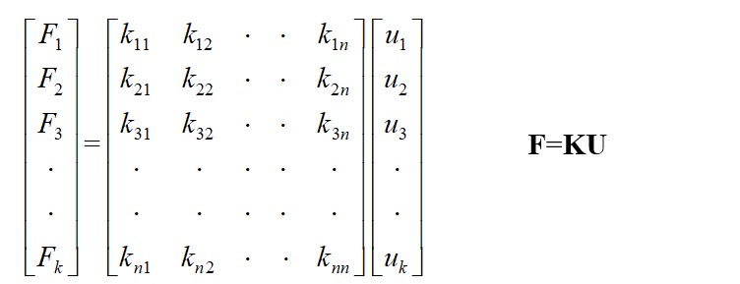
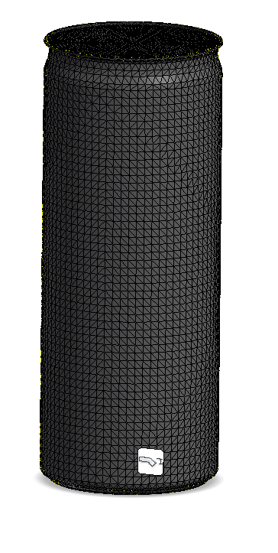
I'm going to use FEM to help humanity and answer this question!
1. Add material properties – Create stiffness matrix
2. Discretization –
Create structure matrix
3. Assign boundary conditions and loads –
Create load matrix
Transnational Project Meeting & Teaching Stars
26 – 27 April 2022 TalTech Estonian Maritime Academy, Tallinn, Estonia.

Slide 10
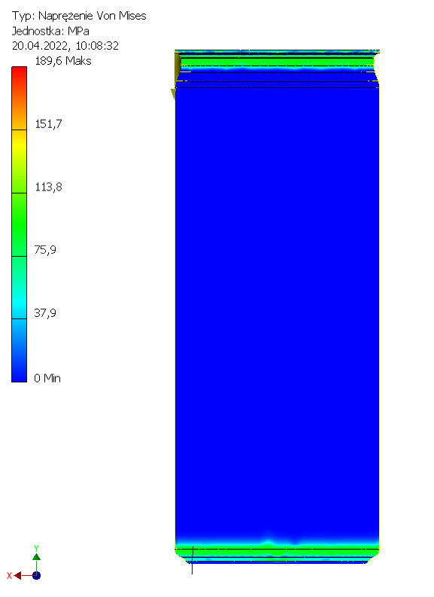
4. The computer solves the matrix equations by numerical integration
5. I get the results in the form of graphic images
Transnational Project Meeting & Teaching Stars
26 – 27 April 2022 TalTech Estonian Maritime Academy, Tallinn, Estonia.

Slide 11
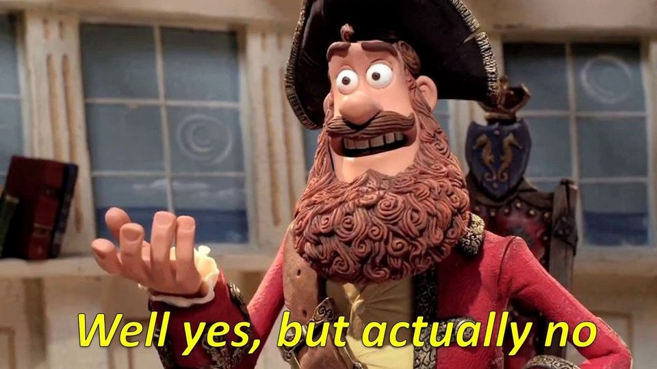
I am happy?
Transnational Project Meeting & Teaching Stars
26 – 27 April 2022 TalTech Estonian Maritime Academy, Tallinn, Estonia.

Slide 12
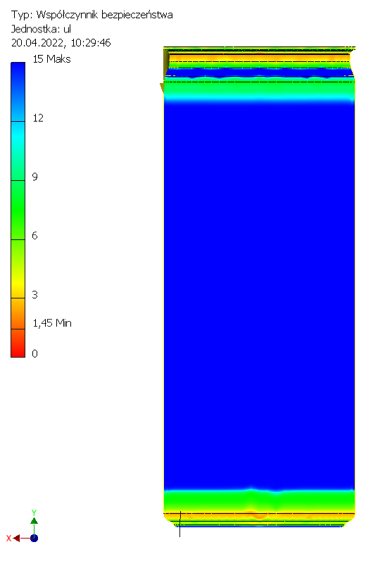
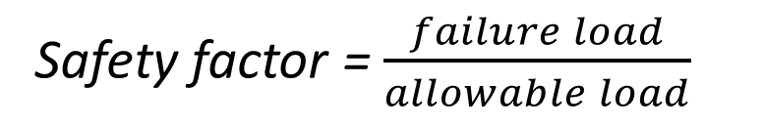
Safety factor = $\frac{failure load}{allowable load}$
We still do not know the answer, is it possible to stand on this can ...
The easiest way to answer this question is to use the safety factor. It is a value that tells us how safe our structure is.
Values below 1 do not meet the safety requirements - they will be damaged.
Transnational Project Meeting & Teaching Stars
26 – 27 April 2022 TalTech Estonian Maritime Academy, Tallinn, Estonia.

Slide 13

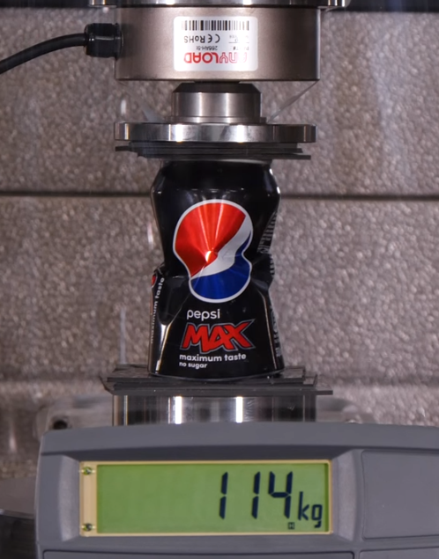
So the answer is YES, but ...
The analysis was carried out for a 100 kg human standing perfectly even on the surface of the can. Such a state is possible, but it takes practice to get it right.
The can might not support a heavier man.
Interpretation of the results of the analysis requires knowledge of mathematics, materials science, mechanics, strength of materials, etc., which is not so obvious at first glance.
Transnational Project Meeting & Teaching Stars
26 – 27 April 2022 TalTech Estonian Maritime Academy, Tallinn, Estonia.

Slide 14
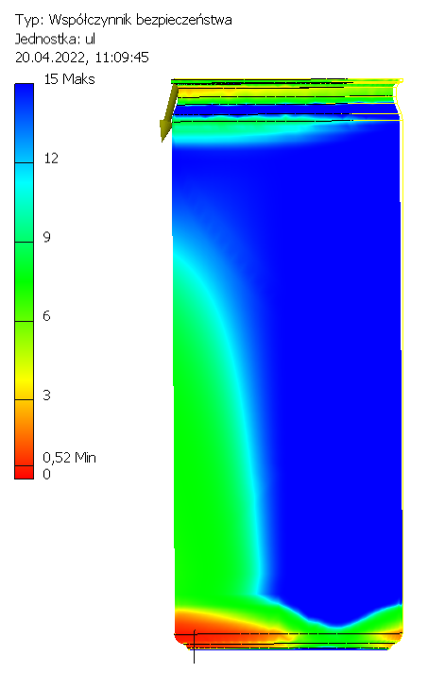
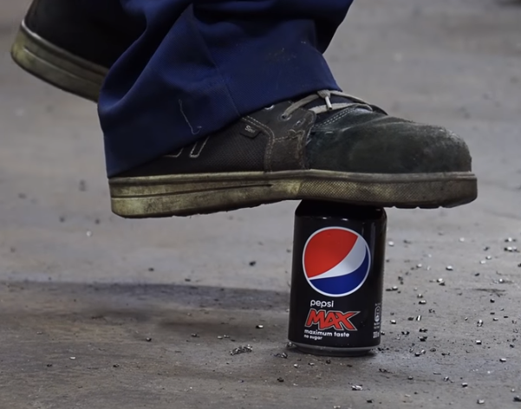
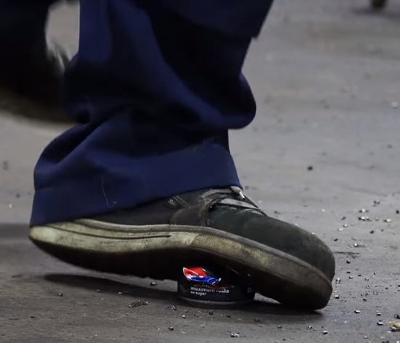
Safety factor = $\frac{failure load}{allowable load}$
The answer is NO if we stand on the can unevenly.
This is due the buckling.
Transnational Project Meeting & Teaching Stars
26 – 27 April 2022 TalTech Estonian Maritime Academy, Tallinn, Estonia.

Slide 15
Summary
The finite element method uses advanced mathematical operations, most of which are hidden from the user often without their knowledge.
The process of 3D graphic design uses Boolean algebra, which was developed over 100 years before CAD was developed.
The presented topic is only a fraction of the mathematical operations used in FEM. Differential equations, regressions, and polynomials are used to describe shape functions, generate meshes, loads, and interpret results.
Transnational Project Meeting & Teaching Stars
26 – 27 April 2022 TalTech Estonian Maritime Academy, Tallinn, Estonia.

Slide 16

Thank You for Your Attention!
☺
Transnational Project Meeting & Teaching Stars
26 – 27 April 2022 TalTech Estonian Maritime Academy, Tallinn, Estonia.

