Slide 1
MareMathics
Summer School - Split
20 -24 September 2021

Slide 2
Matrices
What are matrices and where do we use them?

Slide 3
Example

Slide 4
Application:
- in geometry
- in processing of digital photography
- model of consumer preference
- encryption and decoding of messages in cryptography
- analysis of an economic system
- regression line with the least square deviation from the given data set
- problem of transport and distribution
- traveling salesman problem

Slide 5
Matrix multiplication and its application

Slide 6
Matrix multiplication and its application
Problem 1:
First, we need to know how to find matrix $F=A⋅B$ if $A$ is a row matrix and $B$ is a column matrix with the same number of elements (as matrix $A$).
Remark:
Row matrix is a matrix that has only one row. Column matrix is a matrix that has only one column.
Solution to the Problem 1:
Watch the video ‘02 Example 1 - multiplication of a row matrix by a column matrix’!

Slide 7

Matrix multiplication and its application
Problem 2:
Find $F=A⋅B$ if $A=\left[\begin{matrix}5 & 2 \\ 7 & −1 \\ 1 & −5\end{matrix}\right]$ and $B=\left[\begin{matrix}2 & 3 & 1 & 4 \\ 2 & −2 & 4 & 0\end{matrix}\right]$.

Slide 8
Matrix multiplication and its application
Solution:
Matrix $F$ exists because number of rows of the second matrix ($B$) is equal to the number of columns of the first matrix ($A$).
It has 3 rows (because first matrix has 3 rows) and 4 columns (because second matrix has 4 columns). So, we have
$$F=A⋅B=\left[\begin{matrix}f_{11} & f_{12} & f_{13} & f_{14} \\ f_{21} & f_{22} & f_{23} & f_{24} \\ f_{31} & f_{32} & f_{33} & f_{34}\end{matrix}\right].$$

Slide 9
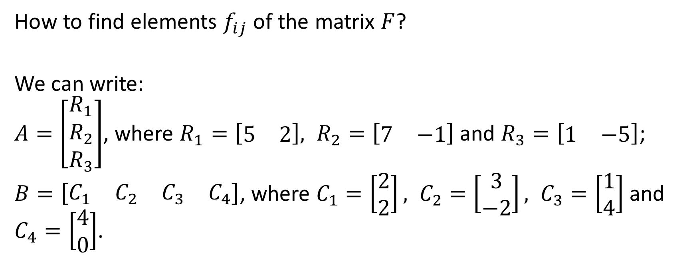
Matrix multiplication and its application
How to find elements $f_{ij}$ of the matrix $F$?
We can write:
$A=\left[\begin{matrix}R_{1} \\ R_{2} \\ R_{3}\end{matrix}\right]$, where $R_{1}=\left[\begin{matrix}5 & 2\end{matrix}\right], R_{2}=\left[\begin{matrix}7 & −1\end{matrix}\right]$ and $R_{3}=\left[\begin{matrix}1 & −5\end{matrix}\right]$;
$B=\left[\begin{matrix}C_{1} & C_{2} & C_{3} & C_{4}\end{matrix}\right]$, where $C_{1}=\left[\begin{matrix}2 \\ 2\end{matrix}\right], C_{2}=\left[\begin{matrix}3 \\ −2\end{matrix}\right], C_{3}=\left[\begin{matrix}1 \\ 4\end{matrix}\right]$ and $C_{4}=\left[\begin{matrix}4 \\ 0\end{matrix}\right]$.

Slide 10

Matrix multiplication and its application
Then
$$f_{12}=R_{1}⋅C_{2}=\left[\begin{matrix}5 & 2\end{matrix}\right]⋅\left[\begin{matrix}3 \\ −2\end{matrix}\right]=5⋅3+2⋅\left(−2\right)=11$$
$$f_{23}=R_{2}⋅C_{3}=\left[\begin{matrix}7 & −1\end{matrix}\right]⋅\left[\begin{matrix}1 \\ 4\end{matrix}\right]=7⋅1+\left(−1\right)⋅4=3$$
$$f_{31}=R_{3}⋅C_{1}=\left[\begin{matrix}1 & −5\end{matrix}\right]⋅\left[\begin{matrix}2 \\ 2\end{matrix}\right]=1⋅2+\left(−5\right)⋅2=−8$$

Slide 11
Matrix multiplication and its application
Remaining elements calculate by yourself.
In the end it is obtained
$$F=\left[\begin{matrix}14 & 11 & 13 & 20 \\ 12 & 23 & 3 & 28 \\ −8 & 13 & −19 & 4\end{matrix}\right].$$

Slide 12

Matrix multiplication and its application
Exercise tasks: Determine the matrix $F=A⋅B$ if
a) $A=\left[\begin{matrix}3 & −2\end{matrix}\right]$ and $B=\left[\begin{matrix}2 & 1\end{matrix}\right]$
b) $A=\left[\begin{matrix}−1 & 1 & 2 & 3\end{matrix}\right]$ and $B=\left[\begin{matrix}−1 & 2 & 0 \\ 2 & −1 & 0 \\ 0 & 5 & 2 \\ −1 & 8 & 1\end{matrix}\right]$
c) $A=\left[\begin{matrix}1 & 0 & 1 \\ −1 & 1 & 2\end{matrix}\right]$ and $B=\left[\begin{matrix}0 & 1 & −1 \\ 1 & 0 & 1 \\ 4 & 8 & 0\end{matrix}\right]$
d) $A=\left[\begin{matrix}1 & 0 & 1 \\ 2 & −2 & 1 \\ 0 & 0 & −1\end{matrix}\right]$ and $B=\left[\begin{matrix}1 & −1 & 4 \\ 1 & 1 & 0 \\ 0 & 4 & 1\end{matrix}\right].$

Slide 13
Matrix multiplication and its application
Solutions:
a)
Matrix $F$ is ​​not defined (i.e., does not exist) because the number of rows of matrix $B$ is ​​not equal to the number of columns of matrix $A$. Namely, matrix $B$ has $1$ row, and matrix $A$ has $2$ columns.
b) $F=\left[\begin{matrix}0 & 31 & 7\end{matrix}\right]$
c) $F=\left[\begin{matrix}4 & 9 & −1 \\ 9 & 15 & 2\end{matrix}\right]$
d) $F=\left[\begin{matrix}1 & 3 & 5 \\ 0 & 0 & 9 \\ 0 & −4 & −1\end{matrix}\right]$

Slide 14
Matrix multiplication and its application
Application of matrix multiplication
Watch videos:
05a Application of matrix multiplication - part 1.mp4
05b Application of matrix multiplication - part 2.mp4

Slide 15
Matrix rank and its application
Example:

Slide 16
Matrix rank and its application
We want to determine the current strength in all branches.
Using the method of contour currents, this problem is reduced to the following problem of solving a system of three linear equations with 3 unknowns.
$$\left\{\begin{matrix}10I_{1} & − & 4I_{2} & + & 0I_{3} & = & −0.24 \\ −4I_{1} & + & 14I_{2} & − & 2I_{3} & = & 0.14 \\ 0I_{1} & − & 2I_{2} & + & 6I_{3} & = & 0.22\end{matrix}\right.$$

Slide 17
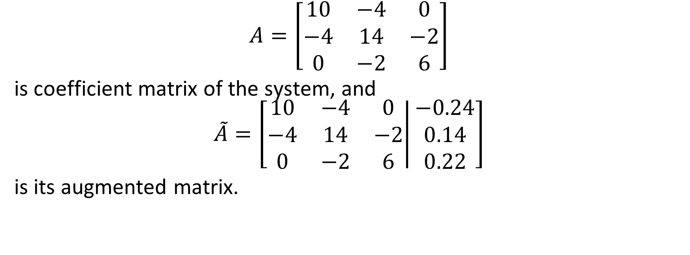
Matrix rank and its application
$$A=\left[\begin{matrix}10 & −4 & 0 \\ −4 & 14 & −2 \\ 0 & −2 & 6\end{matrix}\right]$$
is coefficient matrix of the system, and
$$\tilde{A}=\left[\left.\begin{matrix}10 & −4 & 0 \\ −4 & 14 & −2 \\ 0 & −2 & 6\end{matrix}\right|\begin{matrix}−0.24 \\ 0.14 \\ 0.22\end{matrix}\right]$$
is its augmented matrix.

Slide 18
Matrix rank and its application
It’s very important to find
$r\left(A\right)$ (that is rank of the matrix $A$) and
$r\left(\tilde{A}\right)$ (that is rank of the matrix $\tilde{A}$).
Why?
The rank of each matrix is an integer $≥0$ and it holds:
Our system has at least one solution only if $r\left(A\right)=r\left(\tilde{A}\right).$

Slide 19
Matrix rank and its application
So, if we want to find out if our system has a solution, we must know how to determine matrix rank.
How to determine rank of some matrix $A$?
Elementary transformations (on rows or columns) of the real matrix are:
a) replacing the position of any two rows (columns),
b) multiplying any row (column) by a number other than zero,
c) adding any row (column) to another row (column).

Slide 20
Matrix rank and its application
The rank of the real matrix does not change if elementary transformations are performed on the matrix.
We say that two real matrices of the same dimensions, A and B, are equivalent if one can be transformed from the other by applying finally many elementary transformations.
In such case we write A~B.
It means that equivalent matrices have the same rank.
The rank of the real matrix $A$ is ​​determined using the Gaussian method – by elementary transformations the matrix $A$ is transformed into an equivalent matrix $B$ in which all elements below the main diagonal determined by the elements $b_{11},b_{22},…$ are equal to zero.

Slide 21
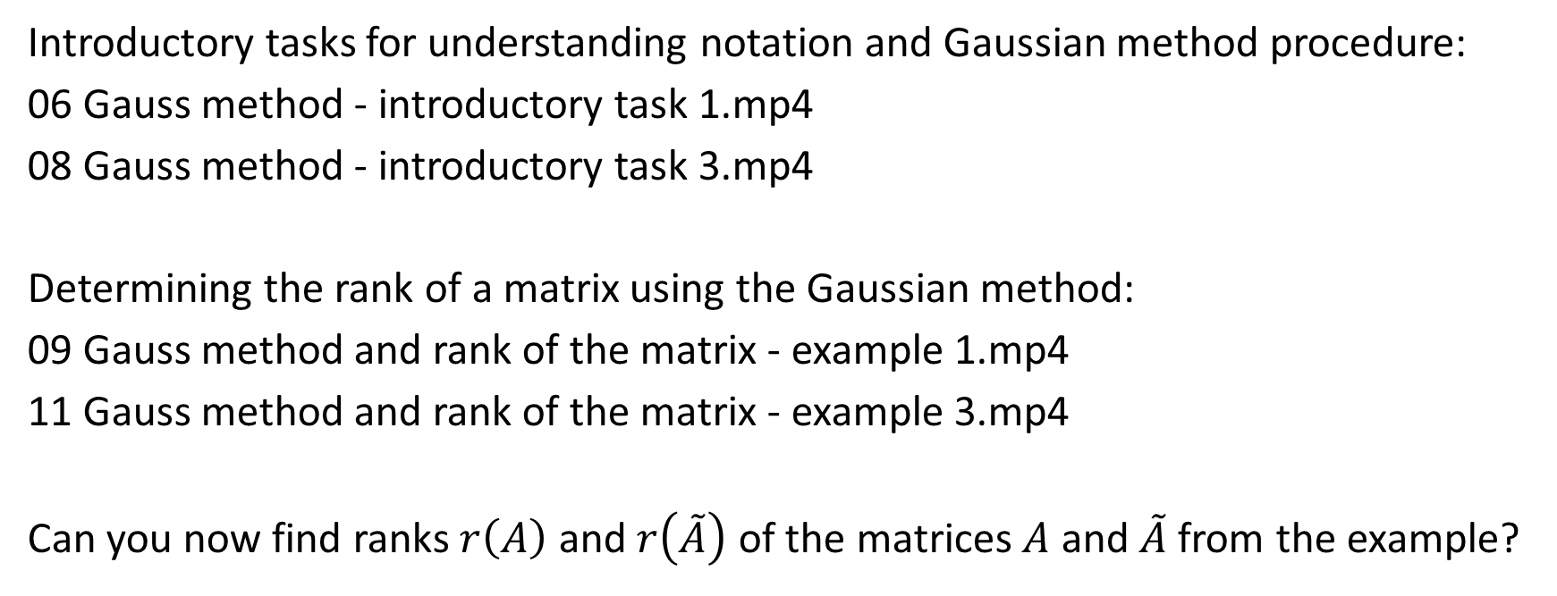
Matrix rank and its application
Introductory tasks for understanding notation and Gaussian method procedure:
06 Gauss method - introductory task 1.mp4
08 Gauss method - introductory task 3.mp4
Determining the rank of a matrix using the Gaussian method:
09 Gauss method and rank of the matrix - example 1.mp4
11 Gauss method and rank of the matrix - example 3.mp4
Can you now find ranks $r\left(A\right)$ and $r\left(\tilde{A}\right)$ of the matrices $A$ and $\tilde{A}$ from the example?

Slide 22
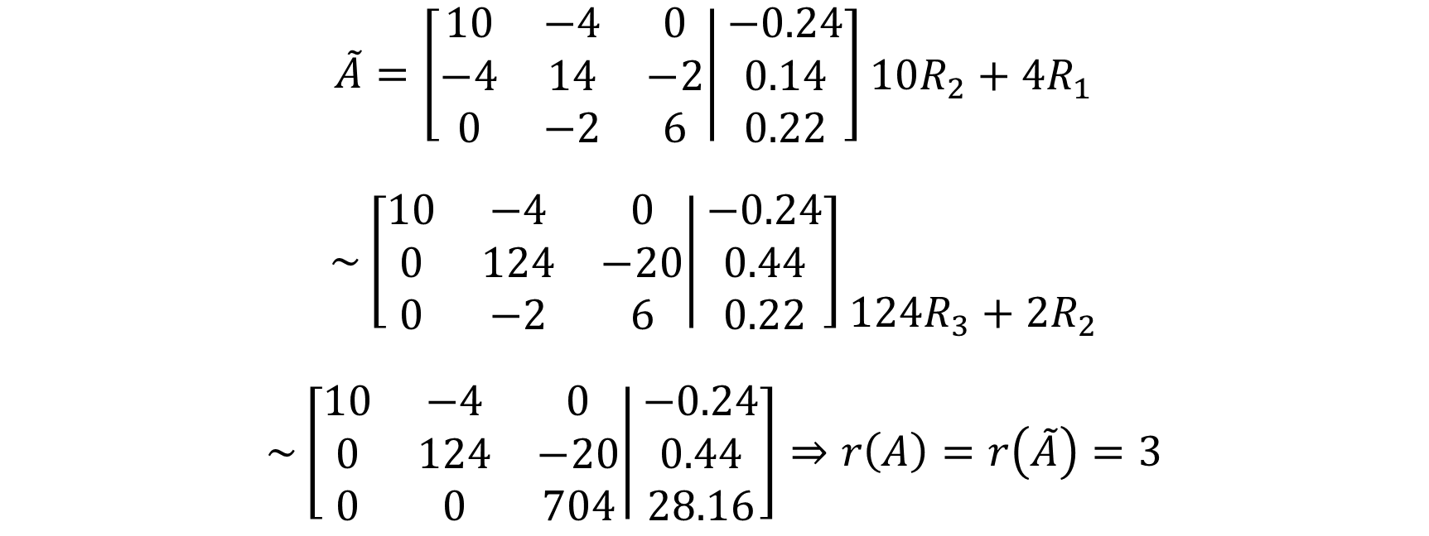
Matrix rank and its application
$$\tilde{A}=\left[\left.\begin{matrix}10 & −4 & 0 \\ −4 & 14 & −2 \\ 0 & −2 & 6\end{matrix}\right|\begin{matrix}−0.24 \\ 0.14 \\ 0.22\end{matrix}\right]\begin{matrix} \\ 10R_{2}+4R_{1} \\ \end{matrix}$$
$$\sim \left[\left.\begin{matrix}10 & −4 & 0 \\ 0 & 124 & −20 \\ 0 & −2 & 6\end{matrix}\right|\begin{matrix}−0.24 \\ 0.44 \\ 0.22\end{matrix}\right]\begin{matrix} \\ \\ 124R_{3}+2R_{2}\end{matrix}$$
$$\sim \left[\left.\begin{matrix}10 & −4 & 0 \\ 0 & 124 & −20 \\ 0 & 0 & 704\end{matrix}\right|\begin{matrix}−0.24 \\ 0.44 \\ 28.16\end{matrix}\right]⇒r\left(A\right)=r\left(\tilde{A}\right)=3$$

Slide 23
Matrix rank and its application
We conclude that our system has at least one solution.
How to determine how many solutions the system has?
Let $n$ be the number of unknowns. Then it holds:
If $n=r\left(A\right)$ the system has one solution.
If $n>r\left(A\right)$ the system has infintely many solutions.
Our system has exactly one soultion because we have $3$ unknowns (so $n=r\left(A\right)=3$).

Slide 24
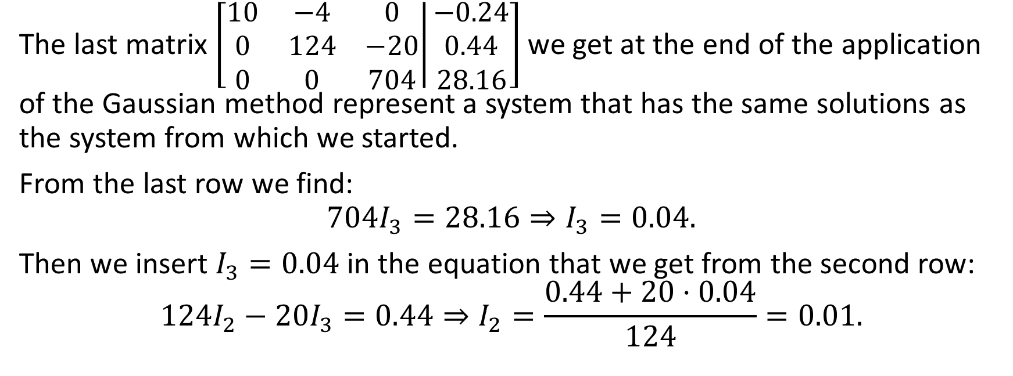
Matrix rank and its application
The last matrix $\left[\left.\begin{matrix}10 & −4 & 0 \\ 0 & 124 & −20 \\ 0 & 0 & 704\end{matrix}\right|\begin{matrix}−0.24 \\ 0.44 \\ 28.16\end{matrix}\right]$ we get at the end of the application of the Gaussian method represent a system that has the same solutions as the system from which we started.
From the last row we find:
$$704I_{3}=28.16⇒I_{3}=0.04.$$
Then we insert $I_{3}=0.04$ in the equation that we get from the second row:
$$124I_{2}−20I_{3}=0.44⇒I_{2}=\frac{0.44+20⋅0.04}{124}=0.01.$$

Slide 25
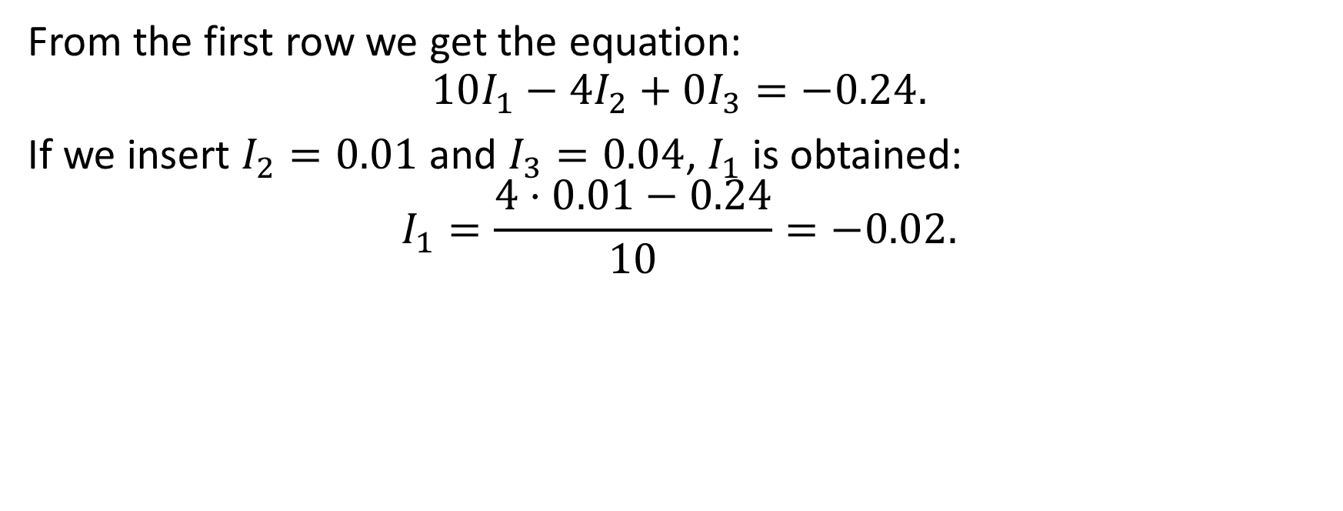
Matrix rank and its application
From the first row we get the equation:
$$10I_{1}−4I_{2}+0I_{3}=−0.24.$$
If we insert $I_{2}=0.01$ and $I_{3}=0.04$, $I_{1}$ is obtained:
$$I_{1}=\frac{4⋅0.01−0.24}{10}=−0.02.$$

Slide 26
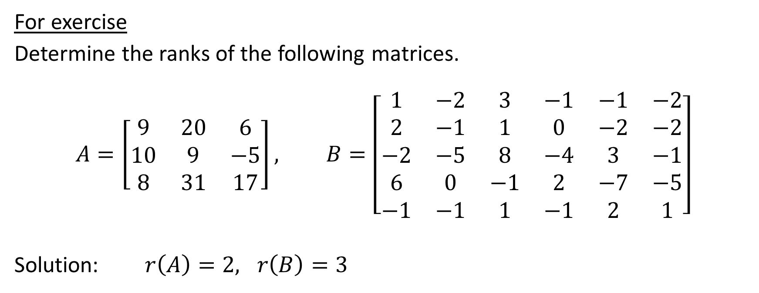
Matrix rank and its application
For exercise
Determine the ranks of the following matrices.
$$A=\left[\begin{matrix}9 & 20 & 6 \\ 10 & 9 & −5 \\ 8 & 31 & 17\end{matrix}\right], B=\left[\begin{matrix}1 & −2 & 3 & −1 & −1 & −2 \\ 2 & −1 & 1 & 0 & −2 & −2 \\ −2 & −5 & 8 & −4 & 3 & −1 \\ 6 & 0 & −1 & 2 & −7 & −5 \\ −1 & −1 & 1 & −1 & 2 & 1\end{matrix}\right]$$
Solution: $r\left(A\right)=2, r\left(B\right)=3$

Slide 27
Questions and tasks
1. Write one $3×2$ real matrix and mark all its elements.
2. Find $F=A⋅B$ if $A=\left[\begin{matrix}1 & 2 & 3 & 4\end{matrix}\right]$ and $B=\left[\begin{matrix}−2 \\ 3 \\ −4 \\ 5\end{matrix}\right].$
3. Matrices can be used in geometry and computer graphics.
What matrix operation did we use to describe symmetry and rotation in two dimensions?
4. List the elementary transformations on the rows (or columns) of the real matrix.
5. What method did we use to determine the rank of the matrix? Briefly describe that method.

Slide 28
Questions and tasks

Slide 29
Thank you for your attention!
"This project has been funded with support from the European Commission. This publication [communication] reflects the views only of the author, and the Commission cannot be held responsible for any use which may be made of the information contained therein".

