Slide 1
MareMathics
Teachers’ Training - Tallinn
Jelena Ligere, prof.
Latvian Maritime Academy - Riga

Slide 2
Ordinary Differential equations
Prepared:
Lecture notes (short theory, much examples)
Videos ( examples of solving of different kind of differential equations)
- separable differential equation,
- 1st kind linear differential equation (Method of Variation of Constants; Bernoulli method).
-2nd kind homogeneous differential equations with constant coefficients
Quizz

Slide 3
Ordinary Differential equations
Considered:
First order separable equations and Linear equations;
Second order linear differential equations with constant coefficients;
Main concept of Laplace transform and its applications for solving of differential equations

Slide 4
Ordinary differential equations
How to introduce?
Examples from applications

Slide 5
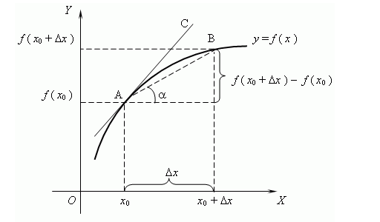
Prior Knowledge:
Important to recall the meaning of derivative

Slide 6
If y(t) describes a time-dependent process,
then describes the rate of the process (speed).
- the rate of the process at the time

Slide 7
What “differential equation” means?
A differential equation is an equation that involves both
an unknown function and its derivatives or differentials.
Example:

Slide 8
An order of a differential equation
is the order of the highest derivative that the equation contains.
A differential equation of the order n

Slide 9
Differential equations
Ordinary
differential equations
Partial
differential equations
Contains Partial derivatives
Contains derivatives
Describe proceses that depends
on ONLY ONE parameter (usually t)
Describes proceses that depends
on SEVERAL parameters (usually t,x,y,z)

Slide 10
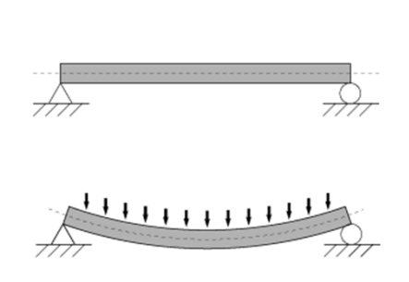
Example:
A beam is a constructive element capable to withstand heavy loads in bending.
The relationship between the beam's deflection w(x) and the applied load q(x) in case of small deflections:
q(x)
w(x)
x
Important in ships design!!!
Where E is the magnitude of elasticity of the beam,
I is the second moment of area of the beam's cross-section.
Function w(x) describes the deflection of the beam at some position x.

Slide 11
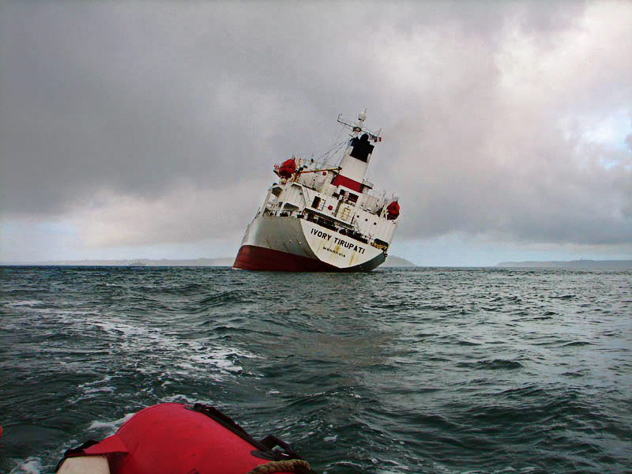
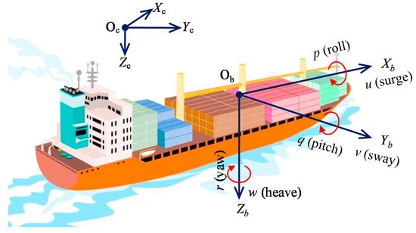
Example 2:
video
Rolling of a ship, occurring in calm water without resistance is described by the differential equation:
is the rolling amplitude at the time moment t,
is the circular frequency of free (natural)
vibrations during the rolling without resistance.

Slide 12
Taking into account the resistance during the rolling in calm water, the equation of motion takes the form
where is the relative coefficient of resistance

Slide 13
PARTIAL differential equation:
In physics and engineering contexts it is more common to consider the specific case of a function u(x, y, z, t) of three spatial variables (x, y, z) and a time variable t.
General form for U=U(x,y):

Slide 14
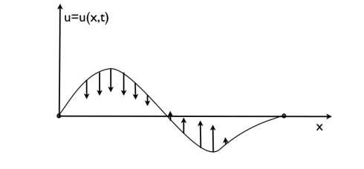
PARTIAL differential equation:
demo
Examples:
1)The eequation of a string vibration (one dimensional wave equation)
U=U(x,t) ?.

Slide 15
2)The wave equation
is a partial differential equation for the function of 4 variables U=U(x,y,z,t).
These equations describe the properties of most wave phenomena:
Describes vibration of the rectangular membrane

Slide 16
3)The heat equation (known also as the diffusion equation)
T=T(x,t) ? -temperature.

Slide 17
“ To Solve differential equation” - what does it means?
The solution of a differential equation is any function that satisfies the given equation identically.

Slide 18
Exercise: Let’s check, if the following functions are the solutions
of the differential equation

Slide 19
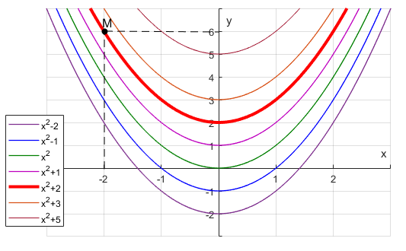
Example:
an arbitrary constant
The General solution

Slide 20
Solution of the 1st order ODE:
Solution of the 2nd order ODE:
Solution of the 3rd order ODE:
General solutions

Slide 21
Example:
The General solution
+
The Particular solution

Slide 22
1st order ODE:
The General solution
+
Initial condition
The Particular solution

Slide 23
There are different types of 1st order differential equations:
First order separable ODE
First order homogeneous ODE
First order linear ODE
First order Bernoulli ODE
and other types ...
CORRESPONDING method of solving
CORRESPONDING method of solving
CORRESPONDING method of solving
CORRESPONDING method of solving
CORRESPONDING method of solving

Slide 24
2) Some ODE from real life applications

Slide 25
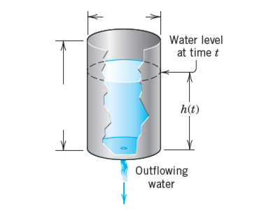
Liquid leakage problem: The liquid flows out of a cylindrical tank of radius R through a small hole of radius r at the bottom of the container.
Example 1:
Separable variable equation
2R
Assuming, that in the initial time moment t=0 the liquid level was H, find:
a) h(t)=?
Find the time T during which the liquid will completely drain out of the container.
H

Slide 26
Taking into account, that in the initial time moment t=0 the liquid level was H
the time T during which the liquid will completely drain out of the tank
The level of liquid h=0 at t=T

Slide 27
Example 2:
Cooling (heating) problems:
Heated body placed in an environment.
The cooling of the body is described by the differential equation:
T(t) is the temperature of the body ( function of time)
E(t) is the temperature of the environment
where k is a physical constant depending on the materials and sizes of the bodies

Slide 28
If the object, whose temperature is being modelled contains a source of heat, then the cooling of the body is described by the differential equation
where m is a positive constant, inversely proportional to the heat capacity of the object and
H(t) denotes the rate of heat generated inside the object.

Slide 29
Example:
A cup with boiling water stands in a room where the temperature is 20◦C. If T(t) is the temperature of the water at time t in minutes, then the cooling of the water is described by differential equation .
What is the sign of k?
Solve this differential equation. If the water cools down to 80◦C in 4 minutes, how long it will take to cool down to 50◦C?

Slide 30
Example 3:
video

Slide 31
Rolling of a ship, occurring in calm water without resistance
is described by the following differential equation:
2nd order homogeneous
linear differential equation
with constant coefficients
where is the rolling amplitude at the time moment t,
is the circular frequency of free (natural)
vibrations during the rolling without resistance.

Slide 32
Taking into account the resistance during the rolling in calm water, the equation of motion takes the form
where is the relative coefficient of resistance
The solution :

Slide 33
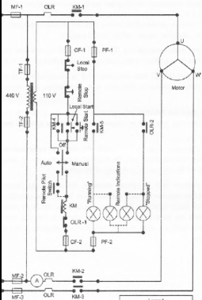
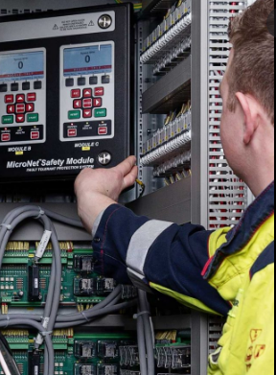
Example 3:
Any modern vessel has electrical and electro-mechanical systems.
An alternating-current electrical circuit is a component of any such system.
CURRENT admitted through a circuit is a function of t : I=I(t)

Slide 34
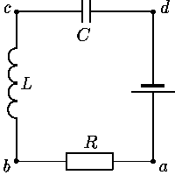
The easiest electrical circuit: a resistor-inductor-capacitor circuit (RLC)

Slide 35
For the case of changing voltage source powering the circuit:
where V(t) is the voltage source powering the circuit
Can be solved by using Laplace transform

Slide 36
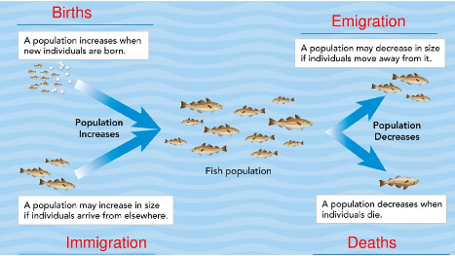
Example 5:
Dynamics of Fish population in the sea
Population dynamics describes the ways in which a given population grows and decreas over the time, as controlled by birth, death, and migration.

Slide 37
Dynamics of fish population P(t) in the sea
-Bernoulli equation
Where
k is the growth parameter
M is the carrying capacity, representing the largest population
that the environment can support

Slide 38
Thank you for your attention!
"This project has been funded with support from the European Commission. This publication [communication] reflects the views only of the author, and the Commission cannot be held responsible for any use which may be made of the information contained therein".

