Slide 1
Practical problems
Innovative Approach in Mathematical Education for Maritime Students
2019-1-HR01-KA203-061000
Elementary mathematics and applications of calculus
Ingrida Veilande Latvian Maritime Academy

Slide 2
Problem 1. The farmer has a lot of hens and chickens. They are growing naturally in the open air. The farmer decides to construct the chicken yard. He has 300 m of wire gaze and he wants to construct the rectangular yard with the maximal possible area. Calculate the size of this yard!
x
y
x

Slide 3
Solution of problem 1
Perimeter
P = 2x + 2y = 300 m
x
Area
$$\left.S = x∙y = x∙(150 − x\right)$$
Function
y
$$S(x) =150x−x^{2}$$

Slide 4
Algebraic calculation
$$S\left(x\right)=150x−x^{2}=−\left(x^{2}−150x\right)==−(x^{2}−2∙75x+{75}^{2}−{75}^{2})=$$
$=−({(x−75)}^{2}−{75}^{2})={75}^{2}−{(x−75)}^{2}$
y = 150 – x = 75
Answer: $S_{max}=x∙y={75}^{2}=5625m^{2}$

Slide 5
Analytic method
$$S(x) =150x−x^{2}$$
S’(x) =150 - 2x
S’(x) $=0$
$$150−2x=0; x=75$$
$$S_{max}=x∙y={75}^{2}=5625m^{2}$$

Slide 6
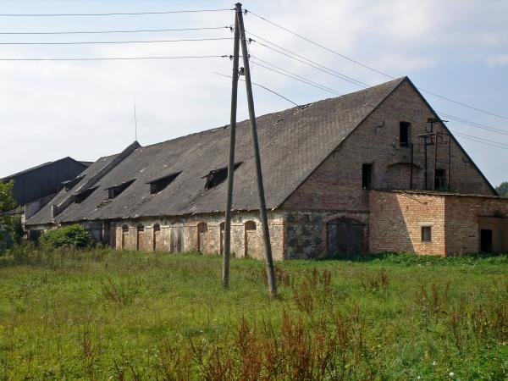
Problem 2. The rectangular yard must be constructed at the wall using 300 m of wire gaze for three sides of this yard. Find the lengths of the edges that the yard has a maximal area.

Slide 7
Solution of problem 2
Perimeter of the wire gaze
x
x
P = 2x + y = 300
y
Area of the yard
$$\left.S = x∙y = x∙(300−2x\right)$$
Function
$$S(x) =300x−{2x}^{2}$$

Slide 8
Calculation
$$S(x) =300x−2x^{2}$$
S’(x) =300 - 4x
S’(x)$=0$
$$x=75$$
$$Answer: S\left(75\right)=300∙75−2∙{75}^{2}=75∙150=11250 m^{2}$$
Answer to the previous problem 1 S = $5625{ m}^{2}$

Slide 9
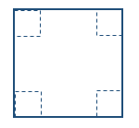
Problem 3. From the metallic sheet of size 2 x 2 m must be fabricated the container with maximal volume. The master will cut out the squares at the corners of metallic sheet and he will solder the edges. What size will have the squares?

Slide 10
Solution of problem 3
x
Side of the corner’s square x
Side of the bottom square 2 - 2x
Volume of the container
$$V(x) = {\left(2−2x\right)}^{2}x$$

Slide 11
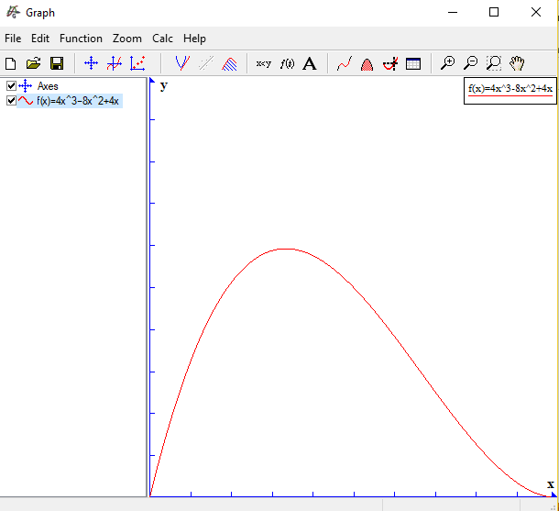
Graph of the
function V(x)
$$V\left(x\right)= {\left(2−2x\right)}^{2}x=$$
= $4x^{3}−8x^{2}+4x$
x

Slide 12
$$V(x) = {\left(2−2x\right)}^{2}x$$
Maximal value of the function is at the point x = c
Value V(x) < V(c) for all
$$x∈ [0; 1] and x ≠c$$
We will investigate similar function F(x)
$F(x) = {(1−x)}^{2}x = x − 2x^{2} + x^{3}$
$F(x) ≤ F(c)$

Slide 13
If $F(x) ≤ F(c)$ then
$$x^{3} − 2x^{2} +x ≤ c^{3} −2c^{2} + c$$
$$x^{3}−c^{3} − 2(x^{2} − c^{2}) +(x − c) ≤ 0$$
$$(x − c)(x^{2} +cx + c^{2} −2x − 2c +1) ≤ 0$$
Maximal value of the expression is when x = c. It gives
$${3x}^{2} − 4x + 1 = 0$$
$x=\frac{1}{3}$;
$$V=\frac{16}{27}≈0.5926$$
Answer:

Slide 14
Problem 4. For practical reasons the fitter has to fabric the steel plate of size 10 x 10 cm with a rectangular hole in the centre. Around the hole must be solder a wire. The weight of 1 cm ² of the plate is 2 g, the weight of 1 cm of the wire is 7 g. The diagonal of the rectangular hole is 5 cm long. The challenge is to make this detail of the maximal possible weight.
Sides of hole x and y
Diagonal d = 5 cm
d

Slide 15
Solution of problem 4
The weight of the plate
$2∙100 g$
d
The weight of the catted out part 2xy
The weight of wire
$$\left.7⋅(2x+2y\right)$$
The weight of detail
$$\left.W=200−2xy+14(x+y\right)$$
The lengths of diagonal
$d^{2}=x^{2}+y^{2}$=25

Slide 16
To express the weight as a function with respect of one argument we will do algebraic transformations
$$\left.W=200−2xy+14(x+y\right)$$
$$x^{2}+y^{2}=x^{2}+y^{2}+2xy−2xy={\left(x+y\right)}^{2}−2xy=25$$
$$\left.W(x,y)=200−2xy+14\left(x+y\right)=200−({\left(x+y\right)}^{2}−25)+14(x+y\right)$$
By the substitution t = x + y
$$W(t)=200−(t^{2}−25)+14t=−t^{2}+14t+225$$

Slide 17
Let us derivate the function
$$W(t)=−t^{2}+14t+225$$
$$W′(t)=−2t+14$$
At the t=7 the function has their maximal value
$$W(t)=−49+14∙7+225=274 g$$
To find the size of the hole
$$\left\{\begin{matrix}x+y=7 \\ x^{2}+y^{2}=25\end{matrix}\right.$$

Slide 18
The solution of the system
$$\left\{\begin{matrix}x+y=7 \\ x^{2}+y^{2}=25\end{matrix}\right.$$
$$\left\{\begin{matrix}x+y=7 \\ {\left.2xy=(x+y\right)}^{2}−25\end{matrix}\right.$$
$$\left\{\begin{matrix}x+y=7 \\ xy=12\end{matrix}\right.$$
d
Answer: (x; y) = (3; 4) or (x; y) = ( 4; 3)
The detail has their maximal weight if the hole is of size 3 x 4 cm; W = 274 g

Slide 19
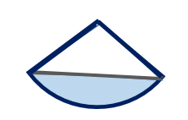
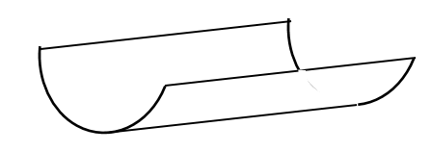
Problem 5. We want to conduct water through a bended rectangular piece of metal so that the section of the piece is an arc of circumference. Calculate the value of the angle $∝$ that the shadowed region $S(α)$ is maximal (and therefore the amount of water through it).
O
$$∝$$
A
B
S($∝$ )
l

Slide 20
Solution of problem 5
The angle of the sector in radians
$$\hat{AOB}= ∝$$
$$0<∝≤2π$$
The radius of the correspondent circumference r = OB
The lengths of the arc
$$l=r∝$$
The area of the segment $\breve{AlB}$
O
$$∝$$
$S\left(α\right)=S\left({AOB}_{sector}\right)−S(∆AOB)$
A
B
S($∝$ )
$$S\left(α\right)=\frac{α}{2}r^{2}−\frac{1}{2}r^{2}sinα$$
l

Slide 21
$S\left(α\right)=\frac{α}{2}r^{2}−\frac{1}{2}r^{2}sinα$ =
= $\frac{r^{2}}{2}\left(α−sinα\right)=\frac{l^{2}}{2α^{2}}\left(α−sinα\right)=$
=$\frac{l^{2}}{2}∙\frac{α−sinα}{α^{2}}$
/Because of
$$l=r∝/$$
Let us investigate the function
$$S\left(x\right)=\frac{x−sinx}{x^{2}}$$

Slide 22
$$S\left(x\right)=\frac{x−sinx}{x^{2}}$$
The derivative
$S′\left(x\right)=\frac{\left(1−cosx\right)x^{2}−2x(x−sinx)}{x^{4}}$=
= $\frac{x(\left(1−cosx\right)x−2(x−sinx))}{x^{4}}$=
= $\frac{\left(1−cosx\right)x−2(x−sinx)}{x^{3}}$=
= $\frac{2sinx−x\left(1+cosx\right)}{x^{3}}$

Slide 23
To find the critical points of the derivative
S’(x)= $\frac{2sinx−x\left(1+cosx\right)}{x^{3}}$=
= $\frac{2∙2sin\frac{x}{2}cos\frac{x}{2}−x∙2\cos^{2}\frac{x}{2}}{x^{3}}=$
=$\frac{4\cos^{2}\frac{x}{2}}{x^{3}}(tan\frac{x}{2}−\frac{x}{2})$

Slide 24
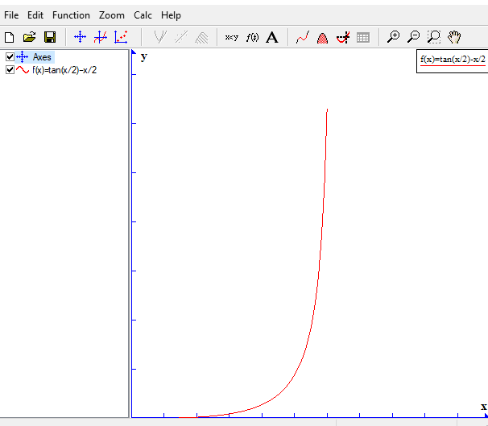
The graph of the function
$$f\left(x\right)=\tan\left(\frac{x}{2}\right)−\frac{x}{2}$$
$$f\left(x\right)>0 at 0<x<π$$
$$f\left(x\right) is not defined at x=π$$

Slide 25
The critical points for the derivative
S’(x) = $\frac{4\cos^{2}\frac{x}{2}}{x^{3}}(tan\frac{x}{2}−\frac{x}{2})$
are when
$\cos^{2}\frac{x}{2}$ = 0
$$for 0<x≤2π$$
We get
$$x= π$$
Answer: the area of the segment is
$$S\left(π\right)=\frac{l^{2}}{2π^{2}}\left(π−sinπ\right)=\frac{l^{2}}{2π}$$

Slide 26
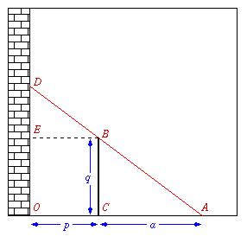
Problem 6. A fence q metre tall runs parallel to a building at a distance of p metre from the building. What is the length of
the shortest ladder AD that can reach from the ground over the fence to the wall of the building?

Slide 27
Solution of problem 6
By the theorem of Pythagoras
$${AD}^{2}={OA}^{2}+{OD}^{2}$$
where OA = p + a
and OD = q + ED
From the similarity of triangles ABC and BDE
$$\frac{ED}{CB}=\frac{EB}{CA}$$
$$\frac{ED}{q}=\frac{p}{a}$$
or

Slide 28
The length of ladder
$${l\left(a\right)=AD=\sqrt{{(q+\frac{pq}{a})}^{2}+{(p+a)}^{2} } }^{}$$
We will find the minimal value of the function
f(a)=${(q+\frac{pq}{a})}^{2}+{(p+a)}^{2}$

Slide 29
Let us derivate the function with respect to a
f(a)=${(q+\frac{pq}{a})}^{2}+{(p+a)}^{2}$
$f′(a)=$2(q+$\frac{pq}{a})\left(−\frac{pq}{a^{2}}\right)+2\left(p+a\right)=$
=2q(a + p) $\left(−\frac{pq}{a^{2}}\right)$+$2\left(p+a\right)$=
=2(p + a)(1 - $\frac{pq^{2}}{a^{3}})$

Slide 30
Extreme value is when
(1 - $\frac{pq^{2}}{a^{3}})=0$
$\frac{pq^{2}}{a^{3}}=$1
$a=\sqrt[3]{pq^{2}}$
$a<\sqrt[3]{pq^{2}}$
then
(1 - $\frac{pq^{2}}{a^{3}})<0$
If
If
$a>\sqrt[3]{pq^{2}}$
then
(1 - $\frac{pq^{2}}{a^{3}})>0$

Slide 31
The minimal value of a is
$a=\sqrt[3]{pq^{2}}$
Answer:
The length of the shortest ladder at the variable a
$l\left(a\right)=\sqrt{f\left(a\right)}=$
=$\sqrt{{(q+\sqrt[3]{p^{2}q})}^{2}+{(p+\sqrt[3]{pq^{2}})}^{2}}$

Slide 32
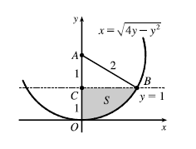
Problem 7. Find the area of the region
$$S=\left\{\left.(x, y)\right|x≥0, y≤1,x^{2}+y^{2}≤4y\right\}$$
The region is a part of the circle
$$x^{2}+{(y−2)}^{2}=4$$
The area is
$$S=\int_{0}^{1}{\sqrt{4y−y^{2}}dy}$$

Slide 33
Calculation by substitution
$$S=\int_{0}^{1}{\sqrt{4y−y^{2}}dy}$$
$$\int_{0}^{1}{\sqrt{4y−y^{2}}dy}=\int_{0}^{1}{\sqrt{4−{(y−2)}^{2}}dy}$$
$$y−2=2sint;dy=2costdt; t_{1}=−\frac{π}{2}; t_{2}=−\frac{π}{6}$$
$$\int_{−π/2}^{−π/6}{\sqrt{4−4\sin^{2}t}∙2costdt}=2\int_{−π/2}^{−π/6}{(1+cos2t)dt}$$

Slide 34
$$=2\int_{−π/2}^{−π/6}{\left(1+cos2t\right)dt=2(t+\frac{1}{2}sin2t)\left|\begin{matrix}−π/6 \\ −π/2\end{matrix}=\right.}$$
$$=2\left(\frac{π}{3}−\frac{1}{2}∙\frac{\sqrt{3}}{2}\right)=\frac{2π}{3}−\frac{\sqrt{3}}{2}$$
Answer:
The area of the region is
S =$\frac{2π}{3}−\frac{\sqrt{3}}{2}$

Slide 35
Geometric approach
In the triangle ABC
$$∡CAB=60°=\frac{π}{3}$$
The area of the region is a difference
$$S={OAB}_{sector}−∆ABC$$
$$S=\frac{1}{2}∙2^{2}∙\frac{π}{3}−\frac{1}{2}∙1∙\sqrt{3}$$
Answer: S =$\frac{2π}{3}−\frac{\sqrt{3}}{2}$

