Slide 1
MareMathics
Teachers’ Training - Tallinn
prof. Zvonimir Lušić, PhD
University of Split
Faculty of Maritime Studies

Slide 2
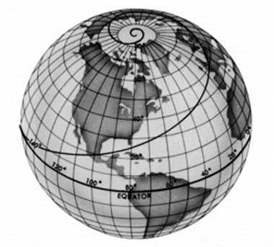
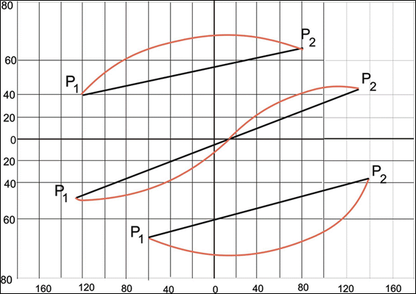
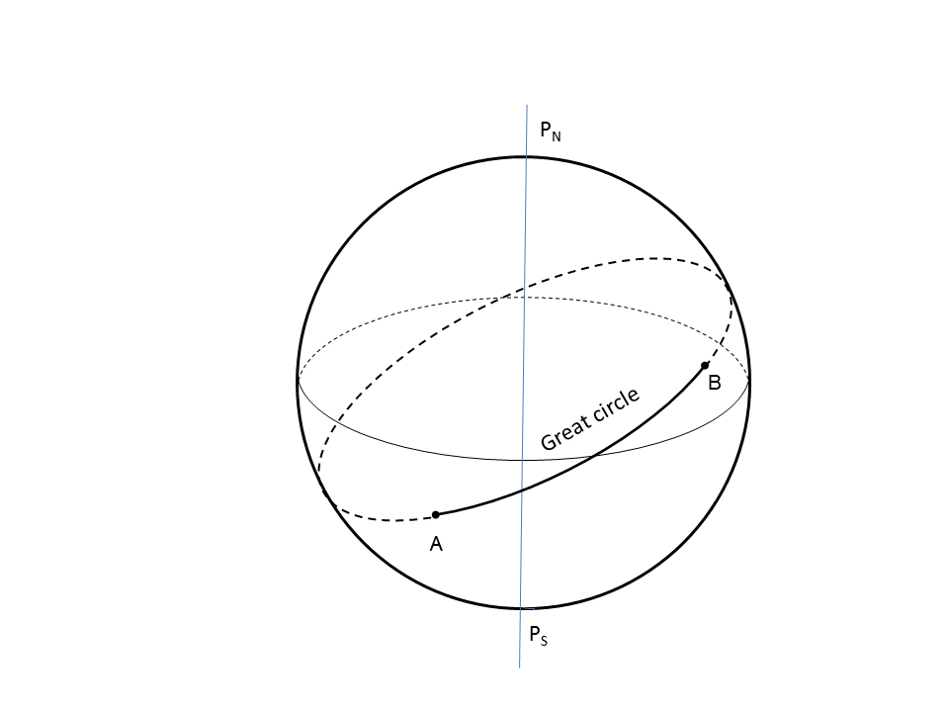
RHUMB LINE (RL) AND GREAT CIRCLE (GC)
A common problem in navigation:
calculating the course and the distance between two positions
Rhumb line (loxodrome)
Great circle (orthodrome)
Rhumb line (straight line) and Great circle (curve)
on the Mercator projection chart

Slide 3
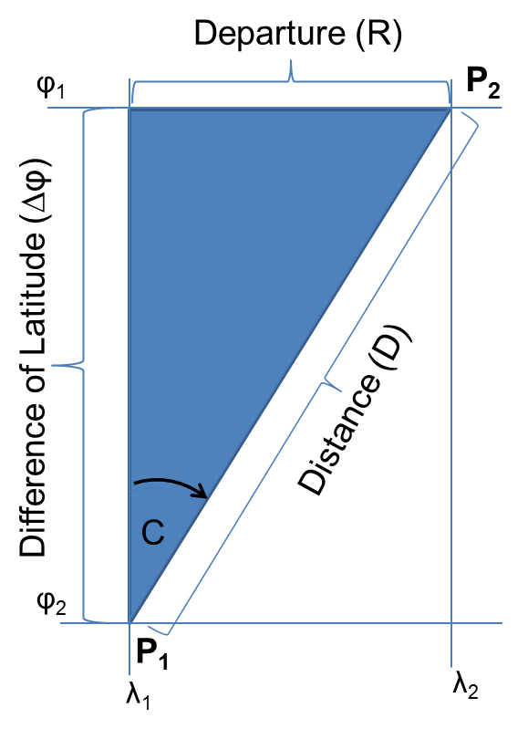
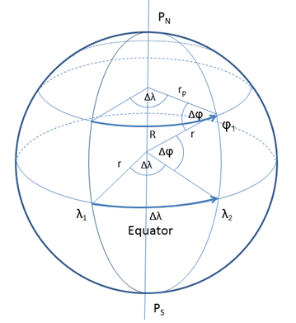
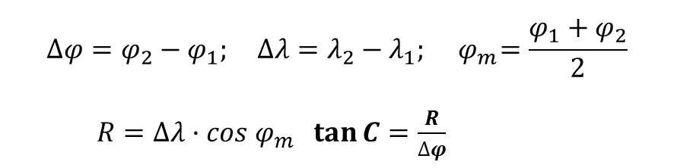
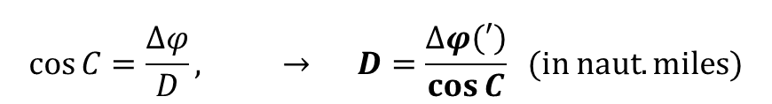
Plane sailing (RL)-mean latitude method
$$∆φ=φ_{2}−φ_{1}; ∆λ=λ_{2}−λ_{1}; { φ}_{m}=\frac{φ_{1}+φ_{2}}{2}$$
$R=∆λ·cos{ φ}_{m}$ $\tan{C=\frac{R}{∆φ}}$
$$\cos{C=\frac{∆φ}{D}}, → D=\frac{∆φ\left(′\right)}{\cos{C}} (in naut. miles)$$
The most common problems / errors:
wrong use of units,
knowledge of the nautical mile,
expressing angles in a circular scale, ...
Plane sailing triangle
Departure-The arc of
parallel of Latitude
(in n.m.)

Slide 4
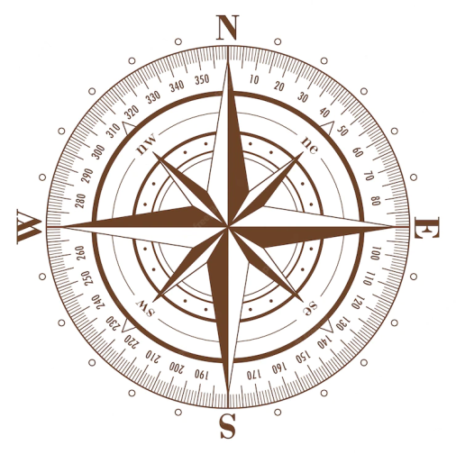
Plane sailing (RL)-mean latitude method
I. Quadrant
II. Quadrant
III. Quadrant
IV. Quadrant
N(0°)
Ship Course 315°
W(270°)
E(90°)
S(180°)
Rules for the course transformation, from the quarter-circle scale to the circular scale
https://www.geogebra.org/m/ngt5m9a6
Compass rouse

Slide 5
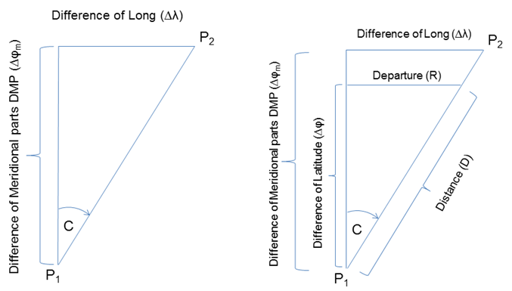

Mercator sailing
$$tanC=\frac{∆λ}{∆φ_{M}} → D=\frac{∆φ\left(′\right)}{\cos{C}}$$
1’= 1 nautical mile
φ_{M} - Mercator latitude
Mercator triangle and comparison of Mercator
and Plane sailing triangle

Slide 6
∆λ_not always mathematical solution, when crossing 180 meridian
it is reduced to a shorter arc

Slide 7
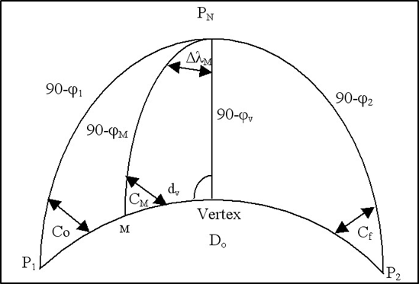
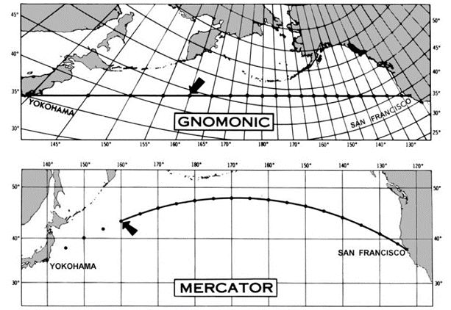
Great Circle sailing
Orthodromic spherical triangle

Slide 8
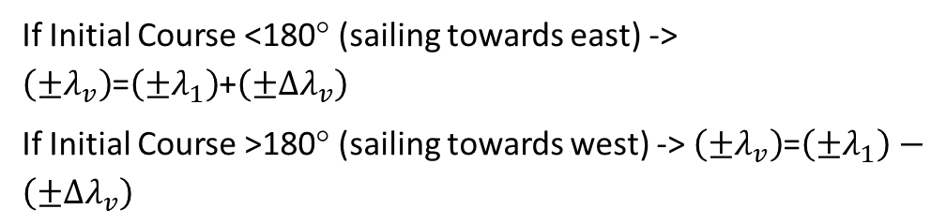

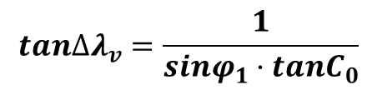
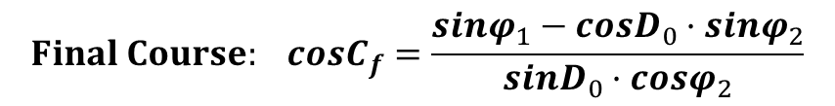
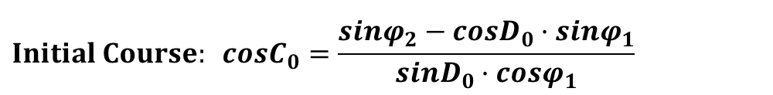
$$Distance: cos{D_{0}}=sinφ_{1}·sinφ_{2}+cosφ_{1}·cosφ_{2}·cos∆λ$$
$$Initial Course: cosC_{0}=\frac{sinφ_{2}−cosD_{0}·sinφ_{1}}{sinD_{0}·cosφ_{1}}$$
If ∆λ positive (sailing towards east)-> Initial Course = C₀
If ∆λ negative (sailing towards west)-> Initial Course = 360° - C₀
$$Final Course: cosC_{f}=\frac{sinφ_{1}−cosD_{0}·sinφ_{2}}{sinD_{0}·cosφ_{2}}$$
If ∆λ positive (sailing towards east)-> Final Course = 180 - C_{f}
If ∆λ negative (sailing towards west)-> Final Course = 180° + C_{f}
If Initial Course <180° (sailing towards east) -> $\left(±λ_{v}\right)$=$\left(±λ_{1}\right)$+$\left(±∆λ_{v}\right)$
If Initial Course >180° (sailing towards west) -> $\left(±λ_{v}\right)$=$\left(±λ_{1}\right)−\left(±∆λ_{v}\right)$
$$Vertex: cosφ_{v}=sinC_{0}·cosφ_{1}$$
$$tan∆λ_{v}=\frac{1}{sinφ_{1}·tanC_{0}}$$
The intersection of the Great Circle and the Equator: $λ_{e}=λ_{v}±90°$
$$\text{Intermediate} \text{positions}: tanφ_{M}={tanφ}_{v}·cos\left(λ_{v}−λ_{M}\right)$$
The biggest challenges — choosing a +/- sign and a Vertex position

Slide 9
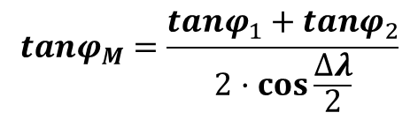
Other GC methods
$$tanφ_{M}=\frac{cosφ_{1}·sinφ_{2}·sin\left(λ_{M}−λ_{1}\right)−cosφ_{2}·sinφ_{1}·sin\left(λ_{M}−λ_{2}\right)}{\left.cosφ_{1}·cosφ_{2}·sin(λ_{2}−λ_{1}\right)}$$
Direct (meridian) method
$$tanφ_{M}=\frac{tanφ_{1}+tanφ_{2}}{2·\cos{\frac{∆λ}{2}}}$$
Latitude equation of the mid Longitude
Tangent method. The total Great circle distance is divides on more symmetrical parts, depending on how many courses should be between starting and ending positions. Each leg is different according to a predefined change of course (for example 1 °).
Great circle for the spheroid

Slide 10
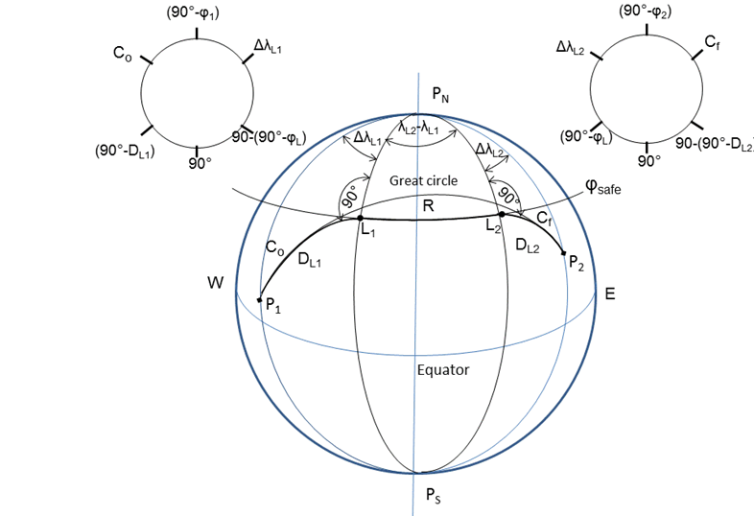
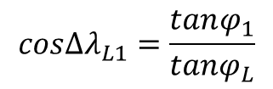
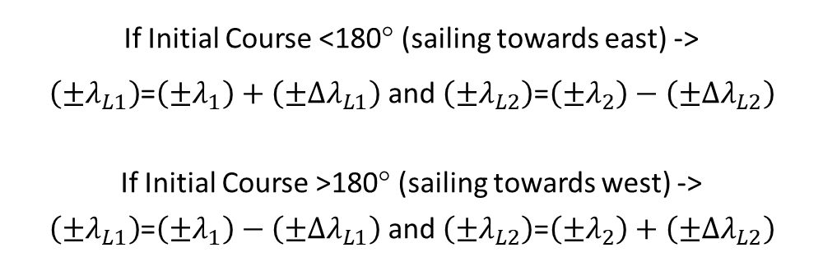
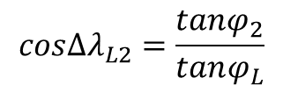
Composite sailing
Combination of parallel and great circle sailing, i.e. a method of sailing along the shortest route possible without crossing safe (limiting) parallel
$$cos∆λ_{L1}=\frac{tanφ_{1}}{tanφ_{L}}$$
$$cos∆λ_{L2}=\frac{tanφ_{2}}{tanφ_{L}}$$
If Initial Course <180° (sailing towards east) ->
$\left(±λ_{L1}\right)$=$\left(±λ_{1}\right)+\left(±∆λ_{L1}\right)$ and$\left(±λ_{L2}\right)$=$\left(±λ_{2}\right)−\left(±∆λ_{L2}\right)$
If Initial Course >180° (sailing towards west) ->
$\left(±λ_{L1}\right)$=$\left(±λ_{1}\right)−\left(±∆λ_{L1}\right)$ and$\left(±λ_{L2}\right)$=$\left(±λ_{2}\right)+\left(±∆λ_{L2}\right)$

Slide 11
Conclusion-the main problems
converting the angles (RL) of a quarter-circle scale to a circular one
converting calculated GC courses to the real ones (from quarter-circle and semicircular to circular scale )
need to reduce ∆λ to a shorter arc, when crossing 180 meridian
position of the Vertex and use of (single) formula for calculating all waypoints
errors in the sign of variables (+,-) in general
use of units (°->° ‘ ‘’; degrees to Hour angles, concept of naut. miles, ...)

Slide 12
Thank you for your attention!
"This project has been funded with support from the European Commission. This publication [communication] reflects the views only of the author, and the Commission cannot be held responsible for any use which may be made of the information contained therein".

