Slide 1
MareMathics
Teachers’ Training - Tallinn
Miro Petković, mag. ing.
University of Split
Faculty of Maritime Studies

Slide 2
Series RLC Circuit Analysis
Differential equations – Maremathics section 8.
Derivative – Maremathics section 6.1 and 6.2
Properties of Continuous Real Function – Maremathics section 6.8
Notes:
Miro Petković – Department for electrical engineering and IT

Slide 3
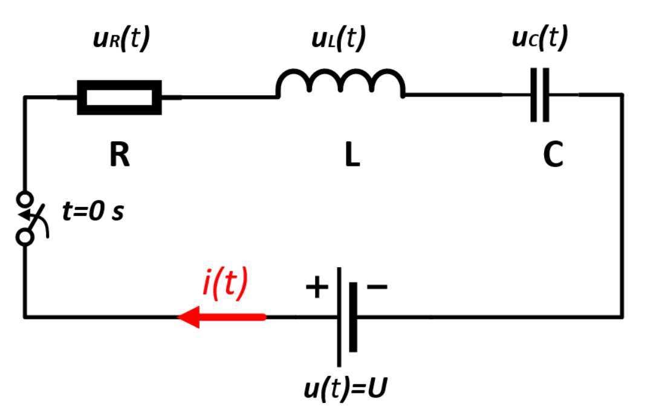
Series RLC Circuit Analysis
What will happen immediately after the closing of the switch at t=0 s ?
Current is still 0 A since inductor L does not allow sudden change of the current, (First condition)
Resistor voltage is 0 V,
Voltage on capacitor is 0 V because he is fully discharged
According to Kirchoff voltage law we conclude that at t=0 s, the inductor voltage is equal to the source voltage. (Second condition)
$$u_{L}\left(0\right)=L\frac{di(t=0)}{dt}=U → \frac{di(t=0)}{dt}=\frac{U}{L}$$
Notes:
Series RLC circuit is connected to constant DC voltage source. We assume that before the closing of the switch the capacitor is fully discharged. According to this assumption, initial conditions in the circuit are: current is 0A, Uc=0V, UL= 0V (coil voltage).

Slide 4
Series RLC Circuit Analysis
At t=0 s : $u_{R}\left(t\right)+u_{L}\left(t\right)+u_{C}\left(t\right)=U$
We apply voltage drop for each element:
$$R∙i\left(t\right)+L\frac{di\left(t\right)}{dt}+\frac{1}{C}\int{i\left(t\right)dt}=U$$
Now this equation will be derived by time and divided by L and we will obtain homogenous linear differential equation of second order:
$$\frac{di^{2}\left(t\right)}{dt^{2}}+\frac{R}{L}\frac{di\left(t\right)}{dt}+\frac{1}{LC}i(t)=0$$
Notes:
After closing the switch at the time of t=0s we apply Kirchoff voltage law as follows. Resistor voltage plus coil voltage plus capacitor voltage equals source voltage.
Then we apply voltage drop for each element: Resistance times current as a function of time plus coil inductance times time derivative of current plus reciprocal (resiprikl) value of capacitance times integral of current equals source voltage.
Now this equation will be derived by time and divided by L (inductance) and we will obtain homogenous linear differential equation of second order.

Slide 5
Series RLC Circuit Analysis
$$\frac{di^{2}\left(t\right)}{dt^{2}}+\frac{R}{L}\frac{di\left(t\right)}{dt}+\frac{1}{LC}i(t)=0$$
Figure 1. Maremathics section 9.3.2 – Differential equations
Notes:
As can be seen, the shape of our equation is similar as the example provided by Marematics section on Differential equations.
Where students can remind themself what linear homogenous differential equations are and how to solve them.
Where in our example constant a1 is 1, a2 is resistance divided by inductance and a3 is the reciprocal of inductance times capacitance.
Our aim is to find current function that satisfies this differential equation.

Slide 6
Series RLC Circuit Analysis
Figure 2. Maremathics section 9.3.2 – Differential equations
$$k^{2}+\frac{R}{L}k+\frac{1}{LC}=0$$
Our characteristic equation is :
$$k_{1,2}=\frac{−\frac{R}{L}±\sqrt{{\left(\frac{R}{L}\right)}^{2}−\frac{4}{LC}}}{2}$$

Slide 7
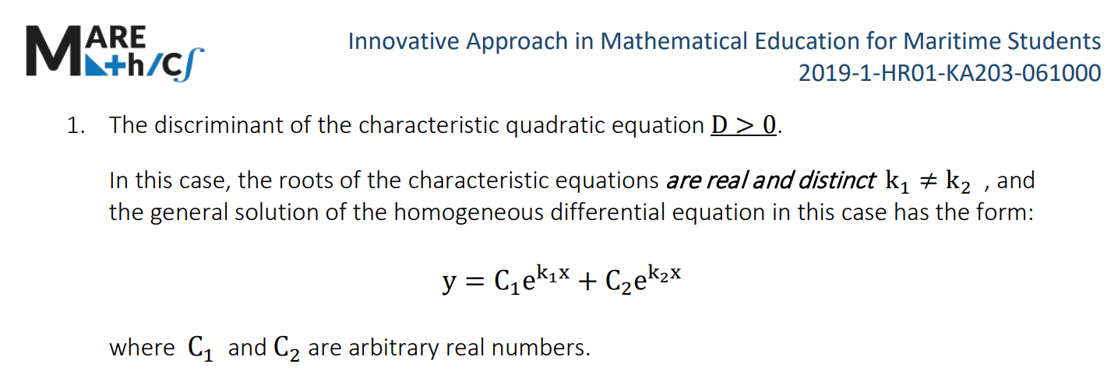
Series RLC Circuit Analysis
We solve this equation for following set of parameters: R = 15 Ω ; L = 0.5 mH ; C = 10 μF ; U = 3 V
$$D=\sqrt{{\left(\frac{R}{L}\right)}^{2}−\frac{4}{LC}}=10 000$$
Discriminant:
$$k_{1}=−10 000 k_{2}=−20 000$$
Figure 3. The general solution when the discriminant is greater than 0
Notes:
We solve this equation for following set of parameters: R = 15 Ω ; L = 0.5 mH ; C = 10 μF ; U = 3 V
According to Marematics we have to calculate the discriminant of the characteristic equation: As can be seen our discriminant is greater than zero

Slide 8
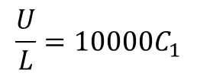
Series RLC Circuit Analysis
So the general solution of the differential equation:
$$i\left(t\right)=C_{1}e^{−10000t}+C_{2}e^{−20000t}$$
First condition say that at t=0 s , $i\left(0\right)=0 A$
$$C_{1}=−C_{2}$$
Second condition say that at t=0 s , $\frac{di(t=0)}{dt}=\frac{U}{L}$
$$\frac{di}{dt}={−10000C}_{1}e^{−10000t}+20000C_{1}e^{−20000t}$$
$$\frac{U}{L}=10000C_{1}$$
$$C_{1}=0.6$$
Figure 4. Maremathics section 6.2.
Notes:
With this equation we obtain the roots of the characteristic equation and we can see that our roots are real and distinct.
So the general solution of our differential equation:
Now we need to calculate konstant C1 and C2.

Slide 9
Series RLC Circuit Analysis
Finally, particular solution of differential equation is:
$$i\left(t\right)=0.6e^{−10000t}−0.6e^{−20000t}$$
Figure 6. Marematics section 6.8
Figure 5. Response of series RLC circuit from 0 ms to 1 ms
Notes:
With this equation we obtain the roots of the characteristic equation and we can see that our roots are real and distinct.
So the general solution of our differential equation:
Now we need to calculate konstant C1 and C2.

Slide 10
Thank you for your attention!
"This project has been funded with support from the European Commission. This publication [communication] reflects the views only of the author, and the Commission cannot be held responsible for any use which may be made of the information contained therein".

