Slide 1
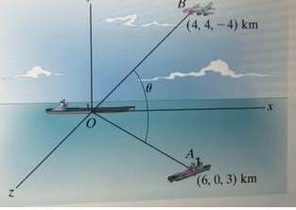
MareMathics
Vector Applications in Real Life

Slide 2
APPLICATIONS OF VECTOR
Force, Torque and Velocity
Military Usage
Projectile
In gaming
Avoiding Crosswind

Slide 3
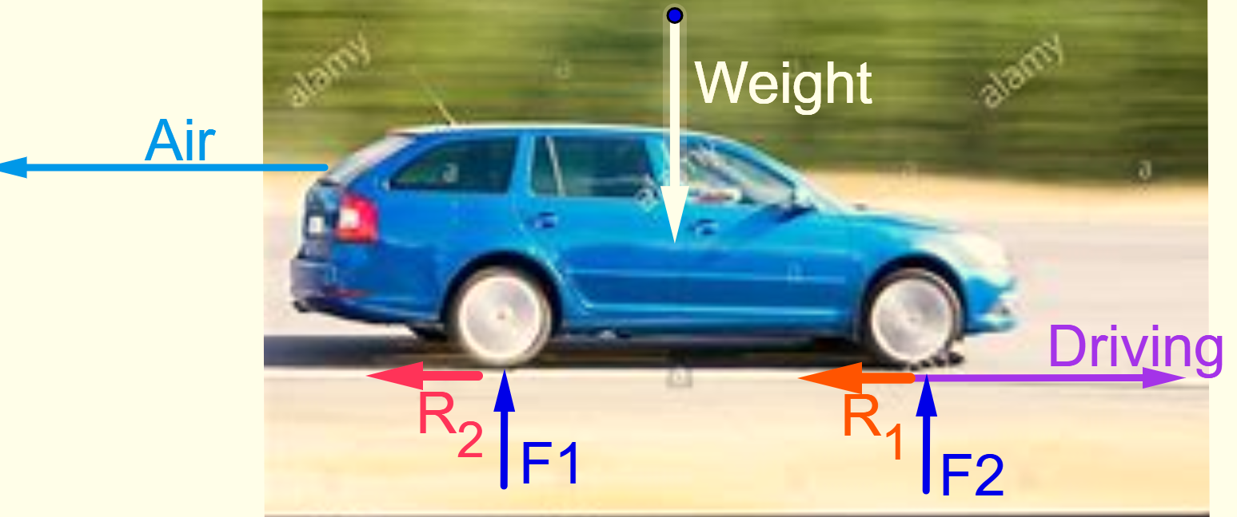
Example: In a driving down car the tire has mass. It has also initial and final velocity,
acceleration and gravitational reaction, friction forces and due to rotation it has torque.
Question: The engine is working hard, so why doesn't the car continue to accelerate?
Answer: Because the driving force is balanced by:
  Air resistance
  Rolling resistance
Like this:
For getting the results we need vectors.
Force is a vector.
Where:
R₁ and R₂ are the rolling resistance of the tires
F1 and F2 are the reaction forces (balancing out the car's weight)

Slide 4
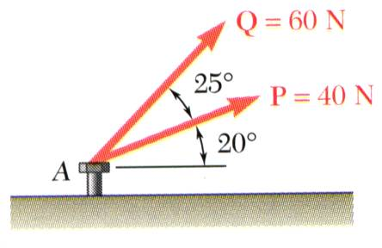
Sample Problem 2: Finding Resultant Force
SOLUTION:
Graphical solution - construct a parallelogram with sides in the same direction as P and Q and lengths in proportion. Graphically evaluate the resultant which is equivalent in direction and proportional in magnitude to the diagonal.
The two forces act on a bolt at A. Determine their resultant.
Trigonometric solution - use the triangle rule for vector addition in conjunction with the law of cosines and law of sines to find the resultant.

Slide 5
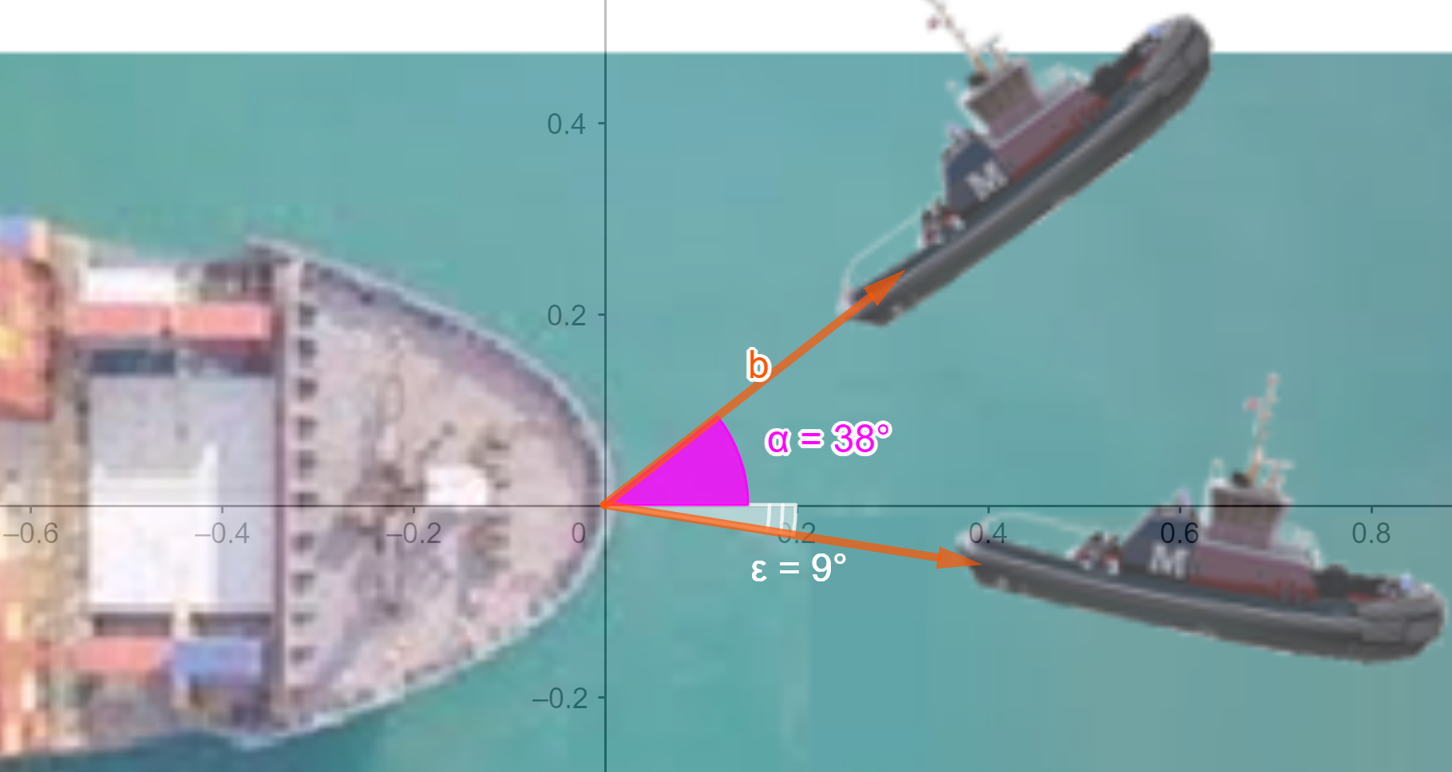
Sample Problem 3: Finding Resultant Force
A large ship is pulled by two tugboats with cables attached, attempt to pull it free. One tug pulls in the direction 38° North of East with a force of 2300 lbs and the second tug plus in the direction 9° South of the East with the force of 1900 lbs.
Find the direction and magnitude of the resultant force.

Slide 6
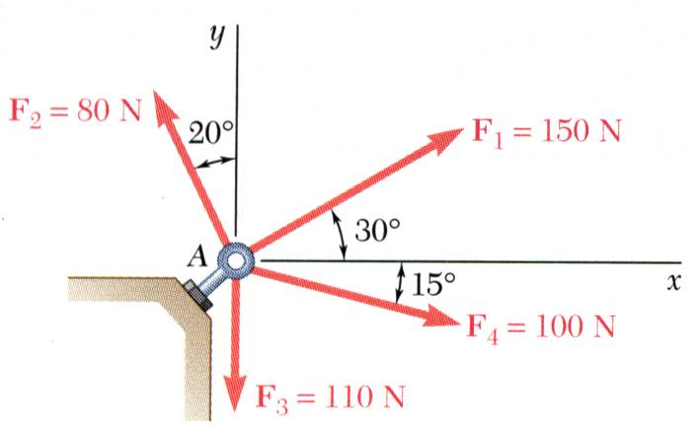
Sample Problem 4: Several force vectors
SOLUTION:
Resolve each force into x-y-components.
Determine the components of the resultant by adding the corresponding force components.
GIVEN: Four forces act on bolt A.
FIND: The resultant of the force on the bolt.
Calculate the magnitude and direction of the resultant.

Slide 7
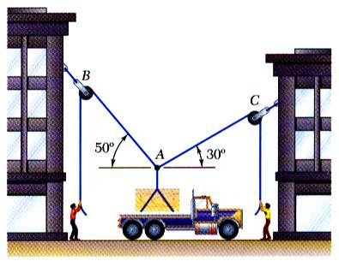
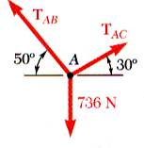
Sample Problem 4: Several force vectors
Space Diagram: A sketch showing the physical conditions of the problem.
Force Vector Diagram: The forces on the selected particle

Slide 8
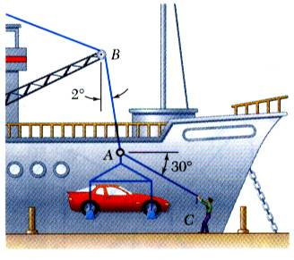
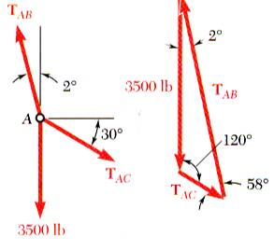
Sample Problem 5: Several force vectors
SOLUTION:
Force Vector Diagram for the particle at the junction of the rope and cable.
GIVEN: In a ship-unloading operation, a 3500-lb automobile is supported by a cable. A rope is tied to the cable and pulled to center the automobile over its intended position.
FIND: the tension in the rope
Apply trigonometric relations to determine the unknown force magnitudes.

Slide 9
Sample Problem 7
Find the resultant of the three forces.

Slide 10
MILITARY USAGE
MILITARY USAGE

Slide 11

Sample Problem 8
A destroyer simultaneously fires two shells with the same initial speed at two different enemy ships. The shells follow the trajectories shown. Which ship gets hit first.
Destroyer
Enemy 1
Enemy 2
A) Enemy 1
B) Enemy 2
C) They are both hit at the same time
Notes:
11

Slide 12
A destroyer fires two shells with different initial speeds at two different enemy ships. The shells follow the trajectories shown. Which enemy ship gets hit first?
Destroyer
Enemy 1
Enemy 2
A) Enemy 1
B) Enemy 2
C) They are both hit at the same time
Notes:
12

Slide 13
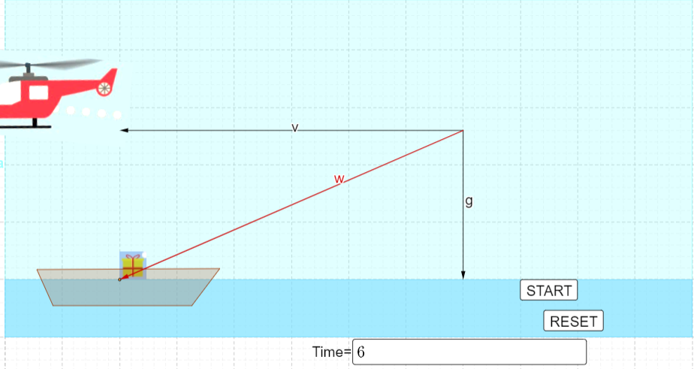
The helicopter needs to drop the package on board.
Q: How many meters before the crash site the helicopter dropped the package, if we know that it flew at an altitude of h = 180 m at a speed of v = 50 ms⁻¹. Assume that gravity is g = 10ms ⁻ ².
Sample Problem 9

Slide 14
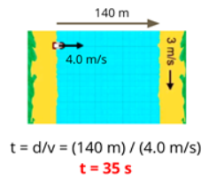
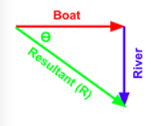
Sample Problem 10: BOAT CROSSING A RIVER
When a boat cross a river there are two velocity work together:
river velocity + boat velocity
The direction of boat change with the respect of velocity of river.
So the boatman find a angle for crossing the river to reach the bank of river straightly.

Slide 15
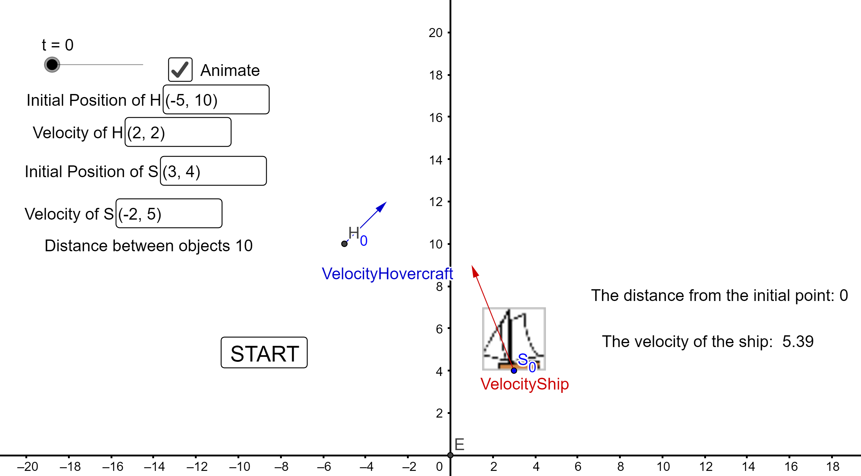
Sample Problem 11: SHIP COLLISION
Do the paths of the boats ever cross? If so where? Will the boats collide?
https://www.geogebra.org/classic/ewbmbzwe

