Slide 1
MareMathics
Why integrals are necessary?
Summer School - Split
20 - 24 September 2021

Slide 2
Missing square puzzle
Demo

Slide 3
Samuel Loyd (1841 – 1911)
American chess player
Author of a number of chess problems
Creator of challenging puzzles in the field of recreational mathematics

Slide 4
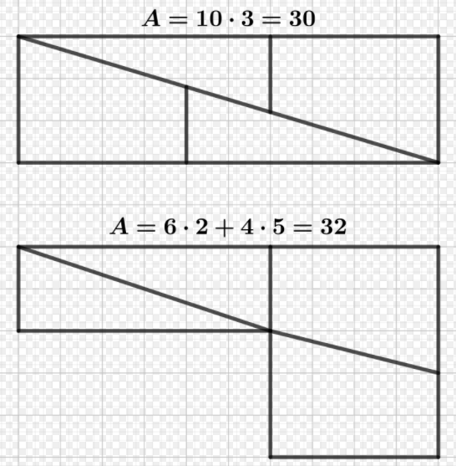
Hooper’s paradox

Slide 5
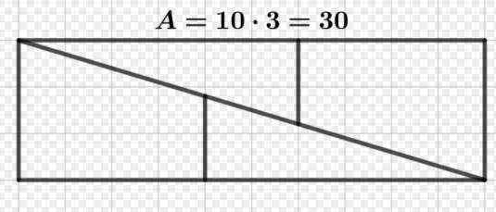
Hooper’s paradox

Slide 6
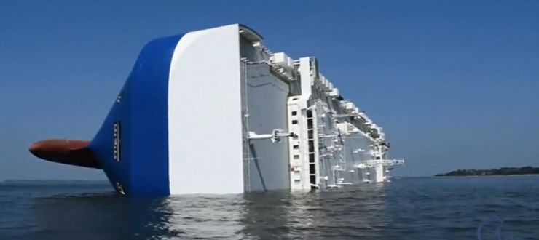
Why do we need to learn math?
A ship with 4,200 cars is sinking due to
incorrect calculations by an employee

Slide 7
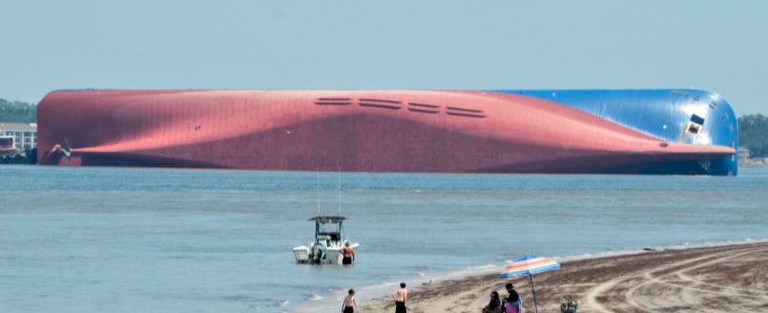
South Corean cargo ship «Golden Ray» sunk
due to an employee's poor knowledge of mathematics,
it is concluded in an investigation in 2019 .
The amount of ballast water in the ship was insufficient.
(By the National Transportation Safety Board of USA)

Slide 8
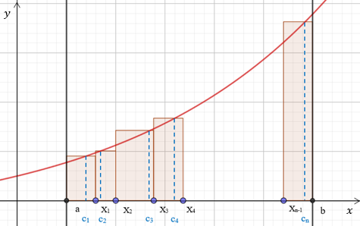
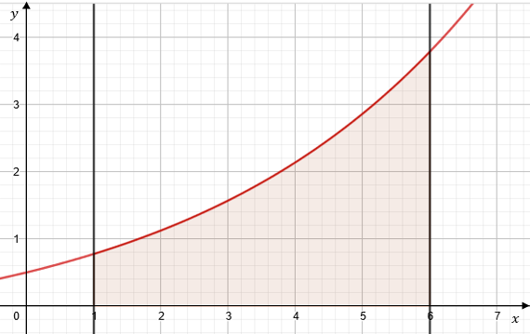
Definite integral
$$\lim_{max∆x_{i}→0}{\sum_{i=1}^{n}{f(c_{i})∆x_{i}}}=\int_{a}^{b}{f(x)dx}$$

Slide 9
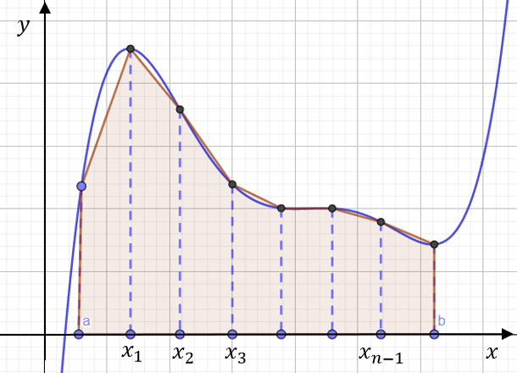
Approximation
Many real applications begin with data that are stored in a table. In such case, the definite integral used in the calculation formula is approximated by the Trapezoidal Rule:
$$\int_{a}^{b}{f(x)}dx≈\frac{b−a}{2n}(f(a)+2f\left(x_{1}\right)+$$
+$2f\left(x_{2}\right)+…+2f\left(x_{n−1}\right)+f(b)$)

Slide 10
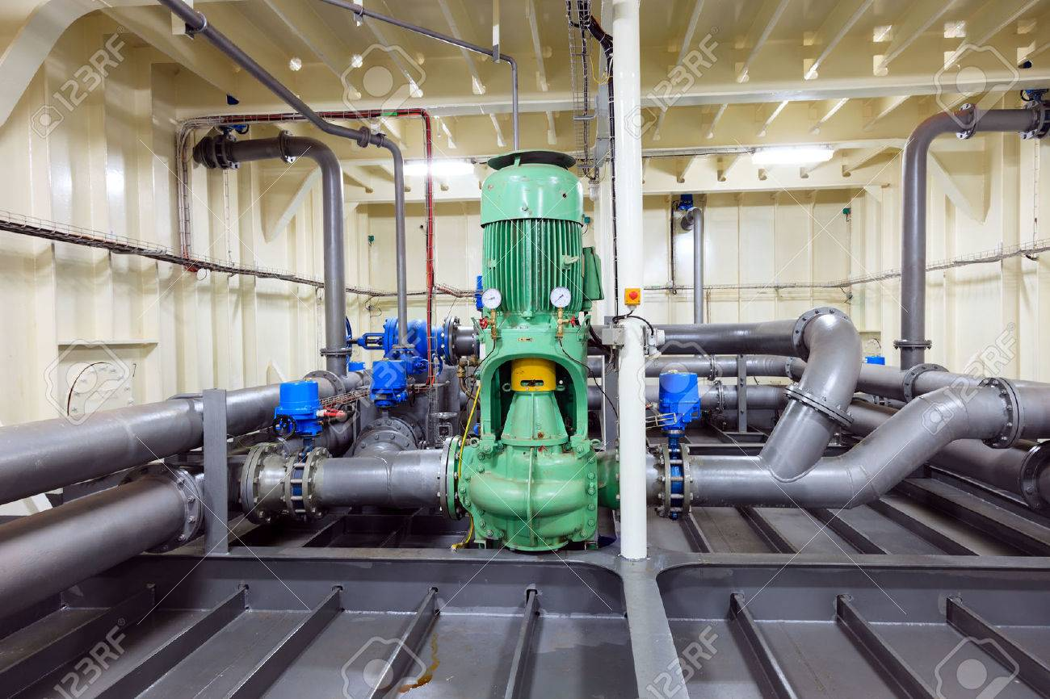
Example 1
A pump connected to a generator operates at a varying rate, depending on how much power is being drawn from the generator. The rate (gallons per minute) at which the pump operates is recorded at 5-minute intervals for one hour as shown in a table. How many gallons of water were pumped during that hour?
Pumping rates
time | 0 | 5 | 10 | 15 | 20 | 25 | 30 | 35 | 40 | 45 | 50 | 55 | 60
gallons | 0 | 40 | 45 | 52 | 44 | 46 | 55 | 52 | 50 | 48 | 46 | 50 | 52

Slide 11
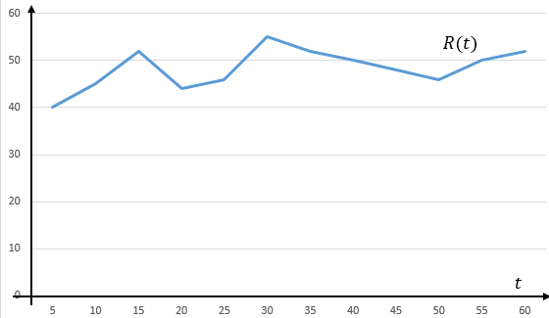
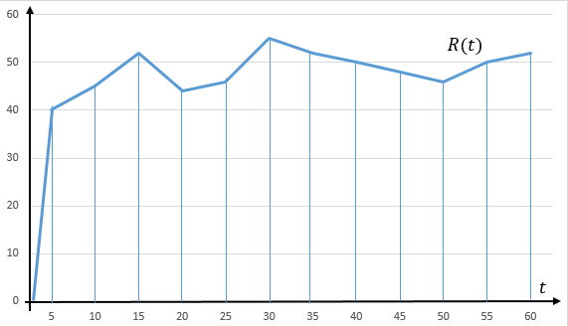
Solution
Let $R(t), 0≤t≤60$be the pumping rate as a continuous function of time:
$$\sum_{i=0}^{12}{R(t_{i})∆t}$$
Approximation of the integral
$$gallons=\int_{0}^{60}{R(t)}dt$$

Slide 12
Estimation of the integral with the Trapezoidal Rule
$$\int_{0}^{60}{R(t)}dt≈\frac{5}{2}\left(0+2∙40+2∙45+…+2∙50+52\right)=$$
$$=\frac{5}{2}∙2(40+45+52+44+46+55+52+50+48+46+50+26)=$$
$= 5∙554=2770$ gallons

Slide 13
Example 2: Shadowed area
Problem: What part of the square is the dashed figure?

Slide 14
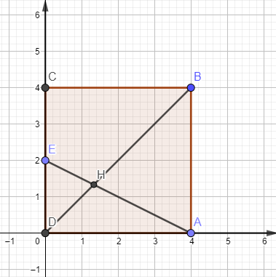
Solution: Crosspoint
GeoGebra
$$A\left(4, 0\right); E\left(0, 2\right)$$
$$\frac{x}{4}+\frac{y}{2}=1; y=2−\frac{x}{2}$$
$$\left\{\begin{matrix}y=2−\frac{x}{2} \\ y=x \end{matrix}\right.$$
Crosspoint:$H\left(\frac{4}{3}, \frac{4}{3}\right)$

Slide 15
Solution: Area
Area of the triangle $ABH$
$$\int_{4/3}^{4}{\left(x−\left(2−\frac{x}{2}\right)\right)}dx=$$
$$\frac{1}{2}\int_{4/3}^{4}{\left(3x−4\right)}dx=$$
$$=\frac{1}{2}\left(\frac{3x^{2}}{2}−4x\right) =$$
$$\frac{16}{3}$$

Slide 16
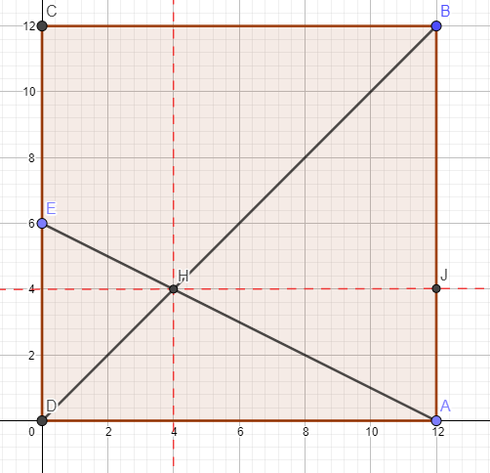
Elementary solution
Area of $∆HJB$
$$S_{1}=\frac{1}{2}×8×8=32$$
Area of $∆HJ$A
$S_{2}=\frac{1}{2}×8×4=$16
Proportion
$$\frac{16+32}{144}=\frac{1}{3}$$

Slide 17
What do we learn from the given examples?
Not always trust what we see
Be careful and evaluate the problem
Make correct calculations
Sometimes we can use approximate values of the results
The integration can be applied for the solving real life problems, theoretical tasks, and for the solving the challanging problems of discrete mathematics as well

Slide 18
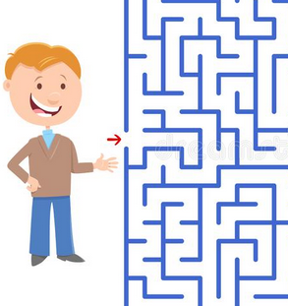
Is mathematics helpful?
with a knowledge of mathematics you will always find your way out of the maze
with a knowledge of mathematics you will always find your way out of the maze
with a knowledge of mathematics you will always find your way out of the maze
Math is food for the brain
If you train your math skills you can think «out of the box»
With a knowledge of math you will always find your way out of the maze

Slide 19
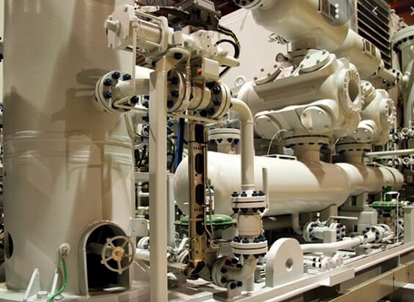
Mean value
Example 3: The bananas storage temperature in cargo holds must be between 13.3 and 13.6 degrees Celsius. The temperature recorded during a half of a day followed the curve
$$f(t)=0.001t^{3}−0.01t^{2}+13.4$$
where $t$is a number of hours
($0≤t≤12$). What is the
average temperature in the
cargo holds during this time period?
Refrigeration plants

Slide 20
Mean value theorem
If the function $y=f(x)$is integrable on the interval $[a, b]$ then the mean value of this function on the interval $[a, b]$ is
$$\frac{1}{b−a}\int_{a}^{b}{f(x) dx}$$

Slide 21
Solution of problem 3
The given interval for variable $t$ is here [0, 12]
$${ f}_{mean}=\frac{1}{12−1}\int_{1}^{12}{\left(0.001t^{3}−0.01t^{2}+13.4\right)}dx=$$
$$=\left.\frac{1}{11}\left(0.001∙\frac{t^{4}}{4}−0.01∙\frac{t^{3}}{3}+13.4t\right)\right|\begin{matrix}12 \\ 1\end{matrix}=$$
$$=\frac{1}{11}(5.184−5.76+160.8−0.000025+0.0333−13.4)≈$$
$$≈13.35 (℃)$$
$$13.3<13.35<13.6$$

Slide 22
Application of improper integral
Example 4: According to the requirements of MARPOL on every vessel has been installed sewage treatment unit. Air compressors blow the air through the sewage continuously. Bio-active substances must be supplied in the unit periodically. The time period of supplement can be computed according to the mean decay time of sewage
$$\overline{t}=\int_{0}^{∞}{t∙ke^{−kt}dt,}$$
where k is the constant that characterises the velocity of the decay.

Slide 23
Solution
$$\overline{t}=\int_{0}^{∞}{t∙ke^{−kt}dt}=\lim_{T→∞}{\int_{0}^{T}{t∙ke^{−kt}dt=}}$$
$$=\left|\begin{matrix} let u=t; dv=ke^{−kt}dt \\ then du=dt; v=k\int_{0}^{T}{e^{−kt}dt=−\frac{{ke}^{−kt}}{k}}\end{matrix}\right|{=}$$
$$=\lim_{T→∞}\left(−t\left.e^{−kt}\right|\begin{matrix}T \\ 0\end{matrix}+\int_{0}^{T}{e^{−kt}dt}\right)=$$
$$=\lim_{T→∞}\left(Te^{−kT}−\left.\frac{e^{−kt}}{k}\right|\begin{matrix}T \\ 0\end{matrix}\right)=$$
$$\lim_{T→∞}\left(Te^{−kT}−\frac{e^{−kT}}{k}+\frac{1}{k}\right)=\frac{1}{k}$$

Slide 24
Thank you for your attention!
"This project has been funded with support from the European Commission. This publication [communication] reflects the views only of the author, and the Commission cannot be held responsible for any use which may be made of the information contained therein".

